Slide 1
EXPO.e & CATO SASE Solution
Be Unstoppable with EXPO.e

Slide 2
Agenda
What is SASE
Why SASE for you and your customers
Customer Challenges
The Solution & Components
Features & Benefits
Your opportunities / Where are the quick wins
Why EXPO.e & CATO – What’s in it for you
Success stories
CTA / Next Steps / Engagement Process

Slide 3


Why SASE for you and your customers
$11b
is the predicted SASE market worth by 2024, as predicted by Gartner.
66%
of surveyed organisations said
their greatest challenge with SaaS
applications was the security
80%
of organisations will be seeking to
procure a consolidated SSE
solution rather than stand alone
CASB, SWG and ZTNA offerings by 2025, up from 15% in 2021
52%
of business prefer to offer a
flexible working model after
COVID increasing the risk area for
a business
500%
is the predicted growth of the SASE market by 2025
Notes:
.

Slide 4
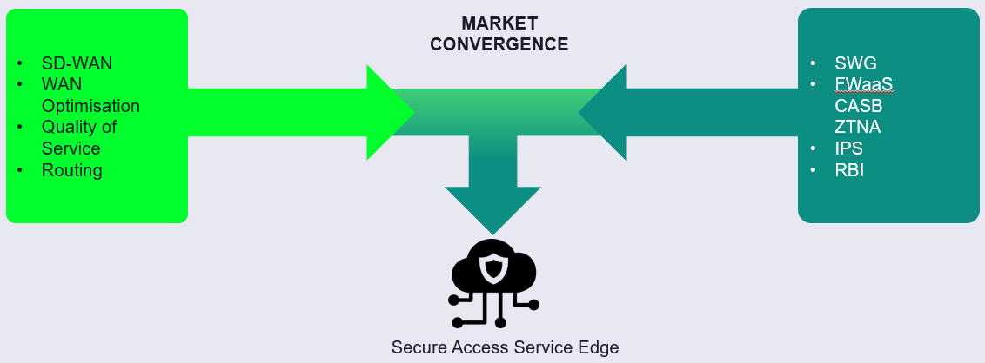


What is SASE
“Secure Access Service Edge (SASE) delivers converged network and
security as a service capabilities, including
SD-WAN, SWG, CASB, NGFW and zero trust network access (ZTNA).
SASE supports branch office, remote worker and on-premises secure access use cases. SASE is primarily delivered as a service and enables zero trust access based on the identity of the device or entity, combined with real-time context and security and compliance policies.”

Slide 5
The Solution & Components
Remote Access
Sites
Client, clientless access Priced per user
Global or Regional Priced per MBPS
Our Secure Access Service Edge (SASE) solution powered by Cato, converges both SD-WAN and Security Service Edge (SSE) to offer the most complete single vendor SASE Solution. Providing a cloud-based solution to optimise and secure applications and access for all users, no matter where they are based.
Simple OpEx charge model without the need for upfront cost, allowing flexibility without the need to get larger one-off budgets approved.
Full SASE
Advanced
Security Services
NGAM, IPS, CASB etc
Priced per total BW and users
Hardware
Sockets, Rackmount kits
Priced per quantity
Managed Services
End-to-end solution fully managed by Exponential-e’s 24x7 service desk
Be unstoppable. The Exponential-e Group Channel Partner Programme
www.expo-e.uk | 0203 993 3374

Slide 6
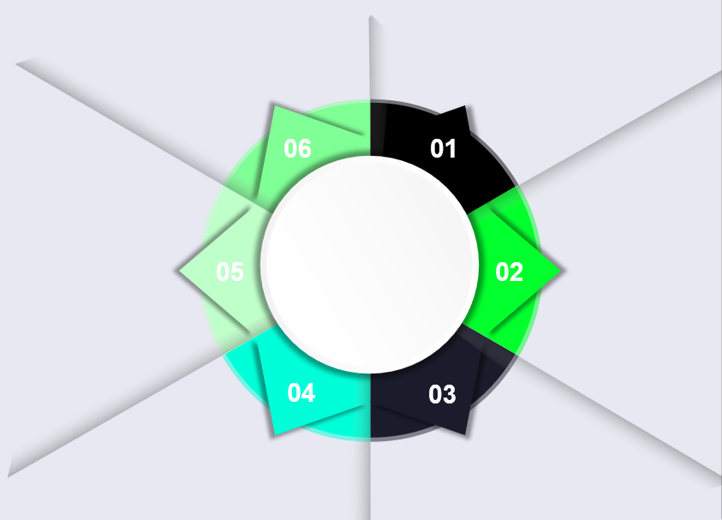
Features & Benefits
Optimize and secure global
mobile users access to
applications on prem and in the
cloud
Cuts MPLS connectivity costs
by augmenting or replacing MPLS with affordable, global SD-WAN
Provides secure Internet
access everywhere without
deploying branch security
appliances
Features
& Benefits
Success
Improves performance
between global locations,
including China, with global private backbone
Optimally connects cloud
datacenters into the WAN with a few clicks
Eliminates branch appliances
with Cato's converged cloud-based network security

Slide 7
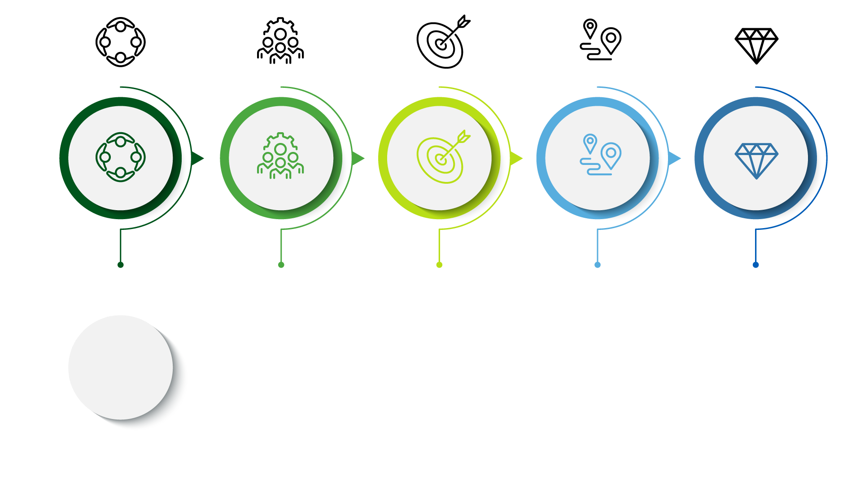
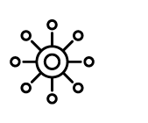
Customer Challenges
Customers require a connectivity solution that is designed for cloud
based adoption,
which their existing solution WAN Architecture may not support.
The importance of zero trust is increasing as businesses are understanding the necessity of securing global and dispersed workforces.
An increasing need to find a more cost
effective solution that allows customers to
optimise their network resources.
Companies need a Cyber Security Solution that supports the flexibility to expand both nationally and internationally.
Needing a solution that will protect both office and remote users when accessing
resources in the private cloud, public cloud and on the internet.

Slide 8
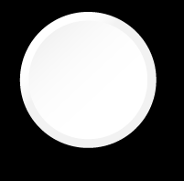

Your opportunities / where are the quick wins
A sweet spot for our managed solution is companies that a globally distributed due to its global private backbone. Also working well for national and regional deployments
Targeting customers that generally have between 5-2000 locations, whether this be nationally or internationally.
Our solution ideal employee target is around 500-30,000, no matter if they are distributed globally or all based regionally.
An average deal size which is UKI based is $86,159 ACV or $216,648 ACV for FTSE companies.
Our solution is not limited to chipset constraint issues, meaning that time for delivery is reduced, with SD-WAN sockets shipped in a matter of weeks.
Offering the markets only single vendor SASE solution combining both SD-WAN and SSE capability.
Notes:
Illustrate the Expo “full stack” ands wider value
Need to add in Cyber Recovery/ Ransomware Defender
Add another pop up box with Data Services
ECS/Powerscale/HDFS/Cyber Recovery Vault

Slide 9
Why EXPO.e
& CATO?
What’s in it for you
Greater discounts through EXPO.e and easy to upsell
Margin Rich & High Revenue Opportunity
High levels of support
and best pricing
Our top tier
partnerships gives us
the biggest discounts available
EXPO.e is CATO’s
No.1 Partner in the UK
Strategic Partnership
Discounts
Available
Full Stack Solution
Deal Registration
Go to SASE deck to pull comment
Additional deal reg discount available just for our Channel
EXPO.e CATO certified engineers
Full Management by EXPO.e
Portal Access Views
Secure access
with MFA
Notes:
Hoping that Marketing can make each section dynamic. For example when you click the box that says Margin rich and high revenue opportunity then the box flips to the bigger description

Slide 10

Next Steps / CTA’s / Engagement Process
Arrange Discovery Session with our solution experts & your Sales Teams
Identify 3 ideal target customers to focus on
Engage Marketing and Enablement Teams to help drive tailored training, engagement and lead gen
Arrange Technical Test Drive with your technical teams and/or target customers

