Slide 1
EXPO.e Connectivity
Be Unstoppable with EXPO.e

Slide 2
Background History
Founded in 2002 as an ethernet-only carrier / services provider – bootstrapper with £400K start-up capital
Organic growth to 2020 Revenues £142m EBITDA £38.5m
Feb 2020 acquired Vysiion - an engineering projects / installations / CNI / data centre / cyber security management company
Sept 2021 acquired Xpertex – intelligence services / cyber security company
Combined Group 2022 / 23 Revenues £206m; EBITDA £81m
With our commitment to customer service excellence, we invest 95% of our EBITDA back into people, technology and R&D
Today, we have 3,000 clients, 820 employees, and operate to management standards with 9 ISO accreditations – recognised as a “World-Class IT Service Provider” by BSI
And an exceptionally high ‘REAL-TIME NPS’ score = 78 (Sept 2023) which is over four times higher than the industry average
For 21 years, we have built a reputation for designing, delivering and supporting bespoke and complex network / Cloud / IT / UCC projects to deliver customer outcomes
We have invested £120m building a homogenous Layer 2 ethernet network with reach throughout UK and internationally, with further investment in our Cloud architecture and Microsoft Teams infrastructure. We call this our ‘non-stop compute platform’
‘We treat your business as if it were our business’, assuring we deliver ‘Peace of Mind-as-a-Service’, backed by full stack SLA’s

Slide 3
Why EXPO.e?
Customer Service Quality
Customer first philosophy since 2003
Service culture begins in Academy
3,000 customers – 96% reference-ability
Real-time Net Promoter Score, consistently scoring high on an index ranging from -100 to 100
Voice of the customer – continuous improvements programme
Board-level escalation
Applied Innovation
Levering technology for the benefits of the customer
First movers in ethernet (2002) and VPLS (2006)
World-first with APM (2010) 100GigE VPLS Network (2012)
Innovative approach keeps clients at leading edge
Cyber Security Operations Centre and Cloud Management Platform
Multi-vendor Global SD-WAN service
Technical Capabilities
100 GigE business-only network
Reputation built on the delivery of high-performance networks
212+ PoP’s, reaching into 39 data centres
Multiple services delivered securely at Layer 2
Built and manage our own Cloud, voice-UCC, and cyber security platforms
Trusted Partner
9 x BSI / ISO standards, as well as the highly coveted Cloud Security Alliance STAR
UK Service Desk offering 24 / 7 Fault, Find and Fix Pro-active 1st, 2nd & 3rd line support
Carrier-class network for resilience / reliability
Financial stability - D&B 1 Credit rating
2022/2023 £206m and EBITDA £81m (Group)
Peace of Mind as-a-Service - NPS 80

Slide 4


Why your customers demand world-class connectivity
$2.42m is the predicted VPLS market worth by 2025, with CAGR growth of 19.5% from 2020-2025
65% of enterprises will have implemented SD-WANs by 2025, compared with 30% in 2020
20-25% is the increase in the capacity of UK networks per year due to the increasing demands for online services, mobile data, increased productivity and new applications
Cloud The increase in use of cloud platforms means the ethernet and switch router market is expected to see significant growth
60% of SD-WAN customers will implement a SASE solution by 2024 compared with 35% in 2020
Notes:
.

Slide 5





Customer Challenges
Businesses are purchasing different internet services from multiple suppliers, leading to increased complexity from billing, contract, and SLA’s.
If a business operates entirely online, sharing bandwidth with consumer peaks, can translate into slow internet and consequently revenue loss.
Cloud computing services are growing and businesses are becoming more and more interconnected, remote working and collaboration cannot be possible without a fast and reliable internet access.
Businesses rely on their internet to complete critical business activities. Any outages can be very costly, so they need robust connections through a supplier they can trust.
Security is a key area of concern for businesses. The public internet is not 100% safe – cyberattacks are on the rise and the number of successful breaches is increasing dramatically.

Slide 6
What is Smart Wires with EXPO.e?
EXPO.e’s offers a range of connectivity options through our Smart Wires Service. Smart Wires brings the customer’s site on-net to EXPO.e’s network, providing access to the internet, WAN, and any other managed services and applications within our portfolio.
The result is optimal control and scalability, reduced operational costs, and an accelerated path to the Cloud, with the highest standard of cyber security inherent in the design of every solution.
Smart Wires Broadband – SoGEA
Single Order Generic Ethernet Access (SoGEA) enables your customer to purchase entry level Ethernet without the need of the phone line.
With SoGEA, customers can save money as well as simplify the ordering process over ordering FTTC and a separate PSTN line.
Our SoGEA offering can offer maximum theoretical speeds hitting 80Mbps download and 20Mbps upload.
Smart Wires – EoF
Ethernet over Fibre is an end-to-end fibre connection that allows high speeds and low-latency to support business for optimum productivity and efficiency. Offering symmetrical speeds up to 10Gbps with bearer sizes at 100Mbps, 1Gbps and 10Gbps.
This connection and speeds ensure your customer is supported now, and in the future, with infrastructure to enable an increase in Cloud adoption and the ability to access multiple services over a single access circuit with our Smart Wires.
Smart Wires Broadband – SoTAP / (SoADSL)
Single Order Transitional Access Product (SoTAP) is a transitional copper product, for premises where fibre is not available and an ADSL type of service is required.
With SoTAP your customers receive both, broadband and IP Phone services, save money as well as simplify the ordering process over ordering ADSL and a separate PSTN line.
Smart Wires – 4G / 5G
We partner with one of Europe's leading IoT and M2M connectivity platform providers, Wireless Logic, to deliver a range of SIM’s that can be used both nationally and internationally.
The SIM’s are connected through to our Private APN, ensuring privacy to our customer’s data and have inbuilt security and ‘always on’ capabilities, ensuring maximum connectivity for your customers.
EXPO.e have dual NNIs into two of Wireless Logic’s DC’s, offering a secure end-to-end cellular proposition.
Smart Wires – FTTP
Fibre to the Premise (FTTP), also known as Full Fibre Broadband, allows you to have faster download speeds of up to 1Gpbs without the need of a Phone line rental. FTTP is a direct route fibre connection from the exchange to the premises via fibre optic cables. FTTP does not require a PSTN, allowing businesses to connect directly to the internet.
FTTP gives the customer a faster and more reliable connection, ideal for accessing cloud-based applications and high-quality video conferencing services.
Smart Wires – Microwave Access
Our Microwave Access solution allows business to have Ethernet services up to 5Gbps over the air using line of sight technology. Last mile connectivity is delivered via microwaves.
A microwave link is established between Exponential-e's PoP and the customer site, which allows the internet access to be transmitted over air. This is finally converted into a cable at the customer site through the use of a router.

Slide 7

Our own fibre - Smart Wires Unlimited
SMART WIRES UNLIMITED
From £599 per Month*
No installation fee
3 years term
*10 Gbps access. Smart Wires Unlimited T&Cs apply.
Be unstoppable. The Exponential-e Group Channel Partner Programme
www.expo-e.uk | 0203 993 3374

Slide 8
Complementary Connectivity Solutions
EXPO.e’s connectivity portfolio brings together a comprehensive range of leading-edge solutions, designed, delivered, and managed by leading experts, supported by robust SLAs, and built on our self-owned, enterprise-class network.
The result is optimal control and scalability, reduced operational costs, and an accelerated path to the Cloud, with the highest standard of cyber security inherent in the design of every solution.
An industry-leading SD-WAN solution
Drawing on EXPO.e’s years of experience as a UK pioneer in software-defined connectivity - delivered as a fully managed service.
Secure Access Service Edge (SASE)
Combining leading-edge networking and zero-trust cyber security in a Cloud-based solution, to provide optimal control, protection, and visibility.
Managed LAN and WiFi
Our LAN and WiFi solution places your customers’ IT infrastructure in safe hands. With 20+ years of experience in managed Network solutions and a 24/7/365 UK support desk, we are highly skilled and available to keep their business running.
5i – Our Own Fibre Network
We are laying our own dark fibre in London with a focus on 10Gb to Unlimited bandwidths. This means we can offer good commercials, flexibility with Wayleaves, and additional tailored and bespoke services. We are already in 20+ key buildings and locations
.

Slide 9
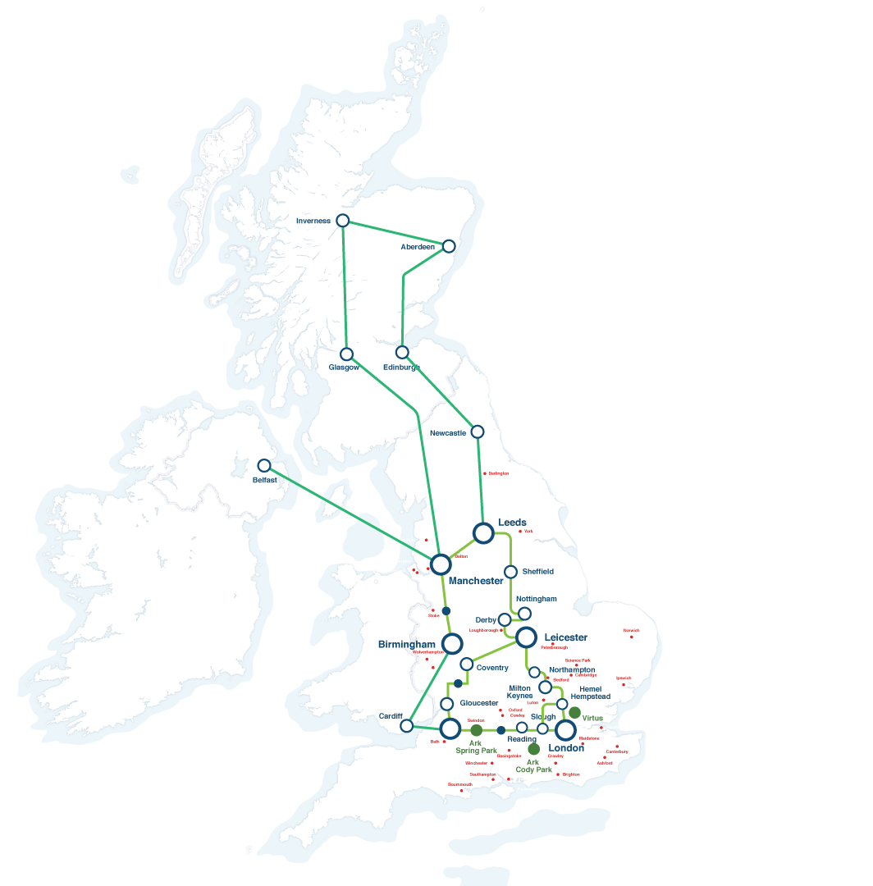
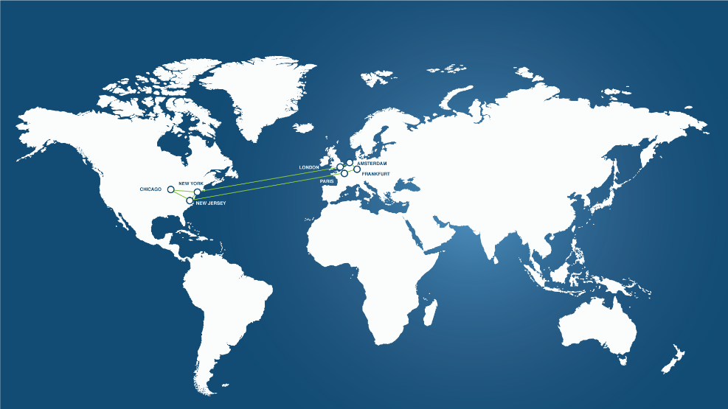













EXPO.e’s £120m Core Network
International Reach
170
177
6
Towns & Cities
Local Exchanges
Internet Gateways
39
212
2000+
Data Centres
PoP’s
Kilometre Fibre
Connect
to US East Coast
180+
NNI
6
300+
200K
UK City Metros
Internet Peers
OnNet Postcode
Connect
to US East Coast
Connect to Amsterdam & Frankfurt
Connect to Paris

Slide 10
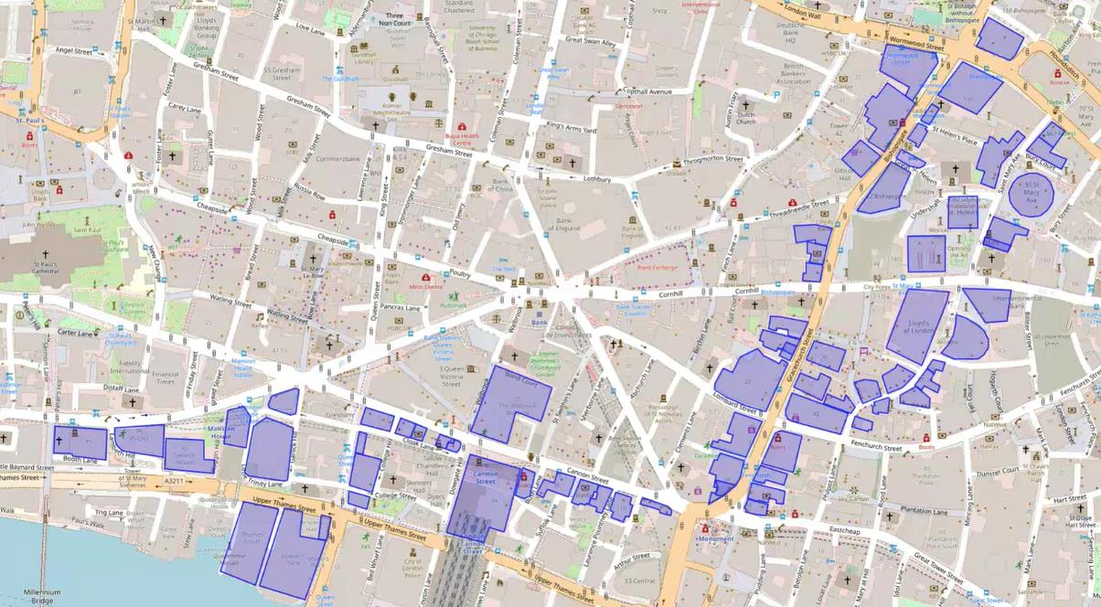
5i – Phase 1
We now have 20+ buildings that either have our own fibre installed or wayleaves agreed, which means subject to survey we can deliver into these buildings within a few weeks. These include:
40 Gracechurch St, EC3V0BT
30 St Mary Axe, EC3A 8BF (The Gherkin)
62 Threadneedle, EC2R 8HP
122 Leadenhall St, EC3V 4AB (The Cheese Grater)
11 Monument St, EC3R 8AF
39 Houndsditch, EC3A 7DB
77 Gracechurch St, EC3V 0AS
62 Queen St, EC4R 1EB (The Rex Building)
31 New Inn Yard, EC2A 3EY
1 Love Lane, EC2V 7JN
130 Wood St, EC2V 6DL
100 Bishopsgate, EC2N 4AG
56 Shoreditch High St, E1 6JJ (The Tea Building)
24 Ludgate Hill, EC4M 7DR
125 Old Broad St, EC2N 1AR
33 St Mary’s Axe, EC3A 8AA (Exchequer Court)
40 Chancery Lane, WC2A 1JA
10-11 Austin Friars, EC2N 2HG
5 St Helena’s Place, EC3A 6AB
11-19 Monument St, EC3R 8AF (The Monument Building)

Slide 11

Multiple Services Over the Same Pipe
Cost-effective and easy to manage - Our Smart Wires technology allows you to split your connection into multiple secure VLAN’s to deliver several services over the same pipe, to converge data, voice, video, and application traffic.
VPLS enables multiple services over a single access circuit, thus bringing true convergence of triple play onto the WAN, keeping these services separate from each other to optimise security.
Limited disruption – The EDD’s allow us to hand off different services as separate virtual circuits across one physical circuit, enabling us to guarantee end-to-end quality of service on all of our circuits. As a result, any faults that occur can be quickly located and fixed, limiting disruption to daily activities.
https://youtu.be/1znMq2XObu0
Note for Marketing – Link is from the SEP in Sharepoint, video needs rebranding if that’s possible?

Slide 12
WAN - VPLS
Our Ethernet-based (Layer 2) virtual circuits can be configured over Smart Wires Services to establish connectivity between sites, configured as either Point-to-Point (E-Pipe) or as Point-to-Multipoint (VPLS).
Point-to-Point - E-Pipe
Cost effective way to connect two customer sites
This E-Pipe provides the required bidirectional data transfer capability between the two locations
Makes the Ethernet interfaces connected at both ends appear on the same LAN segment.
Point-to-Multipoint - VPLS
Combines the capabilities and flexibility of a Local Area Network (LAN) and implements it over a wide area network (WAN)Structured plan to meet your growth objectives
This is through the creation of a completely private Layer 2 virtual switch to which customers can connect all of their offices in order to gain any-to-any connectivity across multiple sites.
VPLS enables multiple services such as Cloud and Voice / UCaaS -CCaaS, over a single access circuit.
Our customers can use the capabilities of VPLS as a building block to converge their services on our Service Creation Platform
Our VPLS is backed by stringent end-to-end SLAs whilst also ensuring low latency between sites
This ensures reduced complexity and administration and easier network planning and cost control

Slide 13
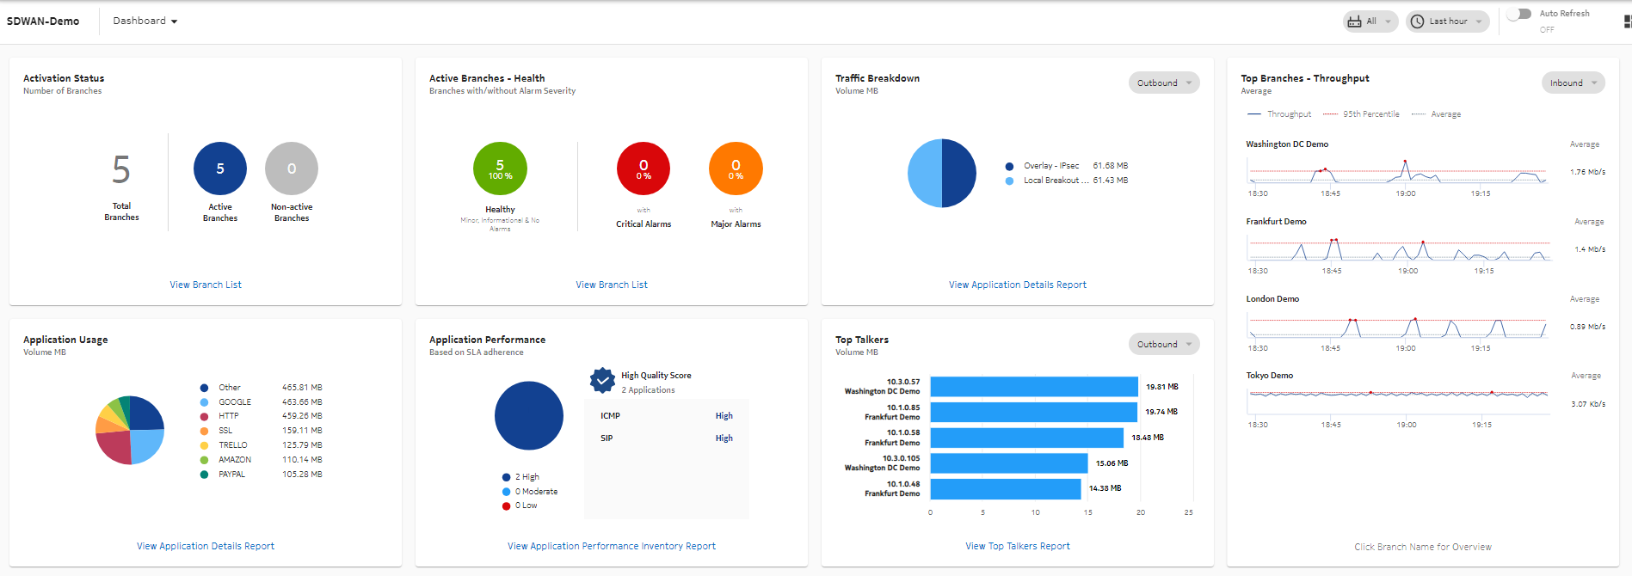
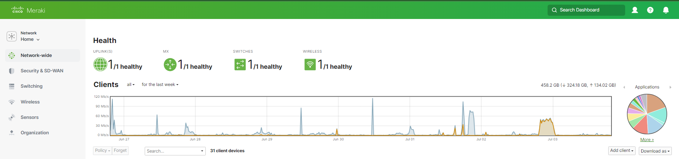
SD-WAN
Our SD-WAN solution is a virtualised, fully managed service to provide your customers with the flexibility to securely connect any service, any application and any employee or partner regardless of location.
SD-WAN Provides a secure unified connectivity service over any transport technology, providing centralised management and operations, with full control and visibility of application performance.
SD-WAN allows Network administrators to programmatically initialise, control, change and manage network behaviour dynamically.
Real-time analytics to generate reports for policies set in the network to give greater visibility into the application performance, to easily diagnose issues and make strategic changes based on usage. All through a single pane of glass
It is a service that gives enterprises the ability to seamlessly connect branch offices, data centres and cloud resources on a global scale.

Slide 14
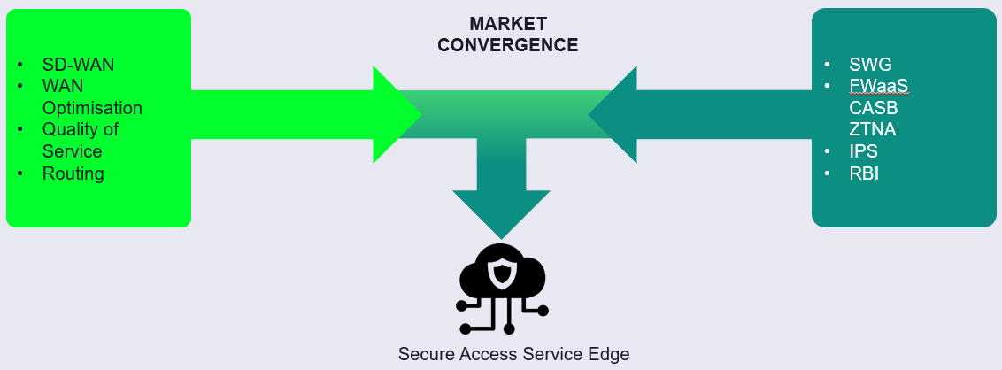


SASE
“Secure Access Service Edge (SASE) delivers converged network and security as a service capabilities, including… SD-WAN, SWG, CASB, NGFW, and zero trust network access (ZTNA). SASE supports branch office, remote worker and on-premises secure access use cases. SASE is primarily delivered as a service and enables zero trust access based on the identity of the device or entity, combined with real-time context and security and compliance policies.”

Slide 15
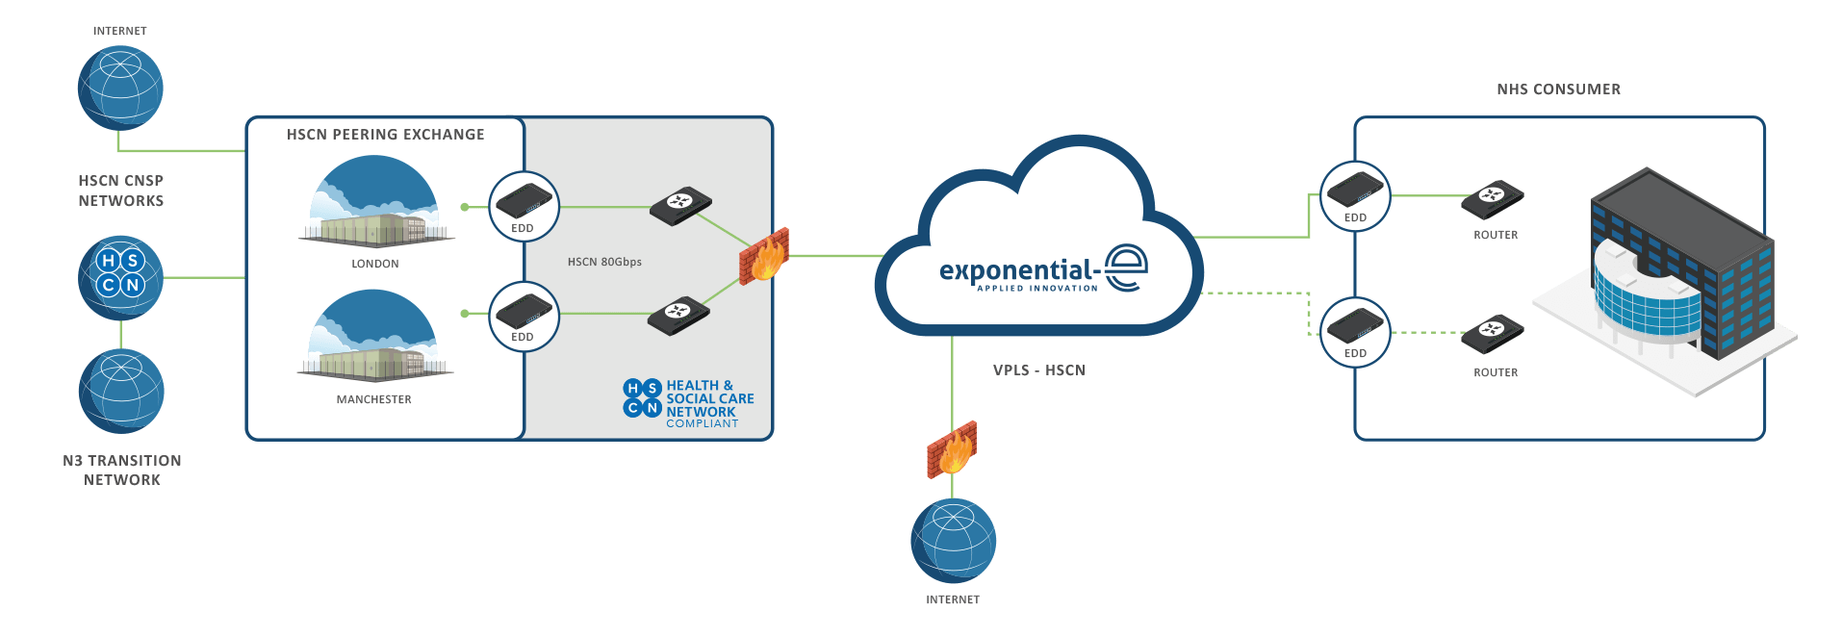

EXPO.e & the HSCN Network
Improving Health
The Health and Social Care Network (HSCN) network is a core component of NHS Digital's drive to improve health through the better use of data and technology, transforming the quality and reducing the cost of health and care service
Next Generation
The HSCN is the next generation national private network for health and care organisations. HSCN is a single logical network, delivered by multiple suppliers, it is a completely reimagined and reengineered successor to the N3 network, providing reliable, efficient, flexible, and cost-effective connectivity for end-users
Secure & Reliable
HSCN provides a secure and reliable mechanism for end users to access and exchange electronic information, anywhere, anytime and across any device and, in turn, facilitates greater collaboration and service sharing to drive greater efficiencies, increased clinical innovation, and improved patient outcomes.
HSCN Connect – An EXPO.e Product
HSCN Connect is an EXPO.e product that will provide NHS-approved private sector customers with access to the HSCN peering exchange network. It consists of managed CPE or CGNAT (centralised), and bandwidth into the HSCN Peering network. HSCN Connect is available in bandwidths from 1 Mbps to 1 Gbps.

Slide 16
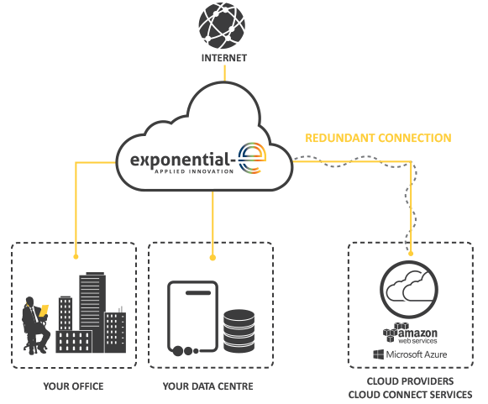
EXPO.e & Cloud Connect
High Performance
A dedicated private connection to Cloud assets that improves Network performance, increasing bandwidth throughput and providing overall cost saving.
Highly Scalable,
Highly Flexible
Choose from multiple bandwidths, providing the flexibility to scale-up your customers’ business demands.
Redundant Connection
Secure & Reliable
Cloud Connect allows EXPO.e to provide secure, low latency and inherently redundant connections to the Cloud Service Providers (CSPs) of the customer’s choice.
Connect to Multiple CSP’s
Cloud Connect allows end customers to connect to multiple public CSP’s via a dedicated network connection from the customer’s premises, including AWS, Microsoft Azure, Microsoft Office 365, and Google.

Slide 17






Support and Management – Service Organisation
EXPONENTIAL-E SERVICE CENTRE
CALLS
EMAILS
PORTAL
E-BONDING
ALERTS
SERVICE DESK
SERVICE MANAGEMENT & CLIENT RELATIONS TEAM
ITIL SERVICE MANAGERS
CHANGE & PROBLEM
INCIDENTS
BROADBAND
NETWORK 2ND / 3RD LINE
SECURITY 2ND / 3RD LINE
DC TEAM
UCC 2ND / 3RD LINE
CLOUD & MANAGED SERVICES 2ND / 3RD LINE
NETWORK & SECURITY CORE
UCC CORE
CLOUD CORE

Slide 18




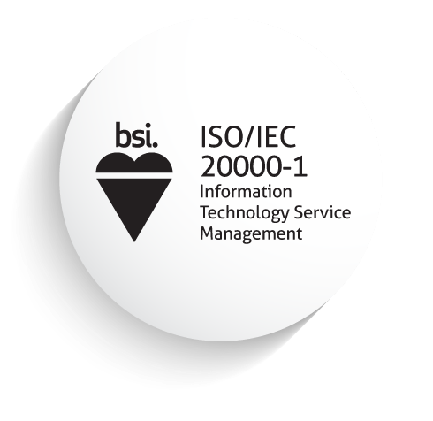


Delivery within a Service Management Framework
Peer-to-peer Relationships, and Long-term Partnerships
Continual Service Improvement Plan (CSIP)
Performance Reporting, Capacity Planning
Client Service Delivery Management Team
Acting as the voice of the Partner within EXPO.e​
​
Your main point of contact for anything service-related​
​
ITIL qualified​
End-to-End SLA Management
Service Catalogue Management
Governance Structure
Change Enablement

Slide 19
Human Touch Provisioning & Service Delivery
How our service differentiates itself from the rest
Dedicated PM aligned to Partner
Named escalation matrix with DDI
Welcome call
Provisioning flowchart
Escalation pathway to Director of Service Delivery
Automated ordering solution being introduced to bring down ordering from 3-5 days to one
Evolution of SNOW
SNOW used for both provisioning and support, which means any transition is seamless as the systems are fully aligned, offering many hidden benefits
Tailored SNOW dashboard, showing orders in the system and where they're at in the process
Access to a live data dashboard, being made available for Partners in the coming months

Slide 20
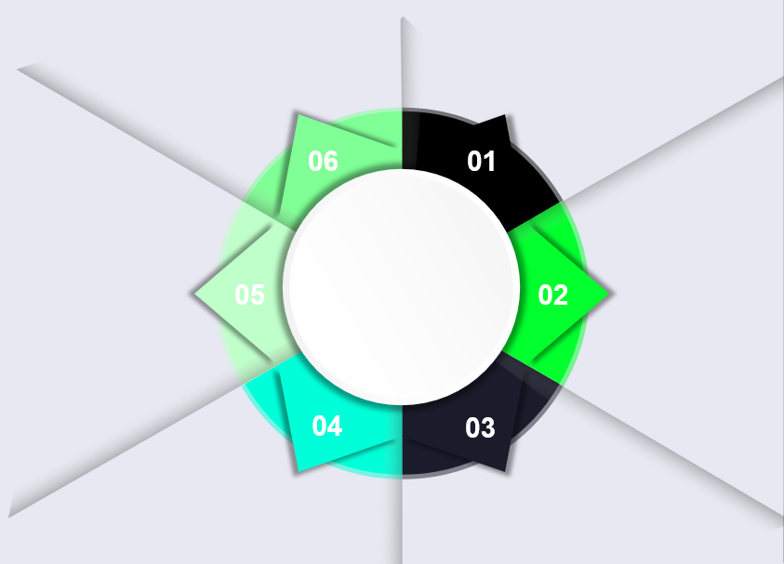
Features & Benefits
Intelligent, Self-healing Network: Our network can detect and remediate outages and failures without any human intervention, allowing for real-time fixes and
maximum uptime
Business-only Network: Our business-only network is not affected by consumer peaks in demand, so traffic is always prioritised
Scalable Capacity: Your customers can choose fixed bandwidth speeds from 10Mbps to 10Gbps business internet over our 100GigE core network, for guaranteed uncontended connectivity
Cloud-ready Internet: Our high-performance network provides the fast and steady Internet access required to access Cloud applications, allowing for the best possible user experience
Features
& Benefits
Highly Available Support: Our Smart Wires services are backed up by strict Service Level Agreements and 24/7x365 technical support
Enhanced Security: All of our internet and network services include free DDoS (Distributed Denial of Service) alerting

Slide 21







Your opportunities: where are the quick wins?
A sweet spot for our connectivity offering is companies that are UK-centric, including offices, branches, data centres and so on. We can also help procure connectivity globally, utilising our procurement, delivery, and support.
Targeting customers that have an office presence of any size, any people volume, a specific way of working that requires high bandwidth, or applications / projects requiring high-speed, dedicated, high-availability connectivity.
We service nearly every vertical, across both the private and public sectors.
Deal size will vary, but connectivity should be included as an upsell in any new IT project, new app, new office, refresh, new DC etc.
Our connectivity solutions are required by all customers. They are a need not a ‘nice to have’.
Offering huge upsell potential, a sticky contract, and regular invoicing to help you stay in the forefront of your customers’ minds.
Notes:
Illustrate the Expo “full stack” ands wider value
Need to add in Cyber Recovery/ Ransomware Defender
Add another pop up box with Data Services
ECS/Powerscale/HDFS/Cyber Recovery Vault

Slide 22





Next Steps / CTA’s / Engagement Process
Arrange discovery session with our solution experts and your sales teams
Identify three ideal target customers to focus on
Arrange workshops on specific solutions within our connectivity stack with your technical teams and/or target customers
Engage marketing and enablement teams to help drive tailored training, engagement, and lead gen

Slide 23
Why EXPO.e & Connectivity? What’s in it for you
Offers easy upsell opportunities
as a core requirement for all services
Peace of Mind as-a-Service to keep your customers happy
Strategic partnership discounts available
Full-stack solution
Direct connectivity through our extensive peering agreements
Full management by EXPO.e
Our own fibre network with aggressive pricing structures
Notes:
Hoping that Marketing can make each section dynamic. For example when you click the box that says Margin rich and high revenue opportunity then the box flips to the bigger description

Slide 24



Success Stories
“Having the right supplier is just as important as listening to customers. We like people that are honest, responsive and proactive, EXPO.e exceed across all of these areas.”
William Linard Head of Sales, Luminet

Slide 25


Success Stories
“The most important thing at the outset of any new partnership is establishing trust between teams. Once you've built a strong rapport and are working towards shared goals, the technological innovations follow naturally.”
Terry Faria Telecommunications Manager, Quiss Technology.

Slide 26


Success Stories
“It's the shared values that have really been the foundation of our relationship with EXPO.e, as well as their willingness to do things a bit differently.”
Robb Thaw Marketing Manager, Natilik.

