Slide 1
EXPO.e Unified Communications & Contact Centre
Let’s raise our voice.

Slide 2
Agenda
Our History in UC
Why UCC for you and your customers
What is Unified Communications as a Service
UCaaS Features & Benefits
TCaaS Features & Benefits
CCaaS Features & Benefits
Enabled Collaboration Spaces Features & Benefits
Our Self-Service Portal
Your opportunities / Where are the quick wins
Success stories
Why EXPO.e & UCC - What’s in it for you
Next Steps / CTA’s / Engagement Process

Slide 3










Our History in UCC
2008
SIP Trunking
Integration of Collaboration & value add tools
2018-2020
Skype for Business & Teams Direct Routing
2022
Migration of 15k UC-One to Cisco Webex clients
2002
Exponential-e starts its
Core Network
2008-2013
Reselling our
BroadWorks HPBX
SIP
2017
HPBX Customer Portal Launched
2021
Integration of Teams Rooms & Contact Centre
2023
UC Relaunch with full
self- service portal

Slide 4


Why UCC for you and your customers
48%
of businesses are planning to create extra meeting spaces to support a distributed workforce
3 out of 4
enterprise employees will not use a deskphone. It has more than doubled since 2020 when it was just 30%
57%
of SMBs plan to maintain remote working for employees as part of their new Hybrid Working policies.
63%
of professionals spend more than two hours a day in meetings. Making meetings more efficient is key to boost their productivity
$15.6B
Global CCaaS market is expected to reach revenue of $15.6b by 2027
Notes:
.

Slide 5
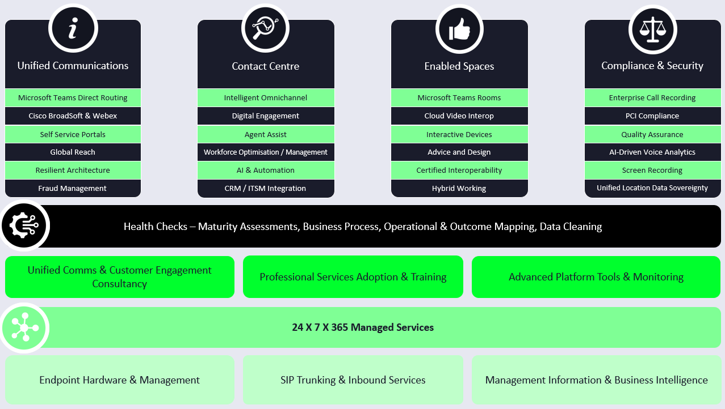
What is Unified Communications as a Service
In partnership with EXPO.e, you can facilitate flexible, remote working practices for your customers, increasing their recruitment options and driving creative collaboration.
This, in turn, will offer insights that help build deeper customer relationships and open the door to integrating AI and machine-learning into their business operations.

Slide 6










End to End
Management
through EXPO.e connectivity
Full PBX
Replacement with simple, easy-to-use Admin portal
UCaaS
Features & Benefits
Our UCaaS network offers:
Multi-carrier resilience
High Availability
Geo diverse SBCs / PoPs
Enterprise Carrier Grade Architecture
European breakout with min. 2 PoPs per country
Tailor your deployment with a choice of headsets, handsets and soft clients
Future proof your comms with enterprise-grade calling
Seamless meeting experience for hybrid working or external meetings
Boost internal collaboration and workflow with persistent messaging for users and teams
Integrate with business apps to improve efficiency and workflows
Secure Collaboration from anywhere for both internally and externally

Slide 7

End to End 24/7 management through EXPO.e UCC Specialists
TCaaS
Features & Benefits
Simplicity - Unified end user experience
Flexibility & Scalability - With a wide range of hardware to meet the varying needs of organisations
Integration - Seamless integration with other Microsoft 365 tools and services such as SharePoint, OneDrive and Office apps.
Intelligent Meeting Rooms - Centralised control including analytics and reporting for Audio, Visual and Management
Save time and reduce costs for customers with a single app for all communication and collaboration needs
Scalable, future-proof solution
which eliminates the need for large CapEx investment and offers a lower TCO
An end-to-end solution
with options for full management of the customer’s MS Teams and Office 365 environment
Fully resilient platform across diverse locations with 100% uptime to date
Intuitive tools to maximise employee productivity anytime, anywhere and across any device. Always-on communications
Competitive calling plans, both domestic and international
Delivered over EXPO.e’s business-only Network for superior call quality and reliability

Slide 8

End to End 24/7 management through EXPO.e UCC Specialists
Contact Centre
Features & Benefits
Our CCaaS solution offers:
Comprehensive Capability - Voice, Chat, Social, Email, SMS, WFM/WFO (Work Force Management /Optimisation), AI, Back-Office integrations and Real-Time Reporting to enhance the contact process
Simplicity & Cost Efficiencies - A fully maintained, continuously up-to-date, cloud-powered platform which reduces costs, offers per-user pricing and has built-in DR
Drive Profitability - More intuitive, personalised customer interactions create stickiness and enhance customer retention
CCaaS provides Voice, Web Chat, Email, Social Media, and SMS in one application
Enables businesses to outsource set-up
and management of complex contact
centre solutions to a trusted provider
Flexibility with options to blend our CCaaS packages with an existing Contact Centre solution
Fully resilient platform with multiple UK and European private, Tier 1 carrier connections into EXPO.e’s core infrastructure
Integration with our Microsoft Teams Direct Routing and UCaaS solutions
Ability to provide end-to-end security all the way to the home
A robust multichannel, multi-tenant platform, integrated with our own private UCC Platform

Slide 9

End to End 24/7 management through EXPO.e UCC Specialists
Enabled Collaboration Spaces
Our solution offers:
Seamless Integration: with popular communication and collaboration platforms, such as Microsoft Teams and Zoom.
Better-Connected Teams: Conduct meetings seamlessly and inclusively, ensuring that teams and users are both seen and heard, while also enhancing productivity.
Range of Options: The solution offers a diverse range of meeting room devices to suit various room sizes and needs, from small huddle spaces to large conference rooms, providing flexibility for businesses of all sizes.
Security: Collaboration Space prioritises security with built-in robust features, to safeguard businesses data and communications.
The solution encompasses a diverse range of Microsoft Teams devices, guaranteeing superior audio
and video quality
Simple wireless or wired content sharing options to suit all users
One-touch meeting access and AI integration so customers can
work seamlessly
anytime, anywhere
Scalability with lots of upsell opportunities
User friendly devices with intuitive interfaces and touchscreen controls
Superior audio and visual quality with crystal clear audio and HD video
Versatile and flexible options for different room sizes

Slide 10








Value-add Services
Operator Connect
12 month or full compliant call recording
Upgrade to Analytics for sentiment analysis
Feature rich against competitors such as Dubber
Cloud-based, real-time call reporting and business insights
Call centre reporting
Directly enable PSTN calling from their current carriers within Teams
Manage calling plans and configure call routing
Integrate with over 100 leading CRMs
Lite desktop integration or full CRM
Automate activity logging
Simple Call Centre and Contact Centre
Easy upgrade from Voice to Omni
Enables your team to manage all voice, email, social media, SMS and web chat enquiries in one place
Wide range of handsets or headsets available
Competitive hardware pricing
Auto Provisioning
PCI-DSS Compliance for all voice transactions for smooth and secure payment processing
Simple interface to descope customer network
Enables immediate, seamless call transitions across leading UC platforms
Improve customer experience with clever AI tech

Slide 11
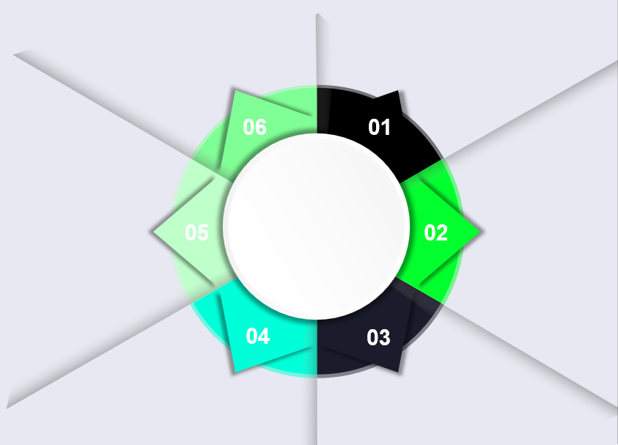
Our Self-Service Portals
Accelerate PSTN onboarding & tenant provisioning process into a single workflow that can be managed by non-technical personnel.​
Partner and Customer login access for simple management.
Our Self-Service Automated Portals streamlines the UCaaS and TCaaS enablement process for Channel Partners
Management Efficiencies: Simplified provisioning and configuration of users, groups, number management and simplifies access for Admins and Managers
Onboarding Training Options: Free On-Demand Training videos and guides or advanced in-depth Professional Led Training for set up and configuration
Optimised Pricing: Special pricing only available through the portal
Complete provisioning all under one platform and​ reduce time to provision licenses for end customers.​
Configure Teams voice users/resource accounts, allocate DDIs, modify licenses and view rate cards, all-in-one intuitive user interface.
Features
& Benefits
API Framework supports on-going integrations development used to integrate with Gamma’s number management platform.
User profiling and alignment to calling capabilities and restrictions.​

Slide 12

Your opportunities / Where are the quick wins
Increase Revenue and Margin in a Growing Market: The global UCaaS market is expected to grow at circa 20% CAGR year-on-year for the next 10 years and is currently estimated to be worth $115Bn per annum – how much of the growth can we invest in and win together?
Cloud-first/cloud migration strategy: Targeting your existing customers that have a strategy for cloud services.
Local to Global: We can support Voice, UC and Application platforms from 10-30,000 users; whether they are distributed globally or based locally in the UK.
Legacy Voice Access Lines: A sweet spot for UC conversations are your customers/prospects that are still on PTSN or still have ISDN’s or business that are moving offices or changing their hybrid working policies
Full-stack Solution and Flexible Implementation and Training: You can sell Basic Voice Services, complex Omni-channel Contact Centres, Compliant Call Recording or deploy a full Audio-Visual meeting room solution – check out a plethora of resources available to you in the UCC section of our Partner Hub
Improve Conversion Rates and Win More!: We go-to-market jointly with our Reseller partners. We will work with you to generate sales leads, incentivise your sales team and your customers and prospects with tailored messaging and solutions via our in-house UC Specialists, Bid Support and Technical help.

Slide 13
Why EXPO.e
& UCC?
What’s in it for you
Margin rich and high revenue opportunity
Lots of available add-ons and easy to upsell
Our Partnership Statement
Training and Adoption
We offer training whether it’s your sales and technical staff, to end-user training for your customers
Resilience
UCaaS is designed with carrier-grade resilient infrastructure, backed by robust SLA’s
  A partnership to strengthen your portfolio, with little internal investment needed
  Deliver commercial efficiency to retain partner margins
  Enable you to focus on delivering the best possible experience and service to your customers
  Benefit from our Microsoft Gold Partner and Modern Workplace status to receive expert knowledge and support
Professional Services
Whether you’re a reseller or referral partners, our team of UC engineering and provisioning teams are here for you
Flexibility
Tailor your solution with our modular licensing structure, only paying for what you need!
Sell with approach
We’re here to support you, through the sales cycle
Self Service portals give you the control and management of your customers
Notes:
Hoping that Marketing can make each section dynamic. For example, when you click the box that says Margin rich and high revenue opportunity then the box flips to the bigger description shown in slide 8

Slide 14



Success Stories
The most important thing at the outset of any new partnership is establishing trust between teams. Once you've built a strong rapport and are working towards shared goals, the technological innovations follow naturally.
Terry Faria
Telecommunications Manager, Quiss Technology.
Notes:
https://youtu.be/NKlNLnhvheA

Slide 15

Next Steps / CTA’s / Engagement Process
Access UCaaS, TCaaS and CCaaS content in our Partner Hub; Blog ideas, Sales Enablement, Solution Content and more. . .
Identify target customers and create a joint Sales Creation Campaign with us!
Arrange UC Training for your Sales, Technical and Operational teams so you can deliver Platinum Sales and Service to your customers.
Engage Marketing and Enablement Teams to help drive tailored engagement and maximise revenue and profits

