Slide 1
EXPO.e Disaster Recovery as a Service (DRaaS)
Fully restored in a matter of seconds

Slide 2


Why DRaaS for you and your customers
$5,600
Is the average cost of IT downtime for businesses
Top 10
Distributed Cloud is expected to be one of the top 10 strategic technology trends for 2024
75%
of small businesses have no DR plan in place. It may fall into the nice-to-have category, that is until they need it
$14.6b
Global DRaaS market expected to grow from $5.1b in 2020 to $14.1b by 2025 (23.3% YoY increase)
93%
of orgs have suffered a data-related disruption in the last 12 months
Notes:
.

Slide 3
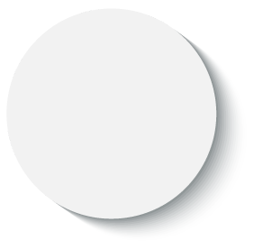





Customer Challenges
Lack of resources and skills sets
33% of companies that have DR measures in place don’t test periodically to ensure these are working - not every company has the resources or knowledge to carry out these processes.
Business survival
50% of smaller businesses do not survive a significant disaster event (e.g. ransomware, data breach etc.) In contrast, 96% of businesses with a DR practice in place do fully recover.
No DR plans
currently in place
75% of small businesses have no DR plan in place - it may fall into the ‘nice-to-have’ category, that is, until they need to use it.
Compliance & Regulatory Requirements
Compliance and regulatory requirements mean companies need to demonstrate plans and approaches to business continuity.
Rising Costs
Companies need more cost-effective solutions that offer options to move away from on-prem costly, legacy hardware to Cloud based environments where they’re only paying for services used and have the capability to scale as required

Slide 4
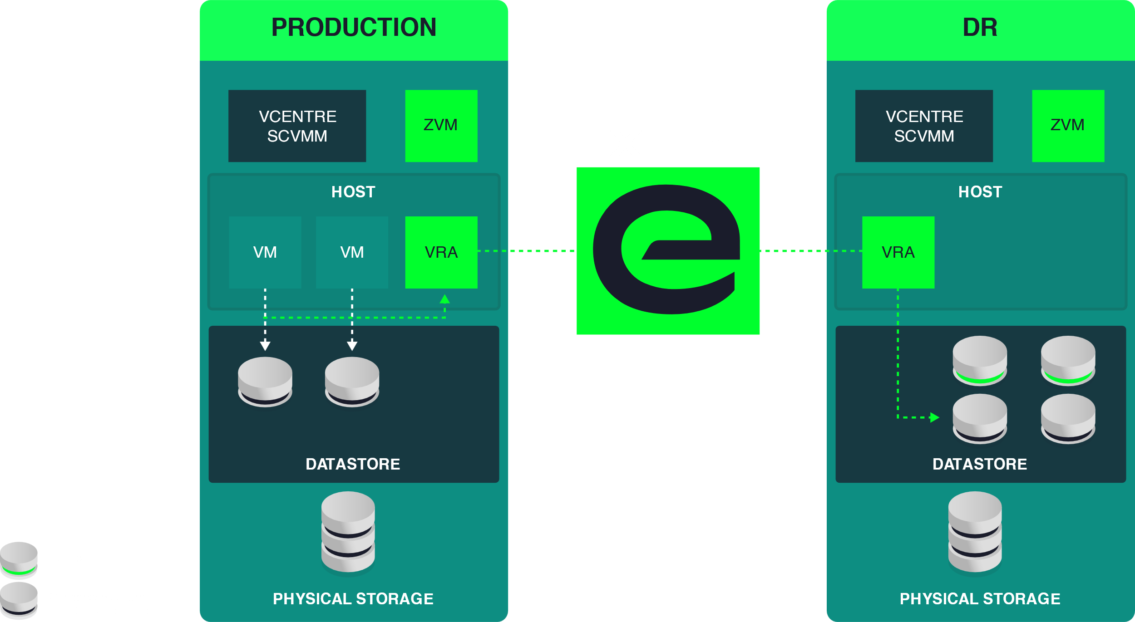
What is DRaaS?
A data centre recovery is a solution designed to capture a point-in-time copy / backup of an enterprise workload and write the data out to a secondary storage device for the purpose of recovering this data in the future.
This delivers the ability to recover or maintain IT systems in the event of outages or recover data from deletion, corruption or criminal theft.
Disaster Recovery with a Single Remote Target

Slide 5
Threat = Opportunity
How quickly could your customer recover in the event of an attack?
How long can they tolerate being offline?
How can you monitor threat?
Can they describe the impact of a ransomware attack to their business?
How confident of an insurance pay out are they?
Prevention
Recovery
It’s no longer “if”, it’s when….

Slide 6
Best of Breed - Business Resiliency Portfolio
DevOps Consultancy
Professional Services
Dedicated Backup
Online Backup
SaaS Backup
Azure Backup
Server Replication
Cyber Vaults
Data Centre Services
Channel Partners

Slide 7
Backup Vs Replication
BACKUP
SERVER REPLICATION (ZERTO)
Copies data to media (tapes / cloud)
Full system or specific data
Stored remotely from production services
Data is encrypted on disk and in transit
Long Term Retention of Data
Data is compressed and deduplicated
Long RTO / RPO
Continuous protection of a server entity (VM)
Geo Resilient
Replicate to secondary site or cloud target
  VDC
  Private Cloud
  Public Cloud
Full system copy
Short RTO / RPO

Slide 8
Zerto Disaster Recovery with EXPO.e
EXPO.e's DRaaS provides best of breed secure offsite server replication with customer references across all sectors.
As Zerto’s largest MSP in the UK, together, we offer leading-edge software-defined replication & recovery automation technology with our self-owned, enterprise-class network - delivered as a fully managed service.
Zerto provides a platform for IT resilience and service continuity across multiple premises and cloud environments.
Disruption-free Deployments
No downtime required during the installation
of the Zerto Virtual Manager and
replication engine.
Effortless Integration
A hardware, storage and application agnostic solution, providing customers with the freedom to integrate Zerto with their existing systems.
Guaranteed Data Integrity
Near-zero data loss should DR protocols need
to be initiated, with automatic failover.
A Comprehensive Service Wrap
Additional capabilities around data centre moves, application migration and hybrid Cloud projects open the door to numerous add-on services.
A Fully Managed Service
EXPO.e’s certified Cloud specialists provide hands-on guidance to streamline and optimize the disaster recovery process.
Stress-free Restoration Process
Critical systems restored in seconds, via Predictable Recovery Point Objectives (RPO) and one-click failover.

Slide 9
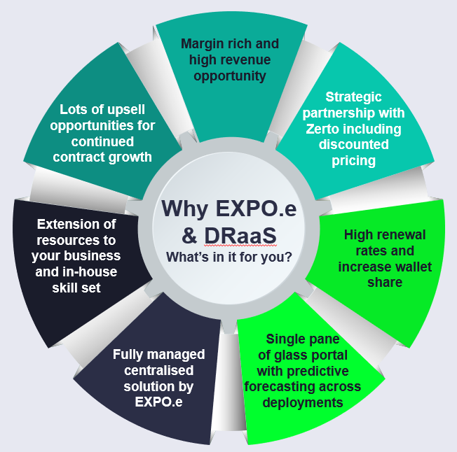
Partner & Customer Benefits
How the EXPO.e & Zerto offers *PARTNER* differentiation in the marketplace
*PARTNER*
CUSTOMER
Shorten Sales Cycles
Operational simplicity
Win bigger orders
Hardware agnostic
Integrate our capabilities into yours
Increased Operational Margins
Augment your sales and technical teams
Reduced Management Resource
Enabling you to Solutionise in larger markets
Consolidate multiple licenses and agreements into a single solution
Single supply chain and vendor consolidation
Speed and simplicity of deployment

Slide 10
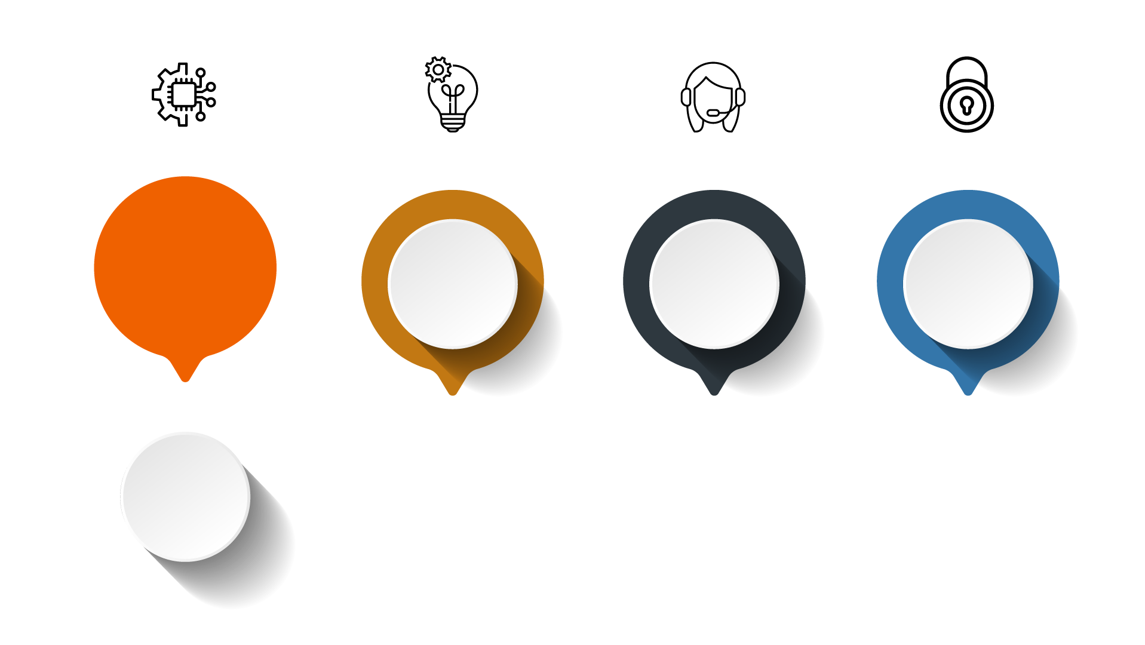
Next Steps / CTA’s / Engagement Process
Access DraaS specific content in our Partner Hub; Blog ideas, Sales Enablement, Solution Content and more.
Identify target
customers and create a joint Sales creation campaign with us!
Arrange DraaS
Training for your Sales, Technical and Operational teams
Engage Marketing
and Enablement Teams
to help drive tailored engagement and
maximise ROI

