Slide 1
CCaaS powered by EXPO.e
Partner Enablement

Slide 2
Why Referral
As an EXPO.e Referral Partner, you enjoy a steady stream of generous commissions each time you refer one of your customers to us, whether that is for Connectivity, Cloud, Unified Communications, Cyber Security, or IT Services. This way, you not only generate a whole new revenue stream, but are able to offer your customers full, end-to-end combinations of solutions, support, and expertise, helping position you as an indispensable technology partner.
Enjoy a stress-free source of ongoing revenue by referring your customers’ leave the complex unique digital challenges to us.

Slide 3
CX Space
Complexity in the CX space is only growing

Slide 4


Partnership
Training and Adoption
We offer training whether it's your sales and technical staff, to end-user training for your customers
Resilience
CCaaS is designed with carrier-grade resilient infrastructure, backed by robust SLA’s
Our Partnership Statement
  A partnership to strengthen your portfolio, with little internal investment needed
  Deliver commercial efficiency to retain referral value
  Enable you to focus on delivering the best possible experience and service to your customers
  Our partners are recognized by thought leaders – Gartner, Frost and Sullivan etc has market leaders in their field.
06
01
Professional Services
Has a referral partners, our team of CCaaS architects, design engineers and provisioning teams are here for you from day 1 to end of the contract.
Flexibility
Tailor your solution with our modular licensing structure, only paying for what you need!
05
02
04
03
Consultancy Service offering a side-by-side assistance, providing you the peace of mind that the solution is fit for purpose.
Sell with approach
We’re here to support you, through the Sales/Referral cycle

Slide 5

CCaaS Positioning Statement
CCaaS portfolio of services enables organisations to achieve superior Customer Satisfaction (CSTATS) scores across several channels.
Our feature-rich and robust Cloud Contact Centre portfolio offers a range of customer interaction points, Voice, Email, Webchat, Social media, AI driven Bots, Agent Assist, Summarisation, Knowledge Portals , IVA, WEM, PCI compliance, Interaction recording.
To complement and assist in the sales cycle, we help our partners and their customers all the way, from initial consultancy designed to identify true business needs and benefits, assisting in the sales cycle providing expertise and guidance, through to ensuring successful implementation, training to ongoing management.

Slide 6








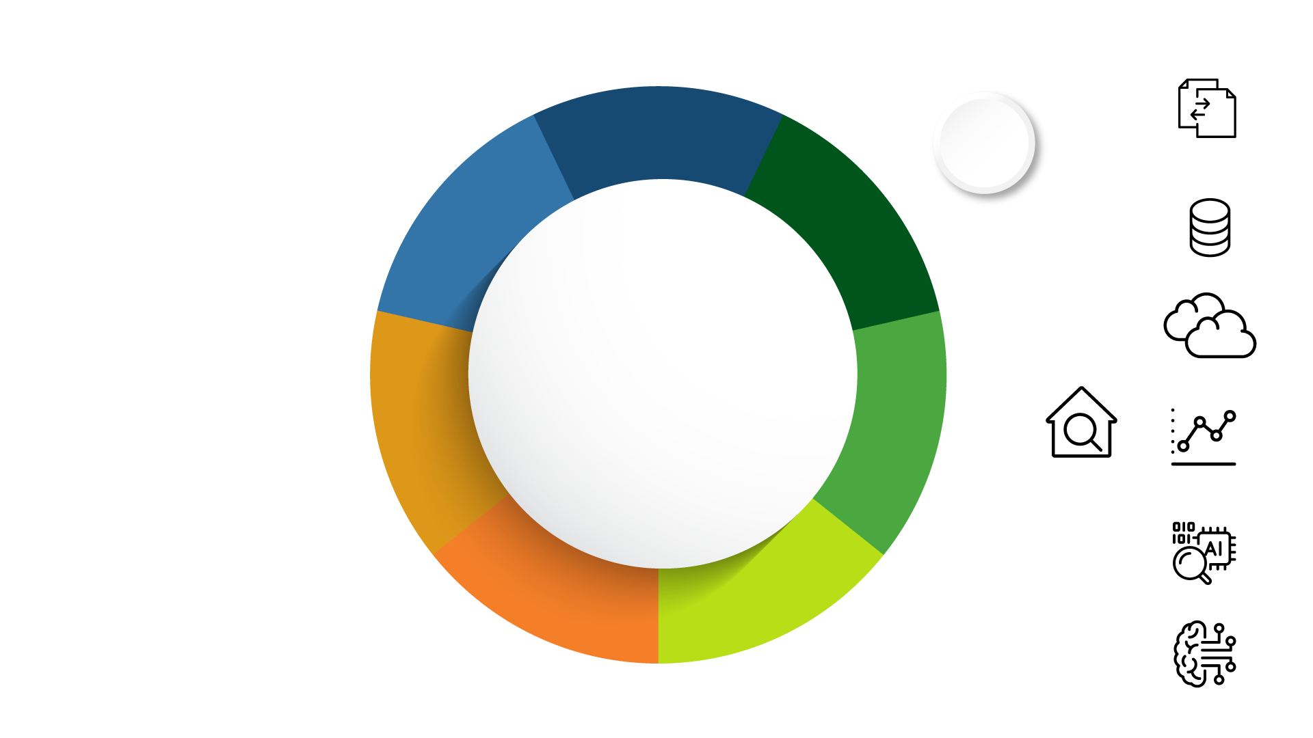


Our CCaaS Network
Multi-carrier resilience
High Availability
Geo diverse SBCs / PoPs
Enterprise Carrier Grade Architecture
Dedicated interconnects to CCaaS cloud service partners.
European breakout with min. 2 PoPs per country
Enfield Virtus
Arc Farn.

Slide 7



Expo & Partners In The Sales Process
A methodical and standardized approach to sales engagements
Prime: Sales
Prime: Solution Consultant
Prime: Sales
1. Qualification
2. Discovery – Maturity Assessment
3. Solution
4. Demonstration
5. Perceived Value
& Buy-in
Company background
Industry knowledge and research
Customer lifecycle
Personas and segments
Established BANT:
  Budget
  Authority
  Needs
  Timeline
Business Drivers
Context for project
Pain points/challenges
Desired customer experience
Goals of the contact center
Customer engagement overview (type, channels, volume)
Current/future state
KPIs/service levels
Staffing/forecasting
Self-service and automation
Systems/data/tools
Self-service solutions
Call recordings
Digital Channels
IVR/IVA/AI Chatbots
Intelligent routing
Data strategy (and AI)
Agent processes and tools
Escalation process
Differentiators
System architecture and integrations
Customer experience
Partner + Five9 Value Prop
Journeys and workflows
Use Cases
Applied Solutions
Role of self-service
Role of live agent
Performance management process
Enabling and measuring success
Problems addressed and solutions understood
Initiatives prioritized
Benefit & ROI analysis
Learnings and recommendations
Strategic implementation plan
Next steps established
Qualification
Define & Address
Problem/Impact
Collaborative Vision & Solution

Slide 8
Qualification
For any CCaaS opportunity, it is important to understand the current challenges and reason that the customer is looking to move into Cloud Contact Centre (CCaaS) migrate services. This helps bring value to the solution, generates more revenue and creates a sticky solution.
To build the solution, you will be looking at:
If they currently have a Contact Centre Solution, “what is it”
What is the key driver for migrating from the existing solution?
What are the key functions of the service agents currently?
How many service agents are there?
What channel are currently active (Voice, Email, Social, Chat etc)
Are they considering Artificial Intelligence has a key tool within their business?
Do they need on-going management / support?
Do they need any on-site or remote training for end users or admin?

Slide 9
Customer Challenges
Below are some of the reasons your customer may be looking to migrate services. It is important to find these reasons early to help angle your pitch:
Legacy on-prem solutions are becoming end of life, leading customers to consider alternative solutions, which still fit their requirements.
Inflexible software and hardware integrations for users both on site and remote.
Migration to a cloud-based infrastructure is potentially seen has a cost saving.
In today's hybrid world, the lack of key technologies in the workplace prevents employees from returning to the office and working effectively.
Many businesses use several apps to bring together a derived CCaaS solution, which is harder to monitor / support, and manage as a result, this delivers a poor user/customer experience.
The demand of businesses to have a single multi-layered view of the customers activity within their organisation, with the ability to track and analyse this traffic is growing in importance.
To reduce the level of dropouts due to lack of communications options and poor queue handling
Increase their service capabilities over multiply channels offering a single interaction resolution capability
Cost of service needs to reduce / budget pressure
To increase their customer satisfaction score (CSTATS)
Customer experience/ Contact centre performance not meeting expectations or targets.
Finding the right provider to assist with the cyber security and data concerns associated with hybrid working and cloud communications.

Slide 10
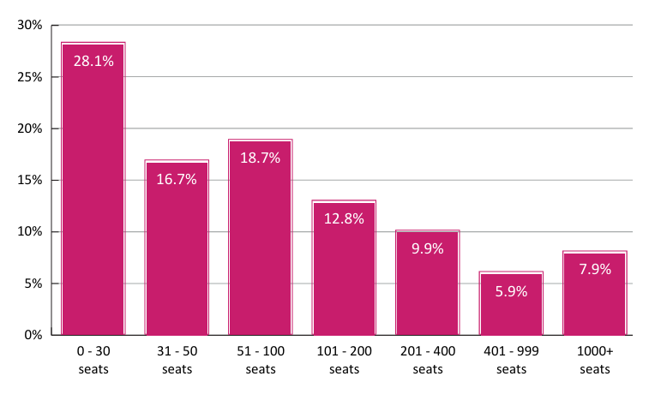
Did you know?
According to a Call Centre Helper Research Paper 2024.
Chatbot Adoption Is on the Rise (Despite High-Profile Failures)
Cost Per Call Hits a 5-Year High
An Increasing Number Now Have a “Work in Progress” AI Strategy
Even More Contact Centres Have Heavily Invested in the Employee Experience.
Participants in this year’s survey came from 200+ contact centres, of all different shapes and sizes, ranging from 0–30 seats to 1,000+.
One of the most enlightening pieces f information is that most Contact Centres are between 0 and 100 seats with the highest 0 to 30 seats.

Slide 11



Title Here
 | Size | Small under 50 agents | Medium 50 to 500 agents | Medium to Large 200 to 1000+ agents
 | Level of contact centre “Formality” | Low May not see themselves as a CC, volumetric reporting, few if any CC processes | Medium Focus on CC performance metrics, CC processes in place | High may have accreditations, awards, CC vital to business, mature CC processes
 | Technical complexity | Low May be voice only with call recording, or simple chat | Medium May be multiple channels with pre-built integrations, simple automation & in-portfolio add-ons | High Multiple channel, complex integration with other vendors, sophisticated automation & ecosystem
 | Number of Stakeholders | Low IT | Medium IT and Contact Centre users and Managers | High Senior IT, Contact Centre executives & users
 | Importance of Brand Recognition & Reputation | Low to Medium | Medium European references are sufficient | High Vendor must be on Gartner MQ or equivalent
 | Importance of Compliance, Security, Resilience | Low to Medium | Medium European data centres sufficient | High UK data centres required, high resilience/reliability

Slide 12
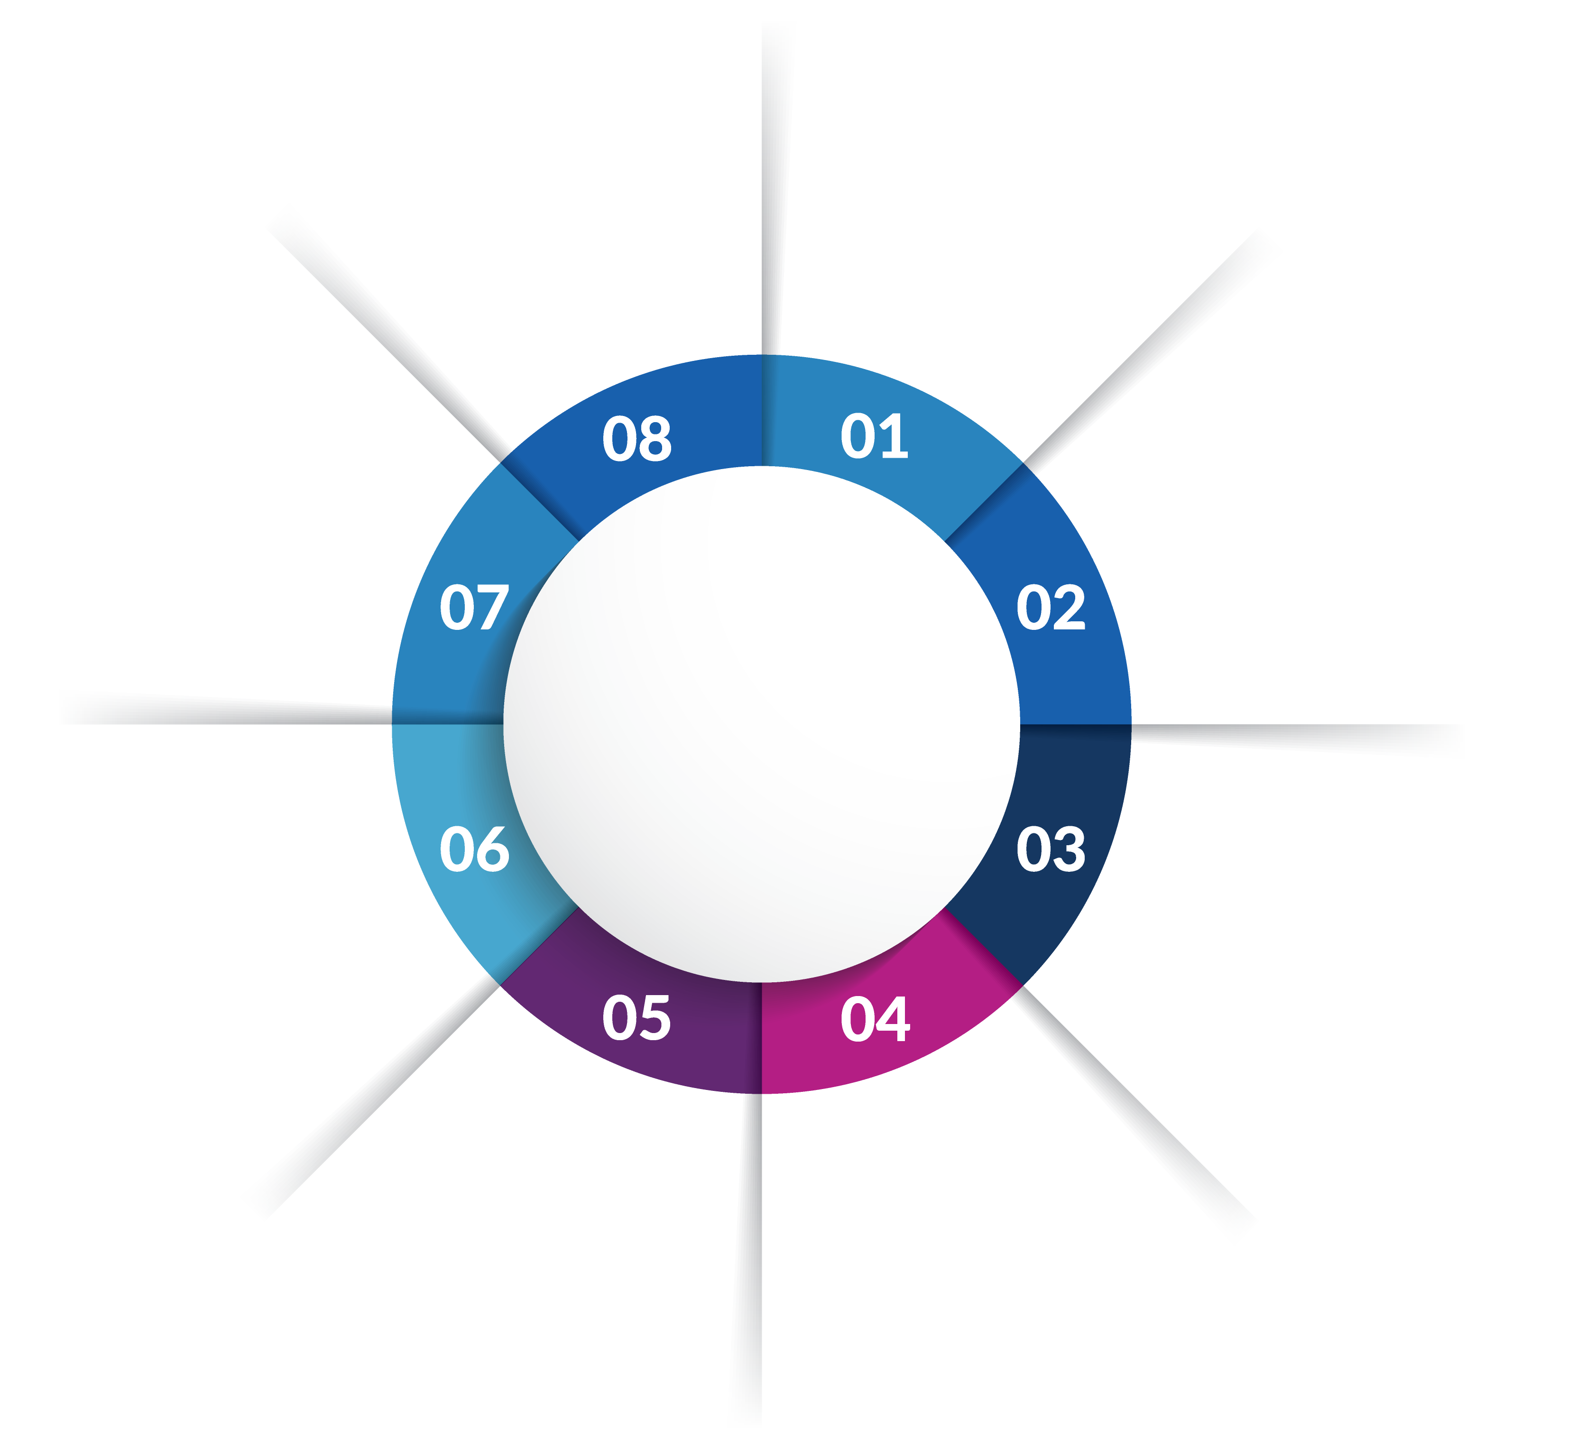
Contact Centre Features & Benefits
Our CCaaS solution offers:
Comprehensive Capability - Voice, Chat, Social, Email, SMS, WFM/WFO (Work Force Management /Optimisation), AI, Back-Office integrations and Real-Time Reporting to enhance the contact process
Simplicity & Cost Efficiencies - A fully maintained, continuously up-to-date, cloud-powered platform which reduces costs, offers per-user pricing and has built-in DR
Drive Profitability - More intuitive, personalised customer interactions create stickiness and enhance customer retention
End to End 24/7 management through EXPO.e UCC Specialists
CCaaS provides Voice, Web Chat, Email, Social Media, and SMS in one application
Enables businesses to outsource set-up
and management of complex contact
centre solutions to a trusted provider
Flexibility with options to blend our CCaaS packages with an existing Contact Centre solution
CCaaS
Fully resilient platform with multiple UK and European private, Tier 1 carrier connections into EXPO.e’s core infrastructure
Integration with our Microsoft Teams Direct Routing and UCaaS solutions
A robust multichannel, multi-tenant platform, integrated with our own private UCC Platform
Ability to provide end-to-end security all the way to the home

Slide 13
Contact Centre Consultancy
Maturity Assessment:
Free-of-Charge
Value Assessment:
Free-of-Charge
Health Assessment:
Chargeable Consultancy
Designed to help our clients identify a strategic path forward and target areas for improvement.
The areas measured are:
Strategy
Structure and Brand
Contact Centre Practices
Team Agility
Business Intelligence and Analytics
Collaboration
Automation
Architecture and Design
Designed to make sure clients get the most from technology investment.
Live observation
Interviews/workshops
Deeper dive into contact centre operations and how they can be improved. It uses questionnaires, interviews, workshops, live observation, as well as offline analysis.
There are four components to the consultancy: Planning, Strategic, Operational, and Technical.
The output of the consultancy is a report that shows perceived strengths and weaknesses, along with recommendations for improvement.

Slide 14
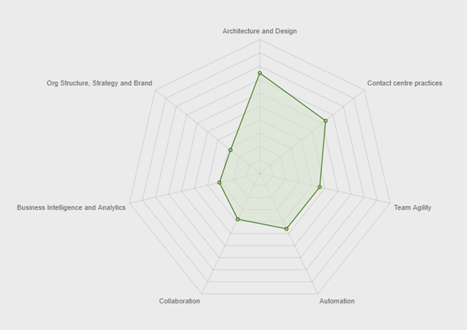







Contact Centre Maturity Assessment
Shows areas of strengths and weakness
Questions are posed in seven areas and scored according to maturity
Assesses practices across people, process and technology
Shows where you are on the maturity scale
Informal
Forming
Established
Optimised
Strategic
Business Intelligence & Analytics
Collaboration
Contact Centre Practices
Designed to help you identify a strategic path forward and target areas for improvement
Organisation structure, Strategy & Brand
Team Agility
Automation
Architecture and Design

Slide 15












APIs Intelligent Contact Centre
Customer
System of Engagement
Business
Agent Assist
Intelligent Routing
APIs
Intelligent Cloud Contact Centre
Integration
Provisioning
Reporting
Email
Web
Smart Dialer
IVA & Chatbot
CRM & Customer Data
Social
Chat
Digital Agent
Voice
SMS
WFO
Dashboard
Live Agent
Agent, Supervisor, Admin
Reporting & Analytics

Slide 16
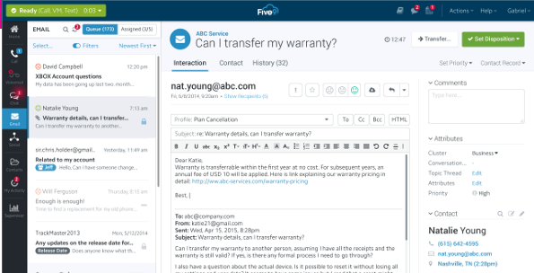
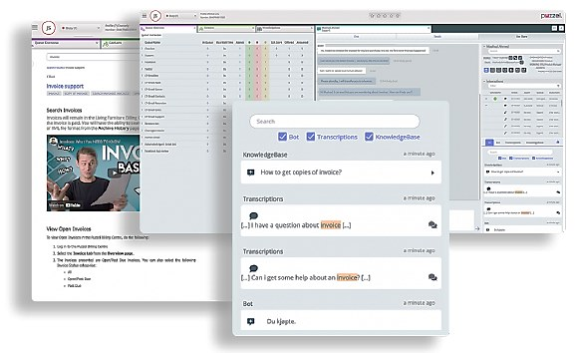
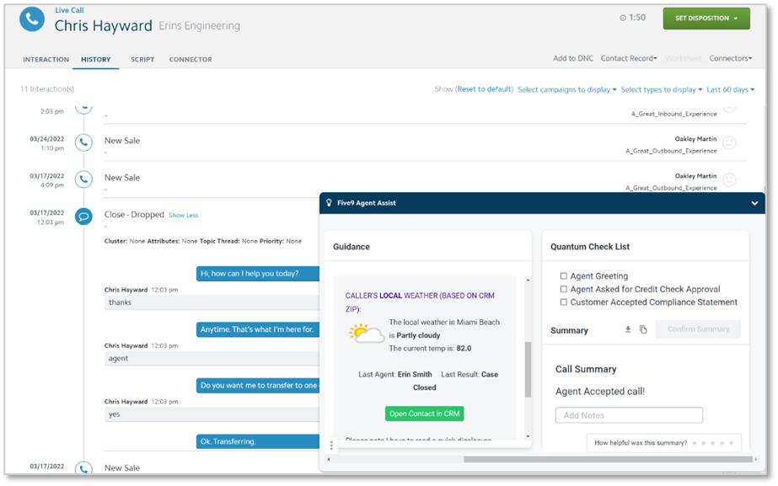
Typical UX

Slide 17





Leveraging Artificial Intelligence for Transformation
Automation
& Deflection
Agent
Augmentation
Precision Routing
Insight
Enable accurate and intelligent routing decisions with data to improve the efficiency, outcome and quality of every interaction
Allow customers to quickly and easily interact with your brand product or services, anytime, anywhere and in the channel of choice
Real time dynamic support to maximize CX and reduce AHT by assisting agents in real-time, during live customer interactions.
Uncover deep insight into the reasons for customer contact, through the automatic interpretation and categorization of customer conversations

Slide 18






Conversational Insights
Conversational AI
Virtual Agent
Live Agent
Post Interaction
Intelligent Virtual Agents
Agent Assist
AI Insights
Automation routine tasks and provide engaging self-service across voice and digital. Allowing the offloading of high volume, low complex tasks where it makes sense
Augment Agent skills to achieve best outcome for every interaction, allowing agents to be more efficient, and ramped up to competency quickly
AI-driven performance measurement & customer insights
in real-time, giving ability to see the trends of operational centers.
Digital Virtual Agents
AI Summaries
Advanced Analytics
Automate tasks, enable chat and facilitate rich self-service experiences, DVA’s take care of routine tasks, auto translate, and aide with peak periods
Auto summarize call transcripts and publish to CRM or Five9 data store. Potential to save agents minutes in wrap up time
Self-service access to data and insights for custom reporting

Slide 19








Customer Conversational Data holds Answers to Crucial Questions
Website
Self-Service
Chatbot
Email
Web Chat
IVR/IVA
Voice Call
Feedback
Customer
Understand where and why digital and self-service support journeys failing?
Identify reasons why prospects & customers are reaching out to the business
Quantify where AI and Automation will improve customer and agent experience
Agent

Slide 20
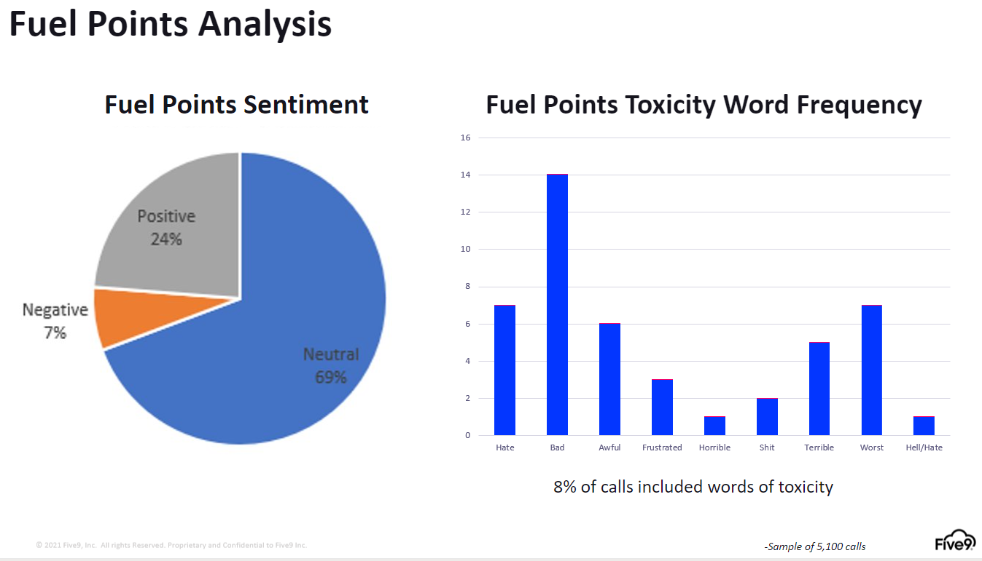
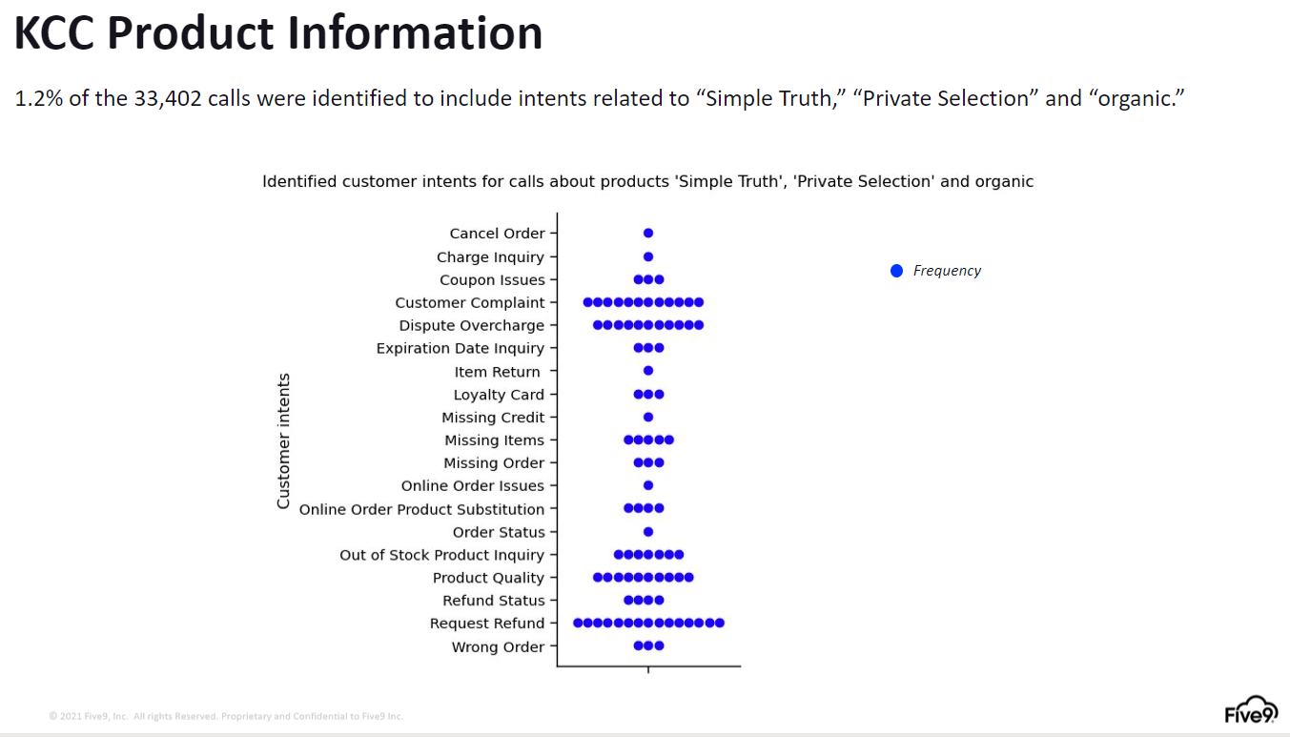
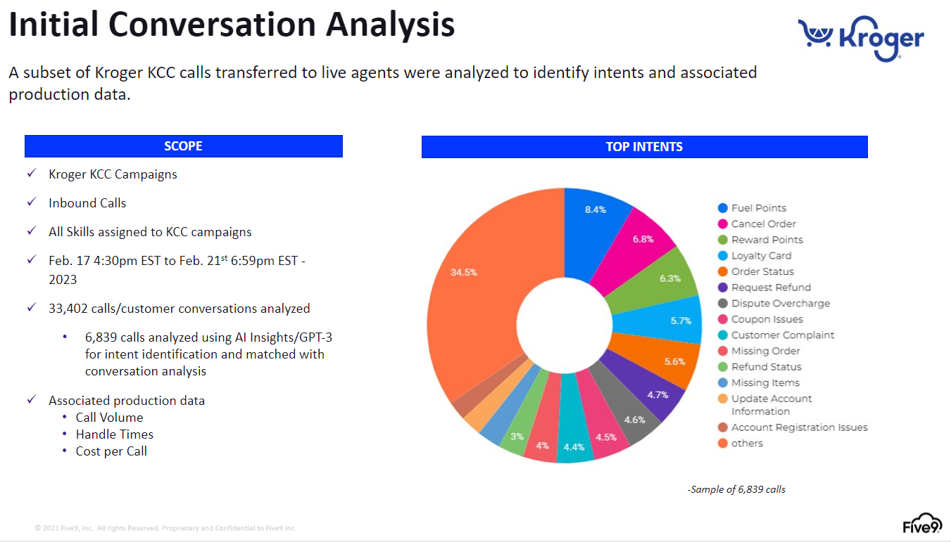
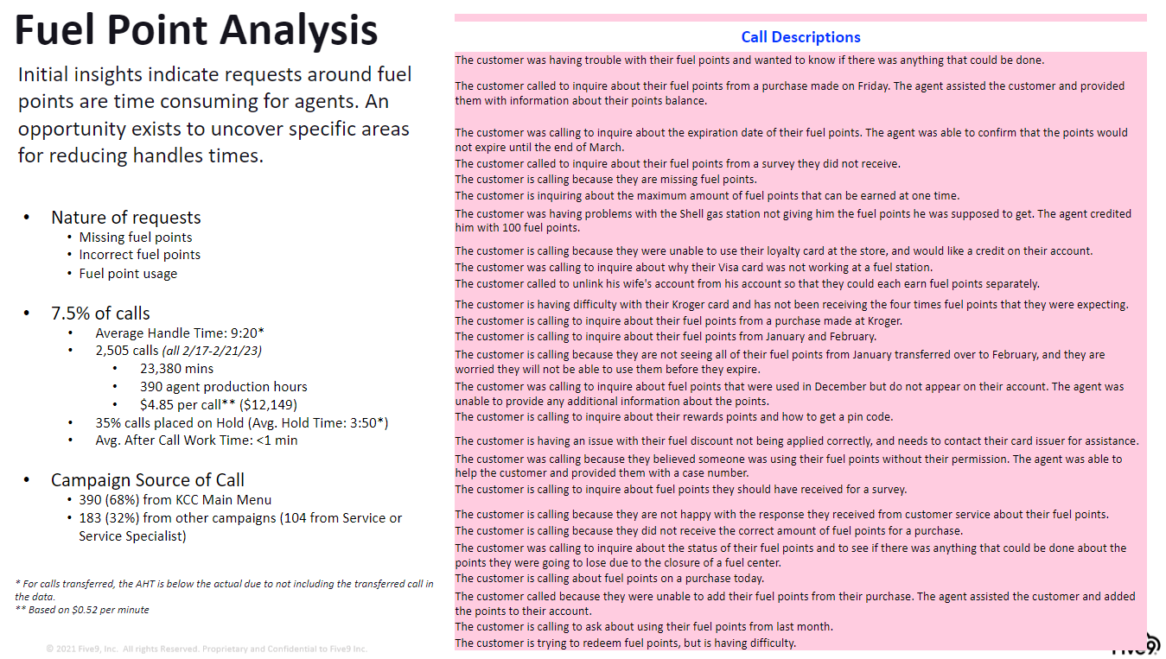
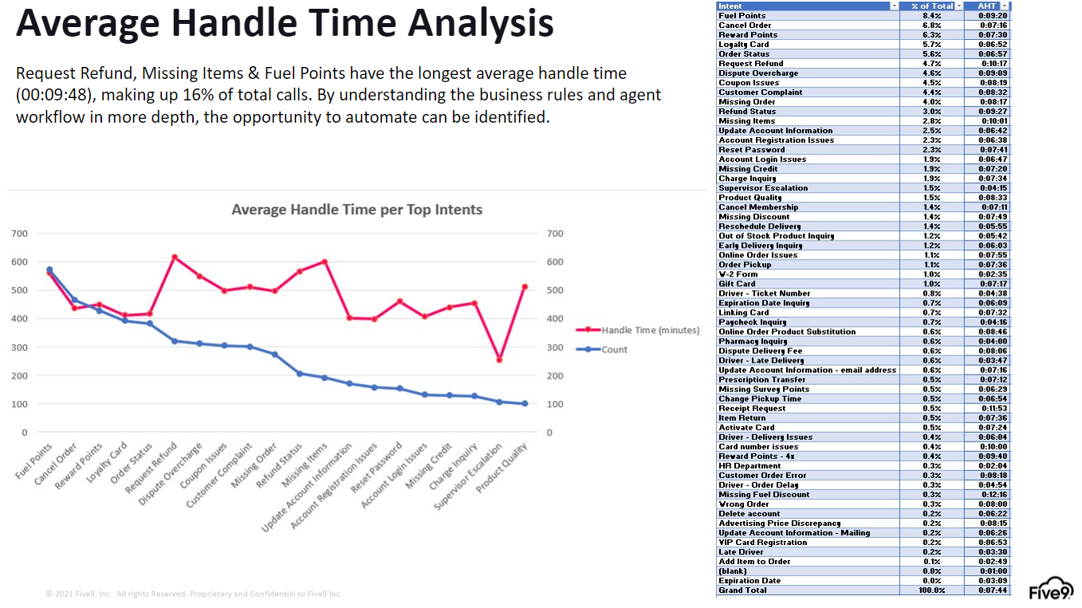
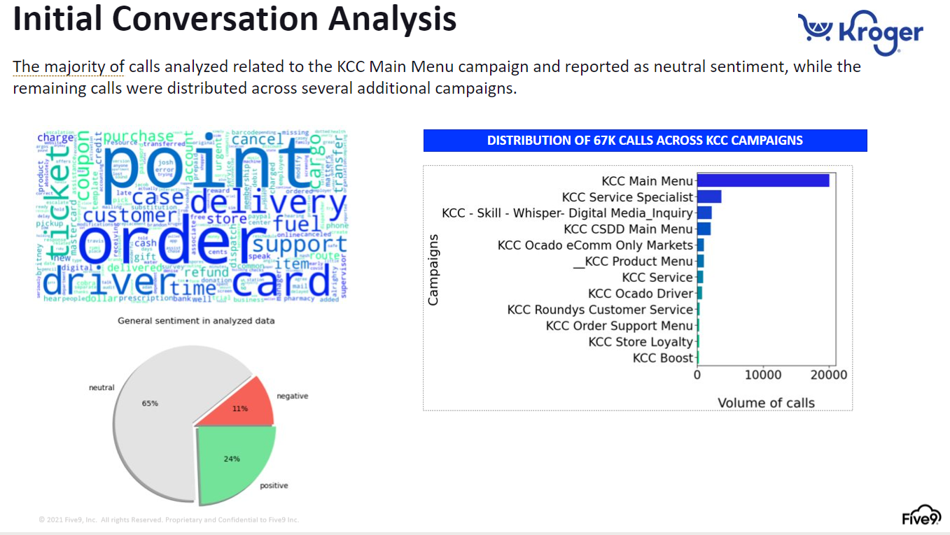
Conversational Insights – Deliverable Examples

Slide 21
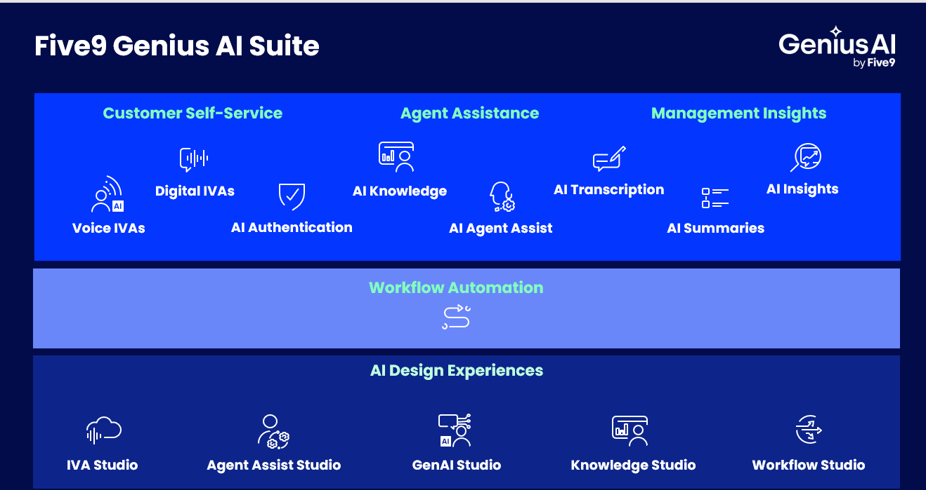




Enterprise Contact Centre
Comprehensive Reporting & Analytics Suite
Genius AI Suite
Intelligent Virtual Agents (IVA)
Agent Assist, Knowledge, Summaries, Insights
Harness conversational and generative AI to implement new automation. Embedded across the Five9 platform, AI elevates customer, agent, manager, and admin experiences.
73%
of leaders agree that automating more customer tasks would help improve customer relationships and loyalty
8x
greater year-over-year improvement in costs for contact centers using intelligent CX programs
Aberdeen, 2023
Quality Management
Performance Dashboard
Workforce Engagement Management
CRM Connectors
KEY BENEFITS
Streamline operations, reduce cost of service, and optimize customer journeys across touchpoints
Amplify the abilities of agents and supervisors with AI
Use practical AI to accelerate time to market and advance AI through your knowledge
Notes:
Insert a ‘New Slide’ or select ‘Layout’
Exponential - Light Background

Slide 22
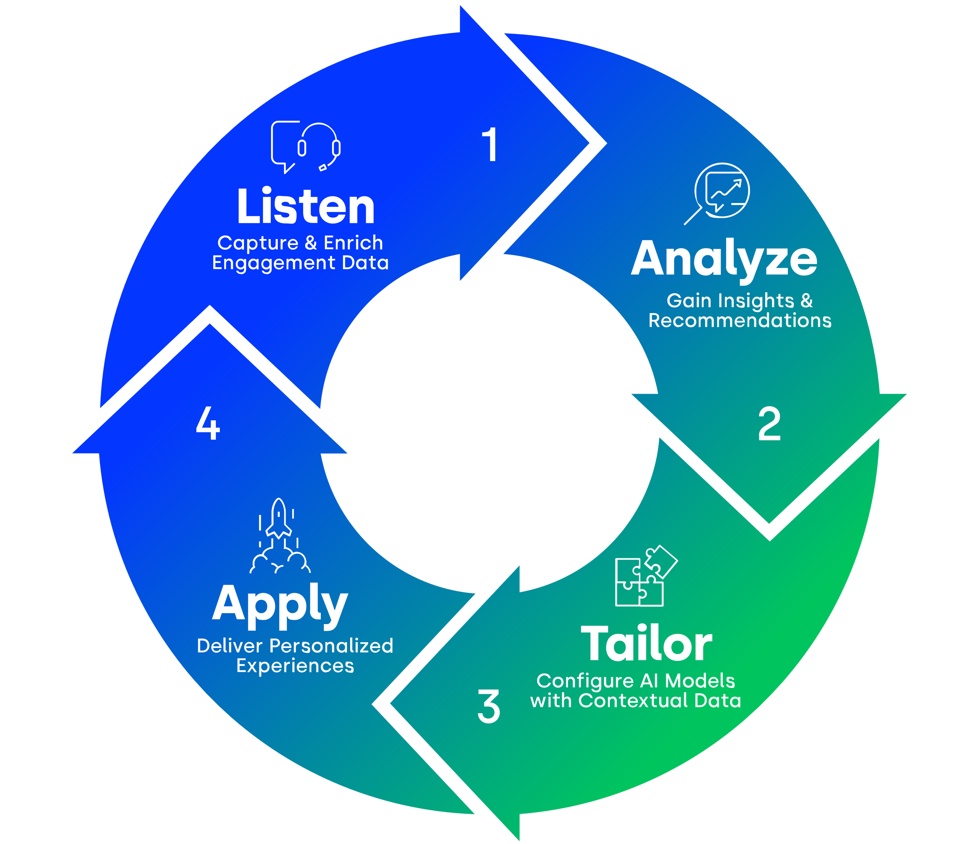




GeniusAI Process
Five9’s commitment to future-proofing your contact center is reflected in four core strategy tenets that steer the development of our AI platform.
Embedded AI
Practical AI
Engine-Agnostic AI
Responsible AI
AI across every contact center application
Make AI accessible, useful, and easy to manage
Rapidly adapt to the
latest innovations
Focus on the proper and ethical use of data
Five9 Genius AI Process
A 4-step strategic guide for delivering AI business value.

Slide 23
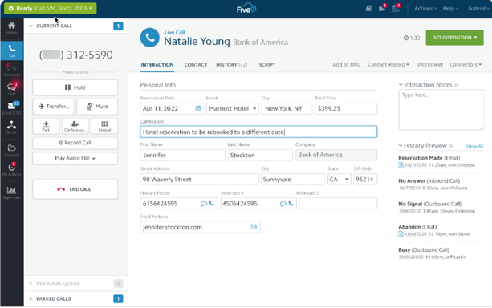
Five9 Inbound Contact Centre
Enable agents to manage multiple interaction queues and deliver a more personalized service experience.
KEY BENEFITS
Boost efficiency with skills-based routing
Enhance customer experience with speech-enabled IVR and intelligent virtual agents ​
Unlock CRM integrations with Microsoft, Oracle, Salesforce, and ServiceNow

Slide 24
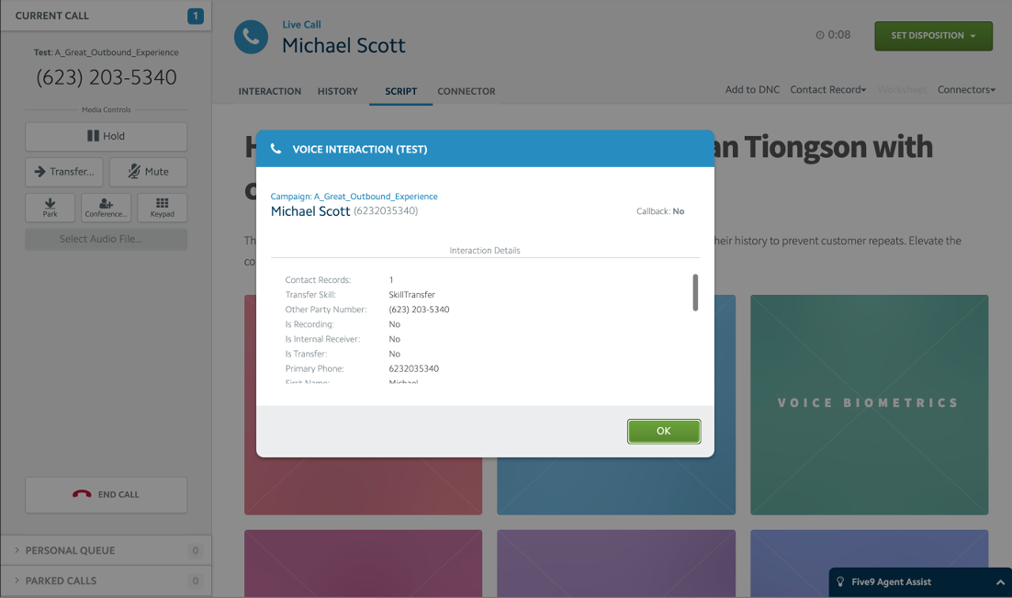
Five9 Outbound Contact Centre
Optimize operations with outbound campaign management, featuring a best-in-class, patented predictive dialer.
KEY BENEFITS
Maximize selling time with automated outbound capabilities
Flexible dialing modes support your business needs, including predictive, power, progressive, and TCPA-compliant options ​
Unlock CRM integration with Microsoft Dynamics, Oracle, Salesforce, ServiceNow, and Zendesk

Slide 25
Five9 Blended Contact Centre
Optimize agent productivity and customer experience by strategically leveraging the peaks and valleys of contact centre traffic.​
Optimize agent productivity and customer experience by strategically leveraging the peaks and valleys of contact centre traffic.​
KEY BENEFITS
Automatically move outbound agents to inbound queues when traffic volume peaks
Increase revenue, conversions, cross-sell, and upsell opportunities while delivering extraordinary service
Leverage inbound voice and digital features, including ACD, IVR/IVA, analytics, and AI

Slide 26



Five9 Intelligent Virtual Agent (IVA)
Create a natural, conversational, omnichannel self-service experience with a seamless transition to live agents when needed.​
KEY BENEFITS
Provide a 24/7 conversational
self-service experience across voice and digital channels
Lower service costs
and increase CSAT by augmenting human agents with virtual agents
Create, deploy, and manage voice and digital IVAs on a single, no-code development platform
IVA
SumUp
We added Five9 IVA and saw the number of customers who opted to speak to a human agent drop by 50%. This is a huge decrease for us and shows us that our IVA is truly serving customers.

Slide 27
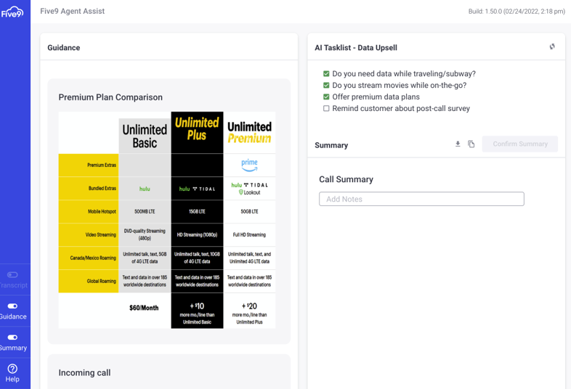
Five9 Agent Assist
Empower contact centre agents to be more efficient and productive with AI.
KEY BENEFITS
Reduce average handle time while improving the agent experience with post-call summaries
Drive high-value customer experience by providing relevant, timely information
Improve upsell, call quality, and compliance with real-time, in-call guidance and checklists
Reduce manual workload and increase ROI with automation

Slide 28
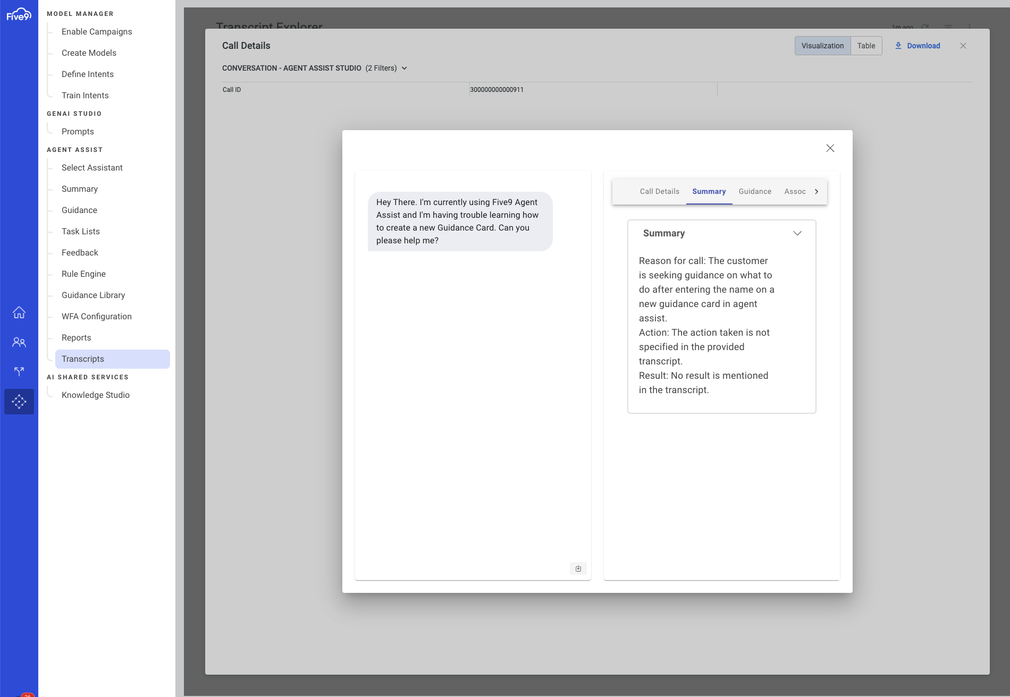
Five9 AI Summaries
Increase the accuracy and consistency of your call summaries with GenAI.
KEY BENEFITS
Reduce manual workload and increase ROI with AI and automation
Free agents from note-taking and focus on each customer’s request for assistance with real-time transcription
Craft and assess free-form prompts effortlessly, and seamlessly integrate them into AI summaries for enhanced customization

Slide 29
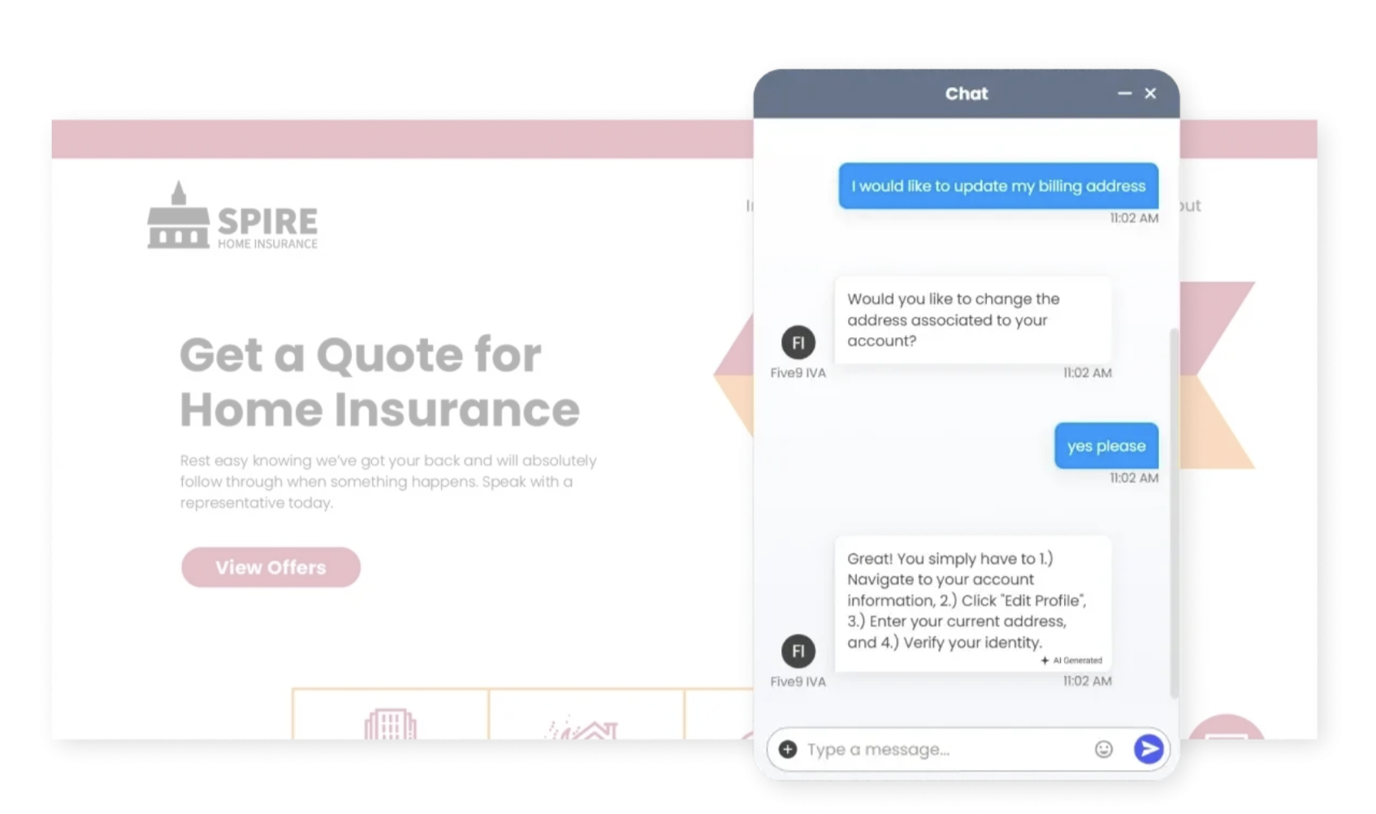
Five9 AI Knowledge
Deliver contextual knowledge-based answers in virtual and live agent interactions for faster resolution.
KEY BENEFITS
Improve the precision of your knowledge
Create better customer self-service experiences
Accelerate agent onboarding and proficiency
Curate knowledge to fit the unique needs of your customers and agents

Slide 30
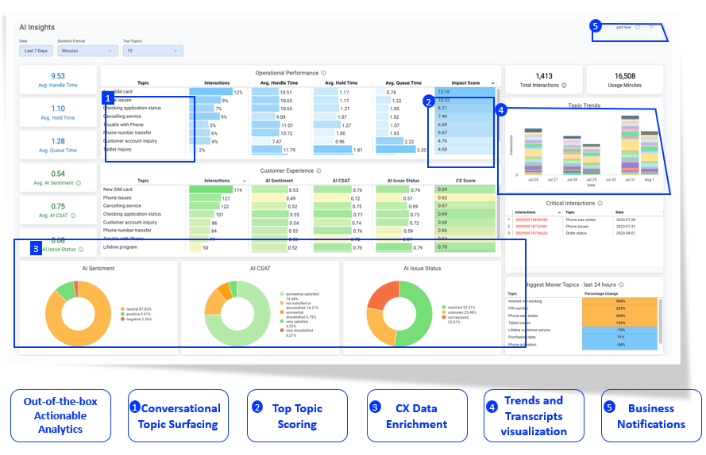
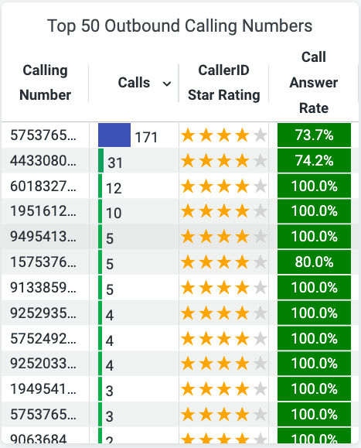
Five9 AI Insights
Harness the power of generative AI to deliver accessible, actionable CX insights faster and with less effort.
KEY BENEFITS
Uncover evolving trends with the Voice of Customer (VoC)
Improve CX agility and identify automation opportunities with real-time trends in customer interactions
Identify areas to optimize contact center operational efficiency and costs
View business-critical data in a single pane with no AI tuning required

Slide 31
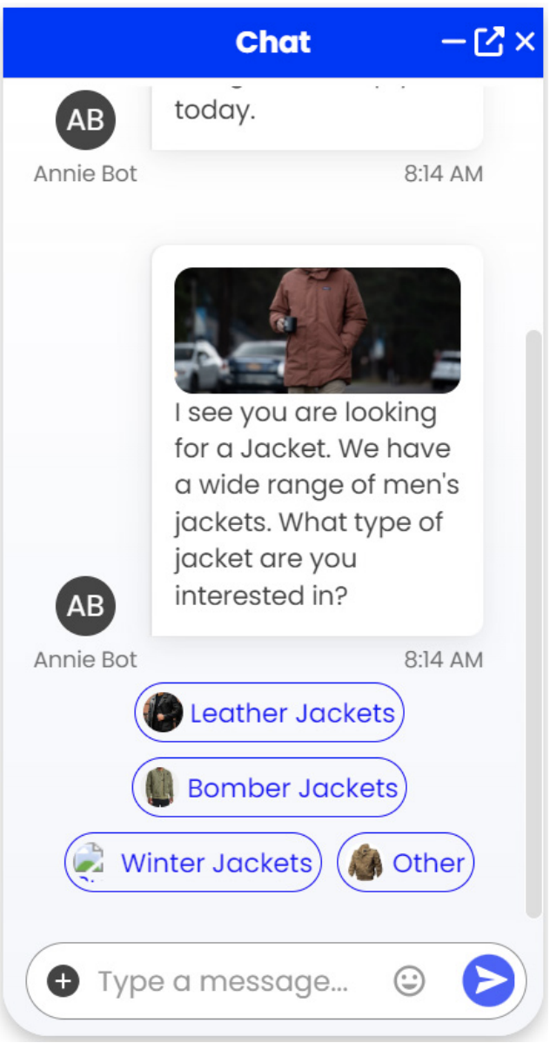
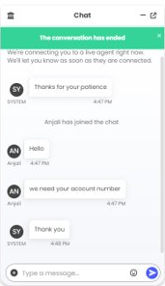
Five9 Web Chat
Deliver rich, engaging, and convenient chat experiences for your web visitors.​
KEY BENEFITS
Integrate chat functionality into your web presence to lower customer effort
Create highly engaging chat experiences with rich media controls
Lower costs with intelligent virtual agents that provide seamless transitions to live service

Slide 32
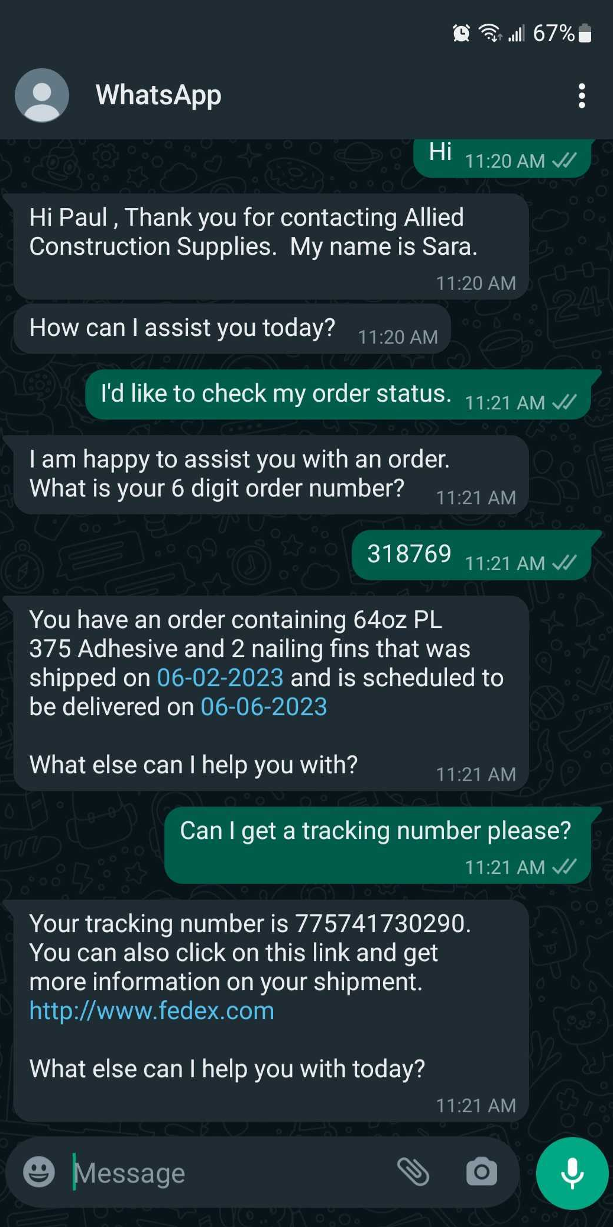
Five9 Social Messaging
Expand your brand’s social presence and engage customers where they are with a social messaging channel.
KEY BENEFITS
Connect with customers on a personal level and foster loyalty
Offer 24/7 service with intelligent virtual agents
Provide a secure alternative to SMS/text, especially in regions where data protection is critical
91% ​
of execs say social will be the primary channel to connect with prospects and customers within the next three years
Sprout Social, 2021​
110% ​
increase in consumers who named social messaging as a preferred channel in 2021 vs. 2020
Zendesk, 2021​

Slide 33
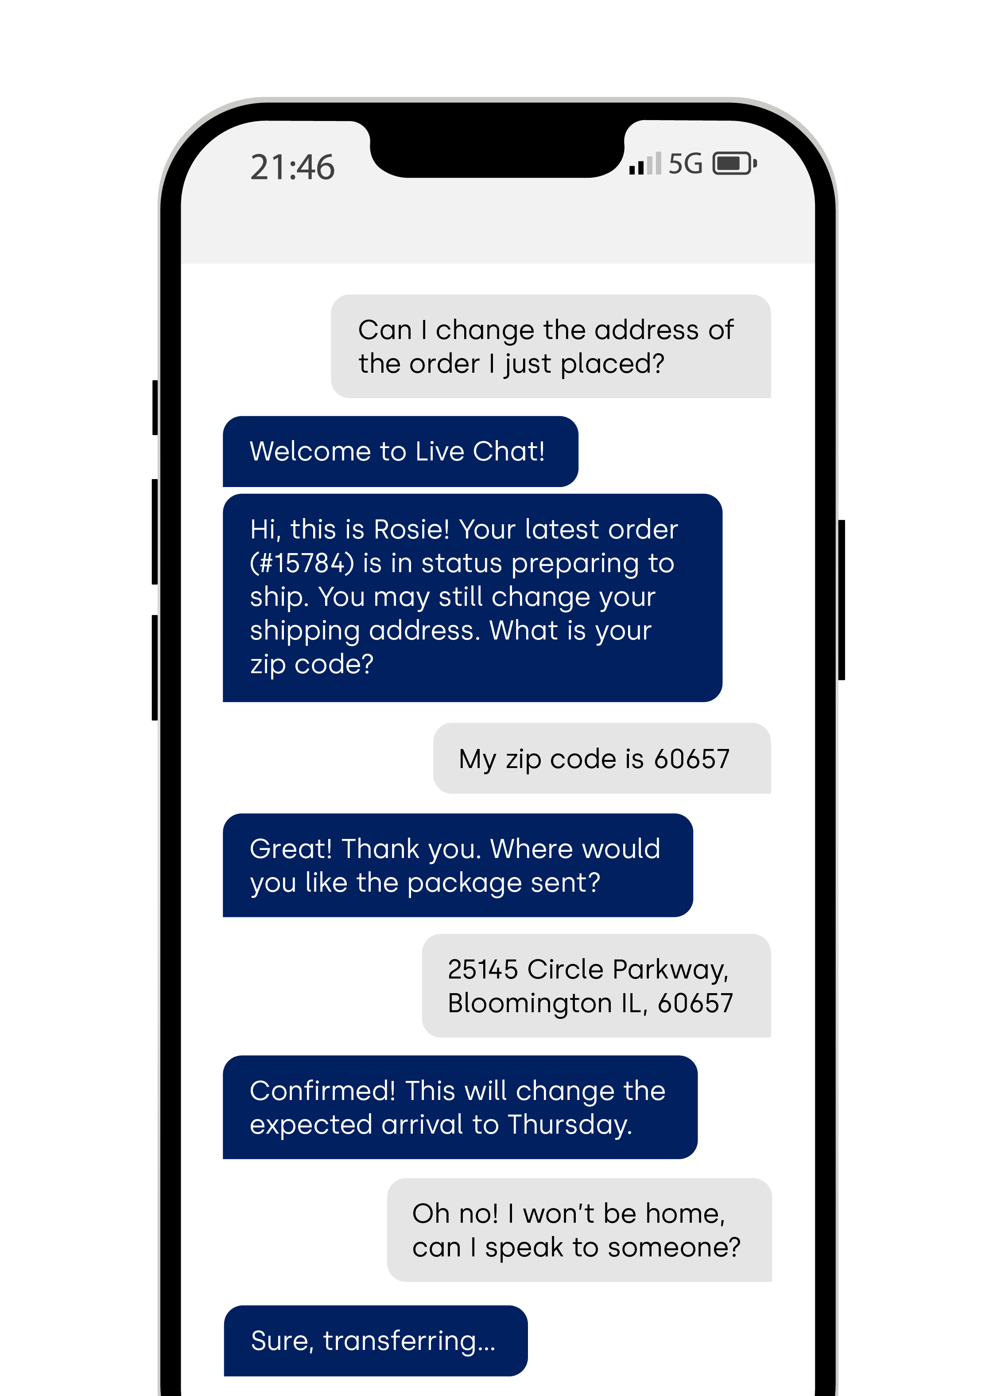
Five9 SMS/Text
Provide a text-friendly option for customers who prefer it.
KEY BENEFITS
Provide proactive service with reminders, notifications, and offers
Create a richer experience with SMS attachments and location sharing
Keep customers informed with bulk SMS messaging
Alaska Airlines
The technology in our contact center really gives the guest the ability to reach out for whatever method they would like. They can call, they are able to use webchat, they can text us. It's really about being available for our guests 24/7.

Slide 34

Puzzel CX Ecosystem Capabilities.
Self-Serve
Virtual Agent • Knowledgebase
A robust connected customer journey enabler
CX Platform
CX Control Centre
Ecosystem capabilities:
AI
Omnichannel routing
Agent CX workspace
Interaction Analytics
Customer Insights
Agent AI Assist
Virtual Assistants
Consumer AI Assist
CX Control Centre
Case Management
Automated workflows
Knowledge management
Seamless Integrations
Sales Intelligence
Automated QM
Compliance Recording
WFM
AI Foundation
Analytics
Analytics
CX Platform
Omnichannel
AI Assist • CX Workspace
Human
CONFIDENTIAL
Notes:
In today’s rapidly evolving digital landscape, delivering an exceptional customer experience (CX) has become a crucial differentiator for businesses. Many organisations are under significant pressure to deliver more efficiently while also maintaining high standards of service. Our CX Ecosystem represents a holistic approach to integrating various touchpoints and technologies, ensuring a seamless and unified customer journey. This enables businesses to meet efficiency demands while delivering great CX.
Unified CX:
The foundation of our ecosystem is the concept of Unified CX, which ensures that every interaction a customer has, whether it’s through voice, chat, email, SMS, social media, or self-serve options supported by virtual agents and knowledgebases, is consistent and connected. This unification is essential for providing a coherent experience across all channels.
AI and Analytics:
At the heart of our ecosystem are AI and Analytics. AI drives intelligent automation, virtual agents, and AI-assisted services, enhancing efficiency and personalisation across all touchpoints. Embedded throughout the platform, AI automates routine tasks and provides users with tools that streamline their workflows, freeing up resources to focus on more complex and value-added activities. By offering real-time insights and actionable recommendations, AI helps businesses optimise resource allocation and improve decision-making processes.
Analytics delivers deep insights into customer behaviours and preferences, enabling data-driven strategies that further enhance operational efficiency. Together, AI and Analytics create a dynamic CX environment that continually learns and adapts, delivering superior customer experiences while driving business efficiency and growth.
Control Centre and WFO:
Surrounding AI and Analytics is the Control Centre, which serves as the central administration hub. It provides a comprehensive overview and control over all CX operations. Workforce Optimisation (WFO) tools, embedded within this centre, are designed to optimise agent resources, time, and performance. This ensures that agents are effectively managed and deployed, enhancing their productivity and the overall efficiency of customer service operations.
Virtual Agents and Knowledgebase:
Our virtual agents are powered by a robust knowledge base and AI assistance, providing quick and accurate responses to customer inquiries. This layer of self-serve capabilities reduces the load on human agents and improves response times.
CX Workspace and Integration:
The CX Workspace is a unified interface where agents can access all necessary tools and information. As well as providing agents with a comprehensive view of customer interactions and history. Seamless integration to business systems enable personalised support by providing contextually relevant information and ensuring all business systems remain current. By becoming an integral part of the customer’s overall business operations, the CX Workspace facilitates a holistic and integrated approach, leading to more informed, efficient support and a consistent customer experience across the entire business ecosystem.
The Human and Self-Serve Interaction:
Human Touch:
Despite the advancements in AI and automation, the human touch remains indispensable. Our ecosystem ensures that when customers need human assistance, agents are empowered with the right tools and information to provide empathetic and effective support.
Self-Serve Capabilities:
On the flip side, for customers who prefer self-service, our ecosystem offers robust self-serve options powered by virtual agents and a comprehensive knowledge base. This empowers customers to find solutions independently, enhancing satisfaction and reducing wait times.
Our CX Ecosystem is designed to provide a unified, seamless, and intelligent customer experience. By integrating AI, analytics, and a centralised control mechanism with robust self-serve and human support options, we ensure that every customer interaction is efficient, personalised, and satisfying. This holistic approach not only improves customer satisfaction but also drives operational efficiency and business growth.

Slide 35
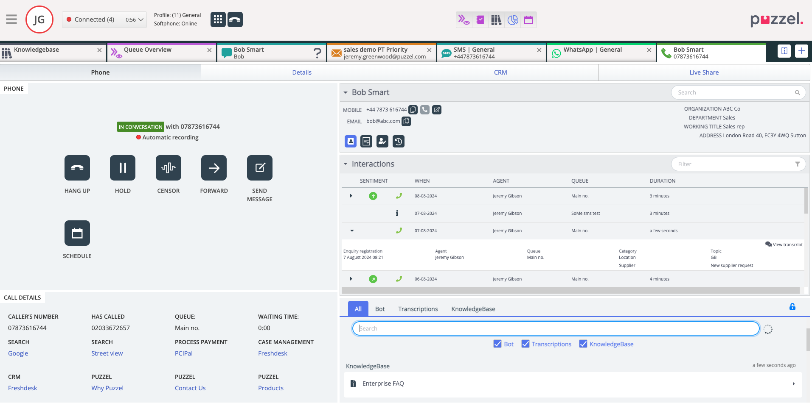
Agent workspace – Improving Agent Efficiency
KEY BENEFITS
The Puzzel Agent Workspace supports an omni-channel concept together with a focus on information needed to support different stages of the customer journey and in single view agent UI.
It supports simultaneous interactions through voice, video and text including social media channels and soft phone. The single view of the customer is supported through a highly customizable and flexible custom widget concept.

Slide 36
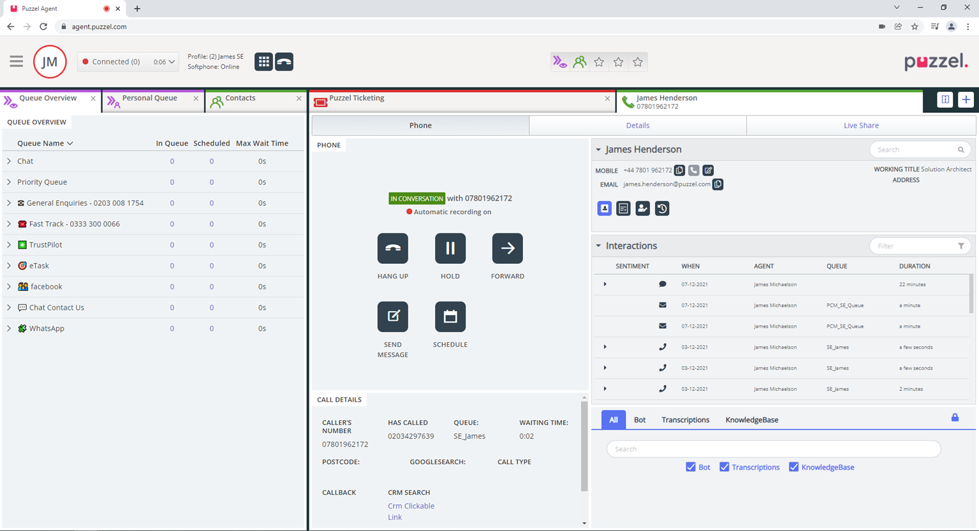
Agent Assist -Transform your customer support
KEY BENEFITS
Equip your agents with AI-powered insights, in real-time. Agent Assist provides automated customer sentiment and response recommendations, empowering your agents to deliver empathic and personalised support, faster. The result? Reduced resolution times and improved customer satisfaction.
Interaction History
Sentiment Analysis
AI–powered Knowledgebase

Slide 37








Agent Assist - Knowledgebase
News and Announcements
WSIWYG Editor
Article Feedback
Scheduled Publishing
Dashboards and Analytics
Nested Content Sections
Content Embedding
Audience-based content

Slide 38
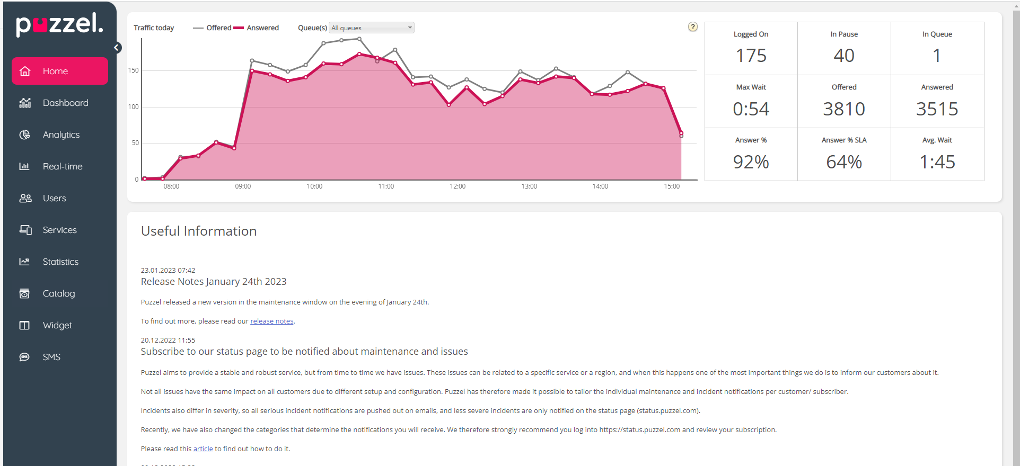
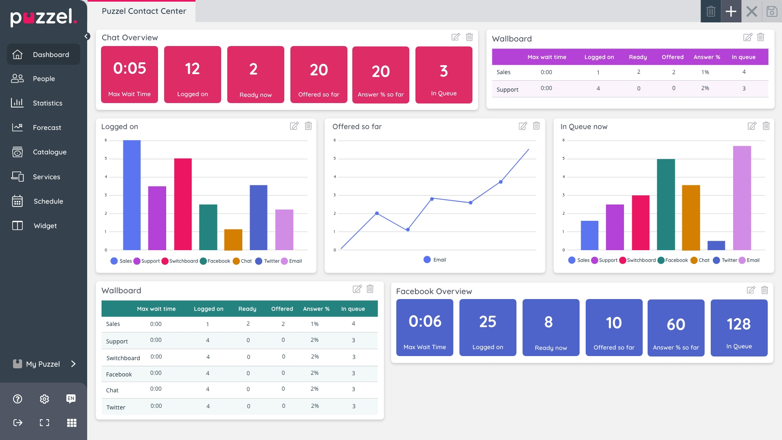
Reporting – Gain Actionable Insights
Simplify your understanding of a Contact Centre’s performance with key metrics that matter in one place
Save time in reviewing metrics and understand how your contact centre is performing against your critical metrics through quick and easy visualisations
Save time in improving your CX, with key information ranging from real-time data to KPI indicators to dashboards and historical reports available in one place

Slide 39
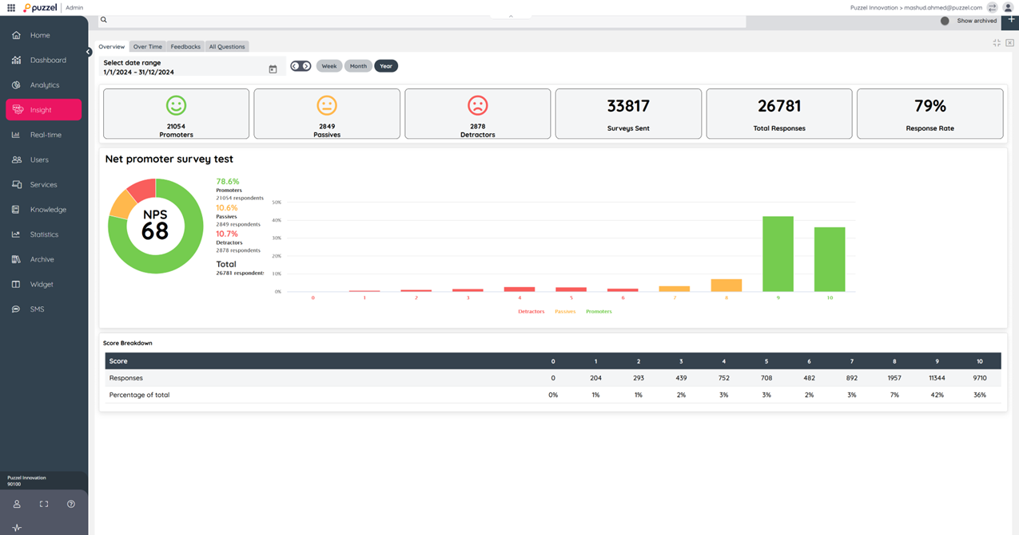
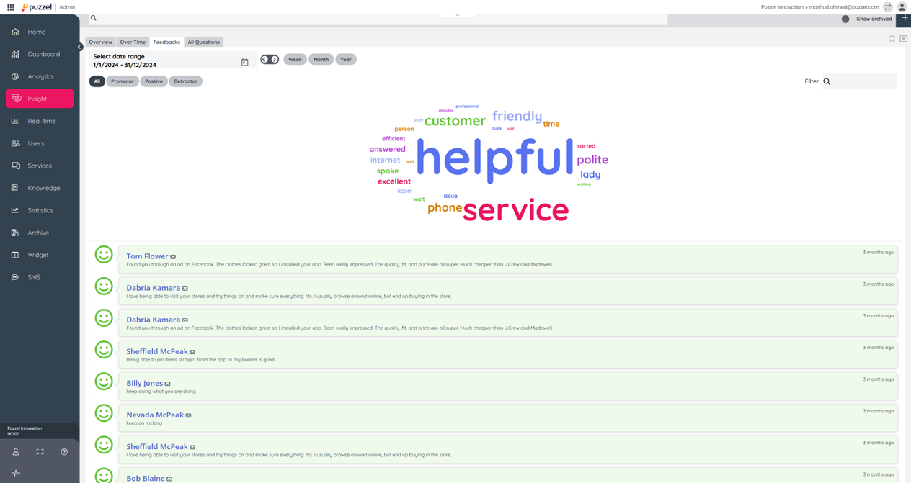
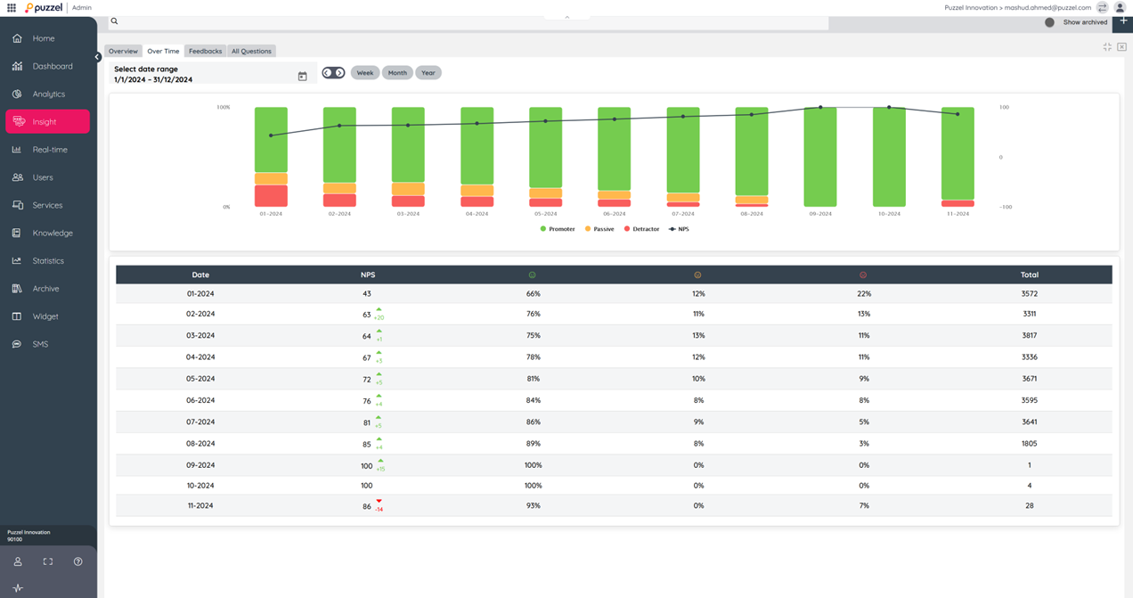
Customer Insights
Allows you to use templates to create surveys and automatically send them via any channel easily.
Enables you to visualise all customers’ responses, from different channels, in one place.
Visualises customer feedback trends so you can quickly identify outliers. It also makes it easy to link customer responses to agent performance.

Slide 40
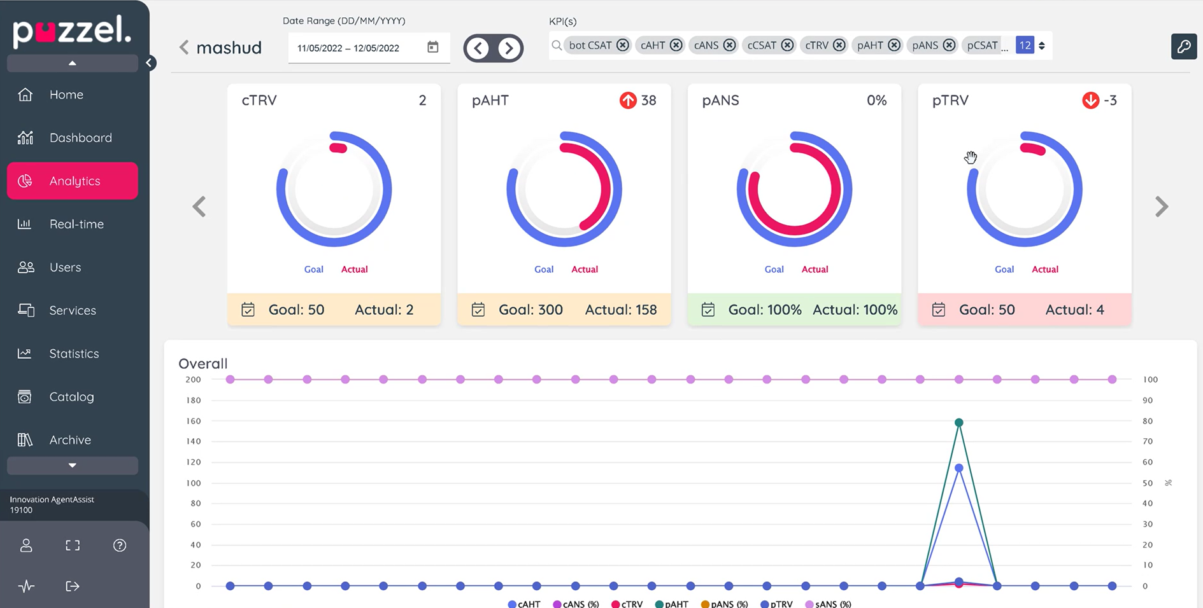
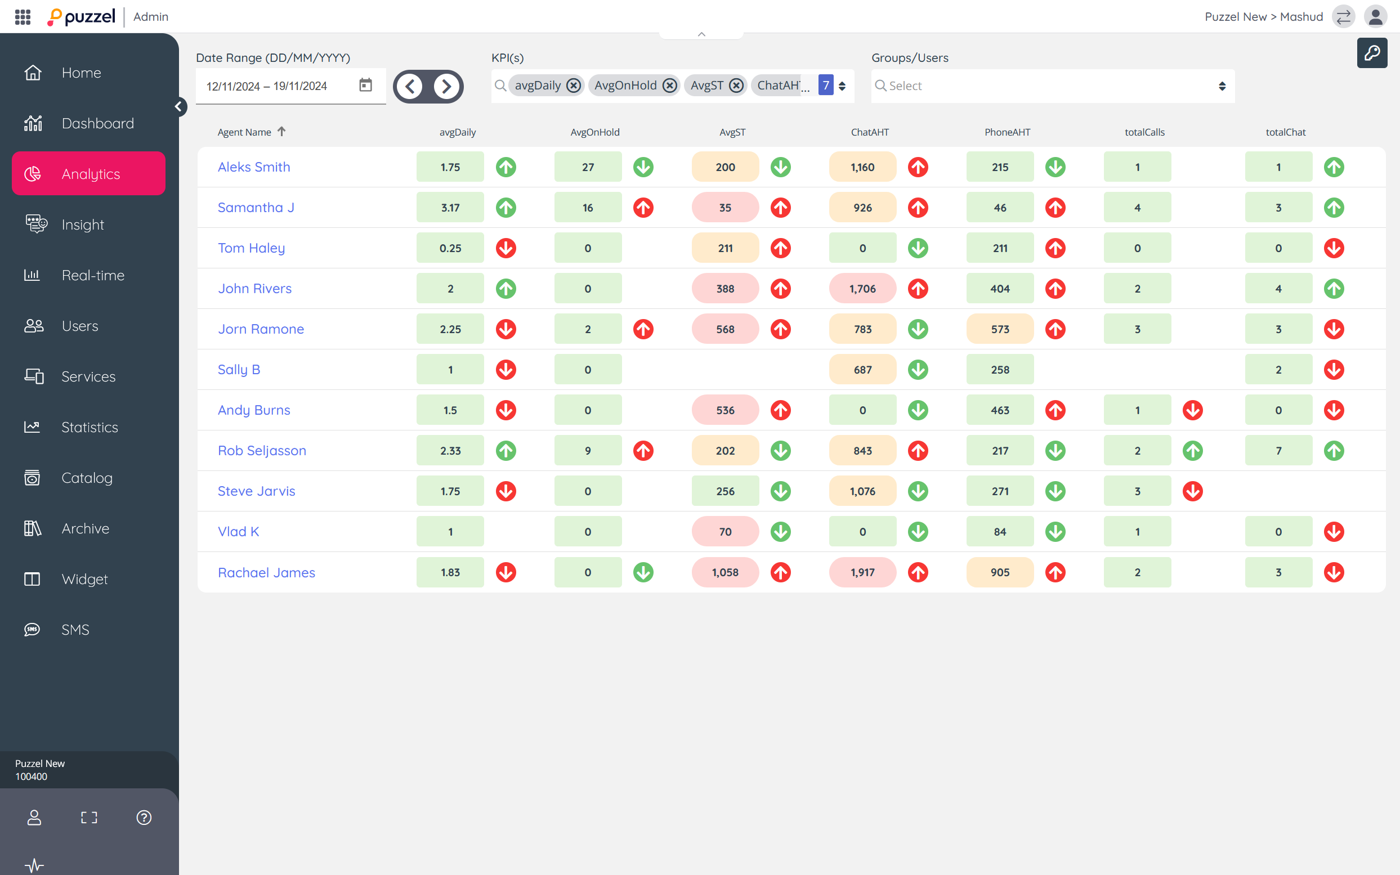
Performance Management – Spend Less Time Finding Insights
Quickly and easily uncover the insights that you need on agent performance, and track progress in one space .
Monitor agent and team performance against set goals
Measure and visualize performance by agents, user groups, queues and channels
Create unlimited number of Performance KPIs

Slide 41
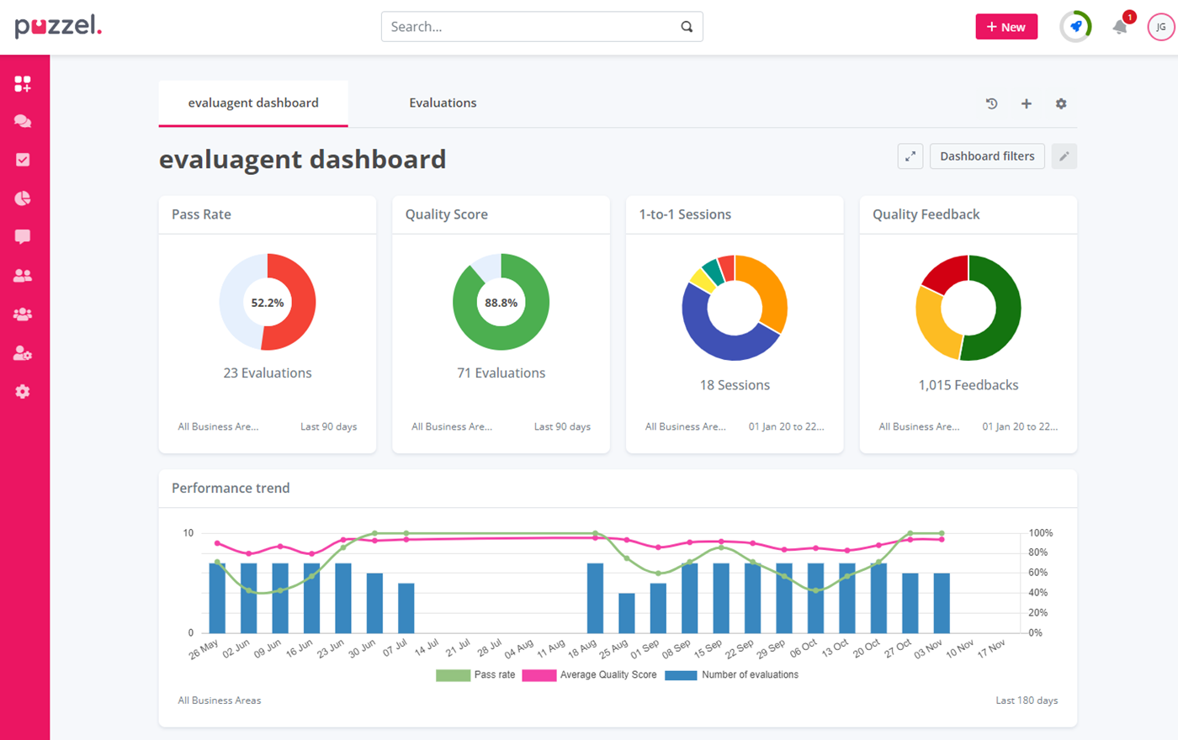
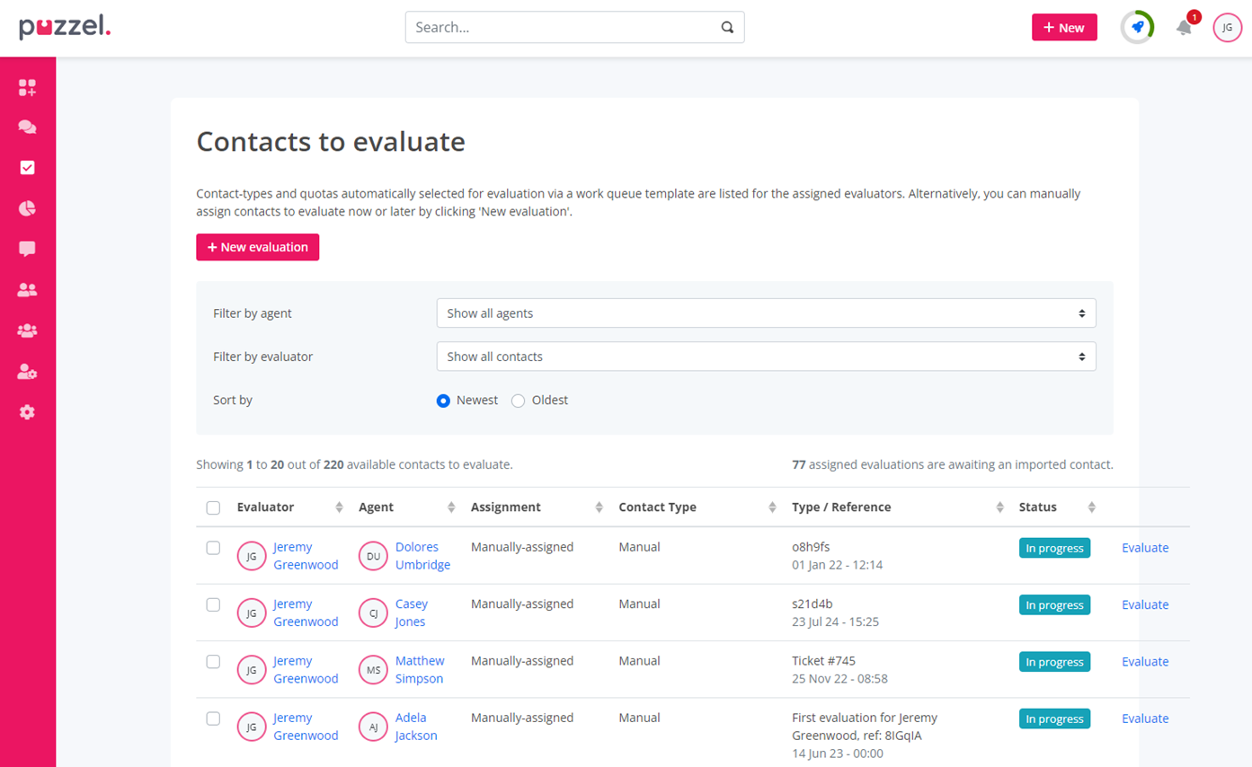
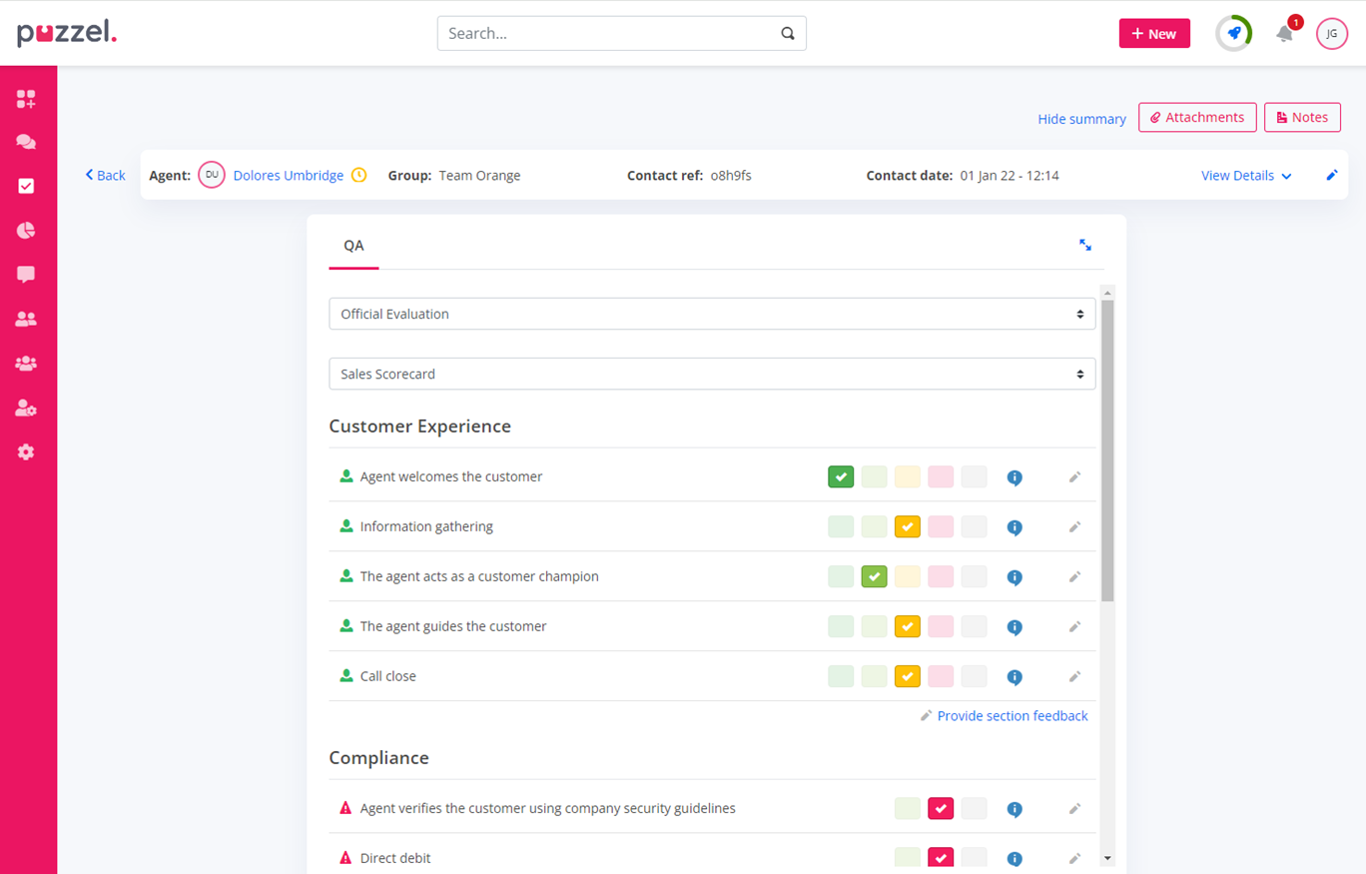
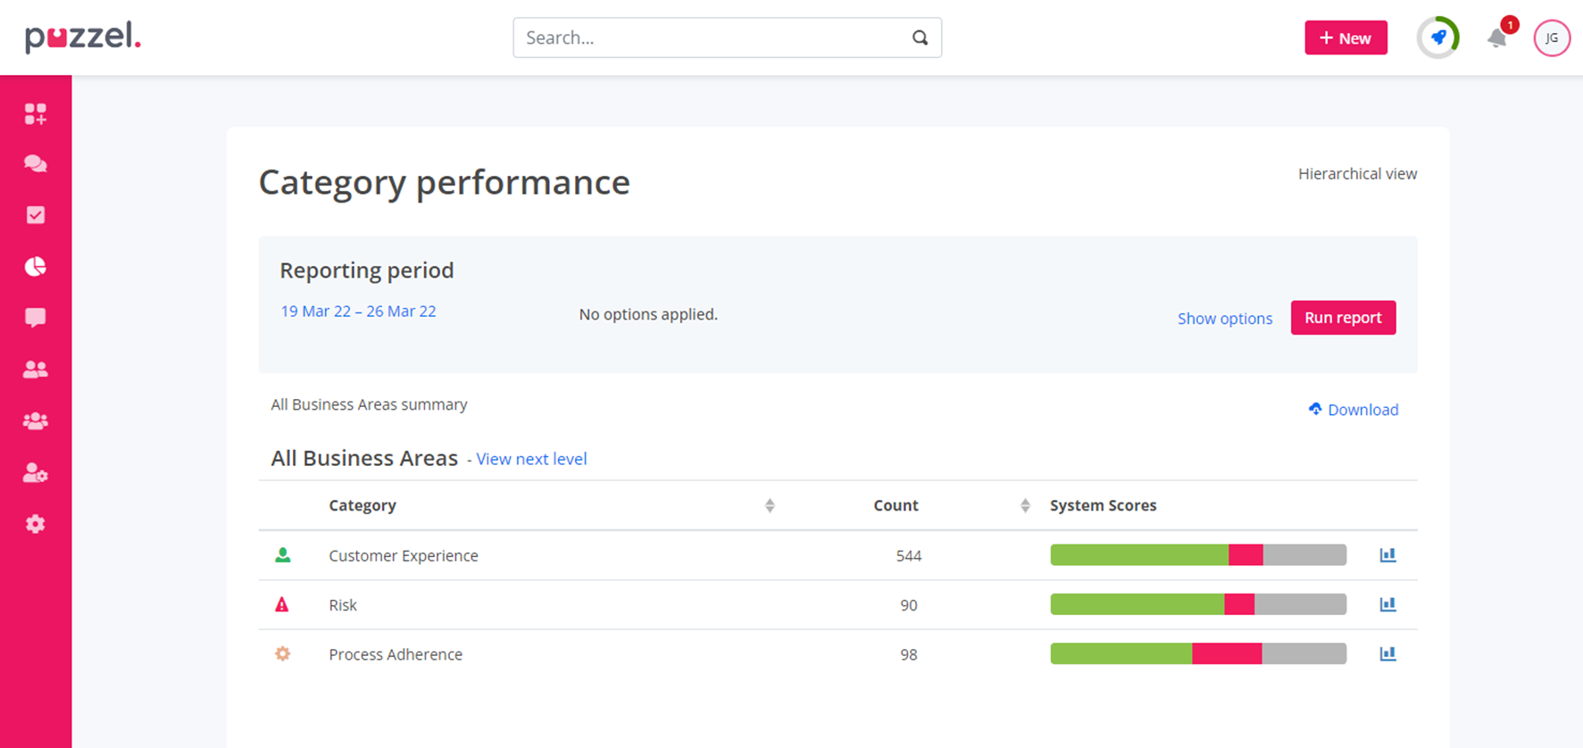
Quality Assurance
Just 3% of customer interactions are currently evaluated in contact centres and even less are acted upon.
With Puzzel Quality Assurance, you can monitor the customer interactions that matter most to your business, extract key, actionable insights, and deliver personalised coaching programmes that have a real impact on your agent performance and improve customer experience.

Slide 42
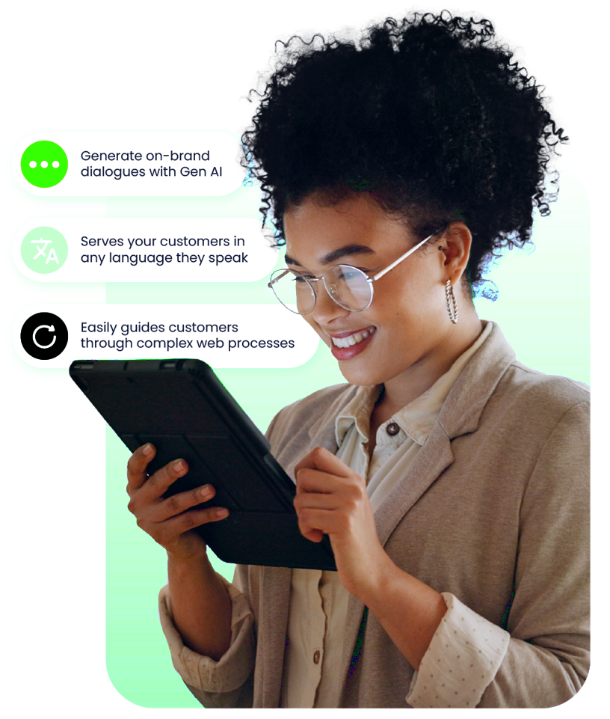







Meet the Puzzel AI Chatbot
Workflow facilitation
One tool for development, testing, production, diagnostics, change logging and more.
98%
issue identification accuracy
Chat framework integration
Integrates with a number of existing vendors for smooth agent handovers.
Language agnostic
Serves your customers wherever they are in the world and whatever language they speak.
75%
of queries solved automatically
Pioneering language understanding
Integrates with a number of existing vendors for smooth agent handovers.
95%
decrease in waiting time
Task automation
Including password resets, data lookups and more, saving agents time for more value-added tasks.

Slide 43

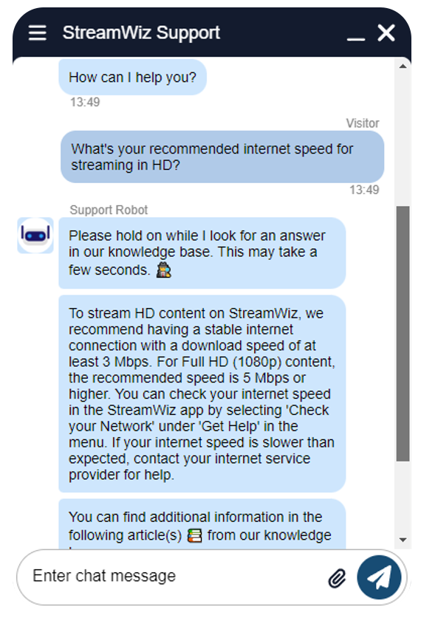


Connect rich conversations with relevant knowledge using GenAI
Have real conversations with empathy
Share relevant knowledge, safely
Provides users a natural dialogue with GenAI
Supports conversations in any language
Adjusts tone of voice to customer sentiment
Understands the context of your business
Recognizes intent despite typos and synonyms
Answer standard questions with confidence
Create new answers using GenAI
Solve advanced problems
Provide personalized service requests
Anonymize customer sensitive information

Slide 44
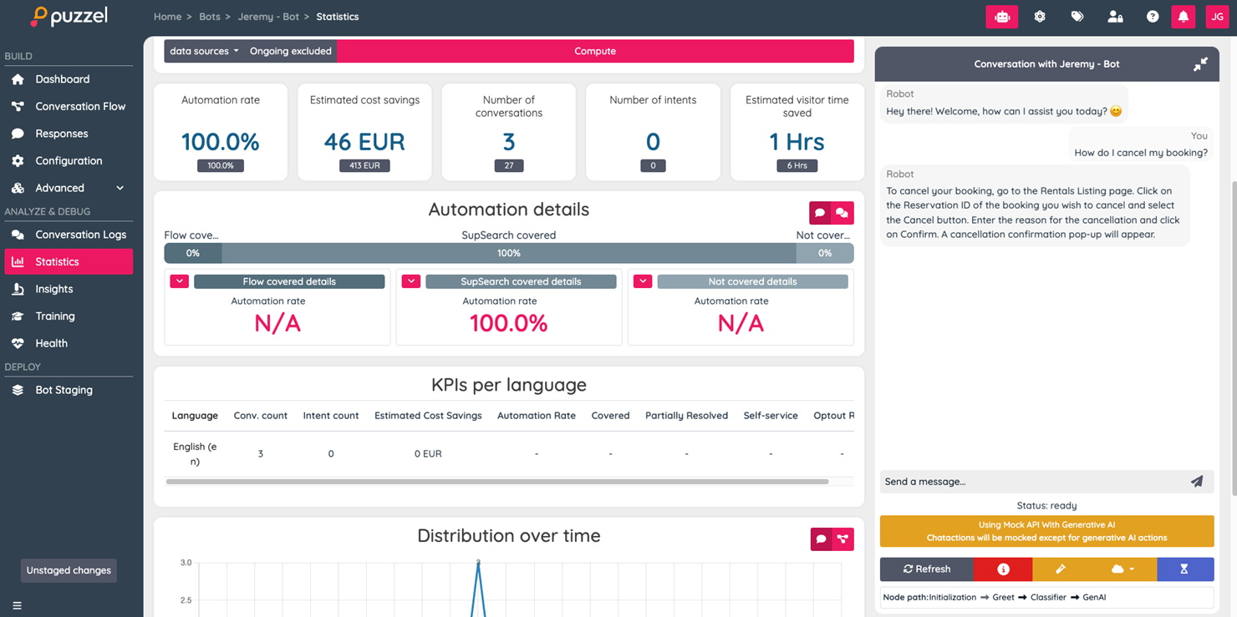
AI Chatbot Statistics
With Puzzel AI Chatbot Statics, you can monitor the customer interactions that matter most to your business, extract key, actionable insights, and deliver personalised AI interactions that have a real impact on your agent performance and improve customer experience.

Slide 45



Gain full control over your Chatbot with easy-to-use tools.
Create a chatbot in a few clicks
Using your most used search terms, the Puzzel chatbot can be easily configured without the need for IT or programming skills.
Manage from a single location
Build, test, update and maintain your chatbot in BotStudio and access all relevant metrics for insight in self-service performance.
Secure chatbot health with ease
The Puzzel chatbot generates suggestions for new conversation flows by identifying what the bot has not yet addressed.
Be in control in
real-time
Track KPIs and data that are important for your business with the operational dashboard and receive alarms about sudden changes.

Slide 46




Ease your mind with a secure, compliant and ethical GenAI chatbot
Hallucinations Elimination
The use of confidence scores about the AI prediction or decision as well as applying additional safeguards & control mechanisms
Cloud Sovereignty Schems II
Puzzel Chatbot offers different cloud storage options to ensure we meet the market’s most rigorous demands.
GDPR Compliance
Your data stays in EU, is not shared with others (including OpenAI), and not used for any other customers or purposes.
Data Security ISAE 3000 certified
Security is our top priority and Puzzel Chatbot products receive the top grade, A+, in SSLLabs’ security test and is ISAE 3000 certified.

Slide 47


Chatbot Security
Industry-leading encryption
Compliance and Regulatory adherence
Data sovereignty and control
Secure AI deployment
Transparency and explainability
Continuous monitoring and threat detection

Slide 48
Case Management
Puzzel Case Management makes your agents’ life easier by enabling them to manage your customers’ messages (SMS, email, social media) in one place.
Automatic Case Creation
Automated Workflow
Customer Hub
Manager Reporting
Email
SMS
Social Media
Unique ticket ID
Assign messages
Skills-based routing
Filters and Tags
Improved visibility for consumers
Easy access to cases
Standard and custom reports
Automated reporting
Report sharing
With the new feature, Customer Hub, it can also improve your customers’ experience with email support, by offering them a space where they can check the status of their email requests.

Slide 49
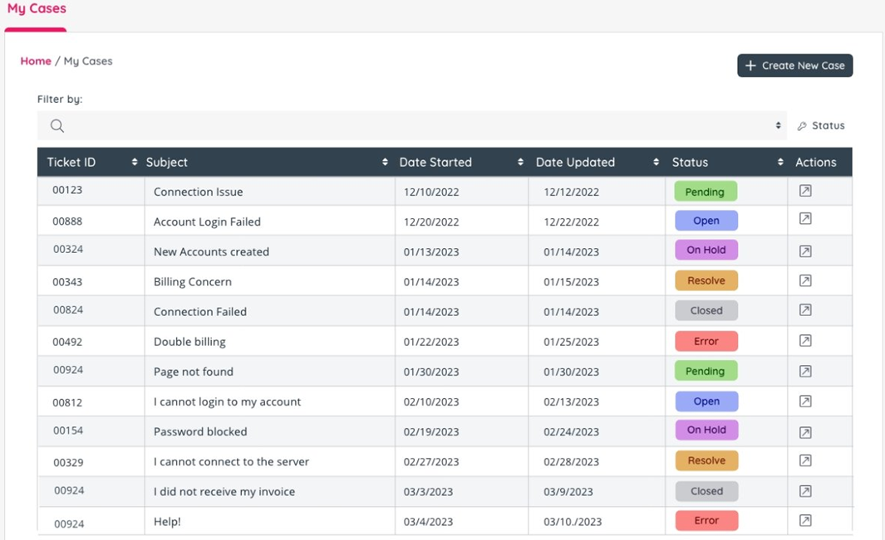
Customer Hub
Puzzel Customer Hub saves your customers from getting lost in long email threads and feeling the frustration of not knowing the status of their case​
Offers a central place where customers can create a case by sending a message and track the status of their inquiry until it's resolved. ​
​Allows quick and easy access, without the need to register and log in​
Enables customers to create and review tickets in one place​

Slide 50
Workforce Management
Stop agonising over complex spreadsheets and start building a more efficient and engaged workforce with our powerful workforce management solution.
Puzzel WFM enables resource planners to accurately forecast demand and generate instant schedules optimised to deliver the highest service levels for your customers, the best experience for your agents, and the lowest operational cost for your business.
Accurate Forecasting
Optimised Scheduling
Real-time Adherence
Agent self-scheduling
Multi-skill forecasting
Direct Contact Centre data
Automatic and manual smoothing
Instant optimised schedules
Intraday management
Reporting
Real-time insights
Improved decision making
Meet SLA targets
Empower agents
Shift change requests
Reduce admin overheads

Slide 51
Sales Intelligence
Research shows that 60% of customers state that when they talk to customer service and sales, they feel like they are talking to different companies1. The disconnect between service and sales teams can hinder the customer experience and impact sales.
Puzzel Sales Intelligence streamlines the process of aligning messaging, product information, and other vital details, enabling you to provide a cohesive and uniform experience across all touch points.
Smart dialler
Booking system
Manager insights
Intuitive interface
Boost agent productivity
Intelligent prediction
Local number ID
Dialler options
Geo-location based bookings
Ideal for hybrid teams
Increase productivity
Visualise KPI’s
Real-time reporting
Agent performance tracking
Simplify onboarding
Support agents in-call
Efficient interactions

Slide 52


Contact Centre Case Study: The Sovini Group
THE PROJECT:
Cloud Migration for 500 Back Office users and 50+ Contact Centre Users across 6 Different Teams
WHAT WE DELIVERED:
Teams Direct Routing (TCaaS) leveraging existing MS licensing
Puzzel CCaaS including
  Omnichannel
  Case Management
  CRM Connector
CallCabinet – unified recording and analytics
BUSINESS IMPACT:
Single platform for communication and collaboration / Improved operational efficiency / AX and CX / Foundation for growth

Slide 53

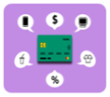




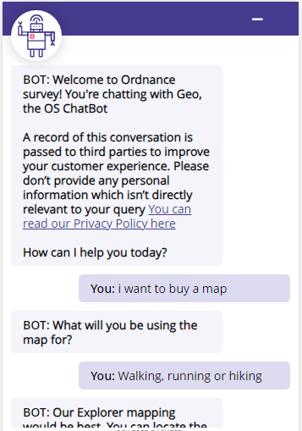

Contact Centre Case Study: Ordnance Survey
THE PROJECT: Multi-phase project transforming their UC and Contact Centre Operation to align with digital strategy
PCI
OS Shop Payments
Call centre Agent Assist
Webchat payments
SD-WAN Services
Displacement of 20 year historic relationship with Vodafone and their Cisco MPLS solution.
Replaced with Nokia Nuage resilient SD-WAN solution across 117 sites with Azure Express Route to support cloud future.
Chat Bot Services
Replacement of existing Webchat
Puzzel Chat Bot/AI Solution – integrated to Dynamics 365
Consultancy/workshops/Strategic planning
Raw Data – PowerBI Integration
Additional enhancements to Customer Service Agents, Web Chat and Bot services
Call back requests
Expansion of Web Chat into OS internal support services
CCaaS
Puzzel – Omni-Channel
WFM and Quality Assurance, Call Recording and Analytics
Consultancy/workshops/Strategic planning
Training
Agent Assist
Knowledgebase services
B2C services third-party integration
Teams Direct Routing Services
Direct routing services approx. 850 users
Call Cabinet Recording
BUSINESS IMPACT:
Improved operating efficiency and reduced cost to serve. Chatbot offers 247 service on website for common journeys.

Slide 54


Contact Centre Case Study: BDO
THE PROJECT:
Cloud Contact Centre Migration and Transformation which met the NHS’s robust cyber security and governance needs
WHAT WE DELIVERED:
Puzzel CCaaS enabling omnichannel interaction managementfor 150 agents including voice, emai, SMS, webchat and social channels
Seamless integration with existing NHSD information systems
Custom dashboards for supervisors and contact centre leadership team
Responsive 24/7 UK-based support
BUSINESS IMPACT:
A flexible, omnichannel solution for all patient communications, optimising the delivery of live healthcare services across the UK

Slide 55



Contact Centre Case Study: BDO
THE PROJECT:
Multi-phase project transforming their UC and Contact Centre Operation to align with digital strategy
WHAT WE DELIVERED:
Bespoke UC infrastructure leveraging BDO’s investment in Microsoft licensing and enabling Teams calling for 10,000 users
‘Future’ IT Service Desk platform, based on Five9 delivering:
  Seamless integration with ServiceNow
  Voicebots and Chatbots to enable self service and automation of common ticket types
  Interaction analytics to deliver business insight
BUSINESS IMPACT:
The solution will help BDO meet its objective of resolving 80% IT Service Desk tickets through self-service and automation.

Slide 56



Customer Testimonials
“Any digital transformation in the public sector inherently challenging, as things can change at a moment’s notice, but Exponential-e supported us throughout to avoid any delays and make sure we could deploy the Puzzel technology with zero issues. So, I’d definitely recommend having a technology partner like Exponential-e for any project of this nature.” Stacey Whyte, CSF Technology & Change Senior Service Manager, NHS Digital
“It just works! We were able to tailor the dashboards to suit us very quickly, so the analysts are able to deliver better insights, faster.” Stacey Whyte, CSF Technology & Change Senior Service Manager, NHS Digital
“We have witnessed a huge improvement in staff performance and our ability to respond to customers more efficiently. We’ve also received many comments by customers noting how quick their enquiry has been dealt with” Customer Service Manager of Cottsway Housing
“As an agile organisation it is essential that our systems enable us to support our staff working remotely. This solution very much supports that as well as providing all the necessary functionality we require for a busy, customer-focused contact centre environment.” Jan Conroy, Head of Customer Services, One Vision Housing

Slide 57
Contact Centre: Quick Metrics
Exponential-e implemented an omnichannel contact centre solution for Sovini Group that used intelligent automation to minimise wait times and optimise efficiency
Exponential-e automated the routing and management of email for The Doctor’s Laboratory to improve overall contact centre productivity by 15%
Exponential-e delivered a Microsoft Teams integrated contact centre for Sovini Group that enabled seamless collaboration between contact centre and back office teams
Exponential-e delivered an outbound dialler for NewLaw Solicitors that improved outbound lead conversion by 30%
Exponential-e helped Ordnance Survey deploy a chatbot to resolve high-volume, low-complexity customer queries, freeing up live resources to deal with more complex issues
Exponential-e migrated BDO’s 90 user, 24/7 IT Service Desk from their old CCaaS platform to Five9 in 8 weeks without any disruption to users
Exponential-e helped Penguin Books migrate from Cisco Contact Centre Express to Five9 and implement email routing and management resulting in an overall productivity improvement of 10%
Exponential-e are working with BDO to automate some of their common IT Service Desk ticket types like password resets using chatbots and speech bots helping them achieve their objective of resolving 80% of all tickets via self-service

Slide 58






Don’t leave revenue on the table
Increase revenue and margin by providing these additional services to strengthen your solution
12 month or full compliant call recording
Upgrade to Analytics for sentiment analysis
Feature rich against competitors such as Dubber
Cloud-based, real-time call reporting and business insights
Call centre reporting
Directly enable PSTN calling from their current carriers within Teams
Manage calling plans and configure call routing
Teams and Zoom Meeting room solutions
Wide range of handsets or headsets available
Competitive hardware pricing
Auto Provisioning
Integrate with over 100 leading CRMs
Lite desktop integration or full CRM
Automate activity logging
PCI-DSS Compliance for all voice transactions for smooth and secure payment processing
Simple interface to descope customer network

