Slide 1
EXPO.e ITSM as a Service (ITSMaaS)
Transform your business with cutting edge technology

Slide 2
ITSM in the UK
45.2% ServiceNow leads the market share of the ITSM software market at 45.2%
78% The ITSM Tool category held 78% share of the total market at $7.1b in 2022 with a growth rate of 16.8% year on year
$17.8b
The market is inclining towards cloud based ITSM solutions for the flexibility & scalability with the Cloud ITSM Market expected to reach $17.8b by 2029
55% of companies are approaching MSP’s to opt for their value-added services and reduce security risks
AI & ML increasingly being integrated into ITSM solutions to automate tasks and improve efficiencies
Notes:
New addition

Slide 3
Market Challenges
Lack of resources and skills sets
Many organisations face a shortage of skilled IT personnel or lack the specific expertise needed to efficiently manage and maintain their ServiceNow instance.
Implementation Challenges
ServiceNow is the preferred choice for many businesses, but its implementation comes with high costs and challenges as it required in-depth expertise and understanding of the processes.
Maintaining Service Quality
Maintaining consistent and high-quality IT services is a constant challenge, especially as organizations grow and IT environments become more complex.
Demand for Solutions with ITOM
Many competitors provide basic ServiceNow integration but lack advanced IT operations management (ITOM) capabilities, which are needed for better service awareness of Configuration Items (CI).
Focus on Data Security & Compliance
With increased attention to data privacy and security, there's heightened demand for ITSM solutions that offer robust data isolation and compliance, especially in managing CIs across different domains that can only be offered in ServiceNow.
Notes:
This slide is in the original as slide 4

Slide 4
Why Invest in an IT Service Management Solution
Investing in ITSM helps service providers stay competitive in a service-driven economy reduce costs, boost operational efficiency, deliver better customer experiences, and…
Reduce Costs
Boost Operational Efficiency
Improve Customer Experience

Slide 5
The Strategic Decision to Invest in ITSM
Centralised Service Management
Improve Service Efficiency and Productivity
Enhanced Customer Experience
Compliance and Risk Management
Scalability and Flexibility
Platform for End-to-End Digital Transformation
Data Driven Decision Making

Slide 6
What is ITSMaaS from EXPO.e
EXPO.e’s ITSM as a Service delivers a fully configured IT Service Management (ITSM) platform, powered by ServiceNow, hosted on an individualised customer domain. Designed around each customer's unique needs, it leverages our internal expertise to ensure streamlined implementation processes and ongoing management.
A comprehensive solution, powered by ServiceNow, that integrates both ITSM and ITOM capabilities.
A fully configured and defined ITSM software platform that leverages our internal expertise to optimise the implementation process and ongoing management.
Our solution offers domain separation for data, processes, and interfaces, making the offer suitable to businesses of all sizes, facilitating a personalised customer configuration, while maintaining strict data privacy.
EXPO.e’s ITSM as a Service powered by ServiceNow is a versatile, robust solution designed for immediate deployment and flexibility.
It balances quality and cost-effectiveness, enabling organisations to elevate their IT infrastructure efficiently and effectively.
The service includes significant system upgrades, professional services for configuration and development, and a robust service suite, reflecting our dedication to advanced technology and customer service excellence.

Slide 7
Why ServiceNow
End-to-End Platform
Break silos and drive transformation. ServiceNow offers a single, extensible platform that supports ITSM, HR, Customer Service, Security, and more.
Top-class Automation Workflow
A powerful flow designer allows to automate complex workflows end-to-end without any coding required.
Best-in-Class Integration and Ecosystem
Seamless integration with hundreds of tools (ERP, CRM, cloud platforms, etc..) via connectors and the IntegrationHub.
AI-Powered Service Intelligence
ServiceNow uses AI and machine learning through its Now Intelligence engine to predict issues, recommend resolutions, and proactively deflect tickets.
Proven ITIL Alignment at Scale
Built to scale, ServiceNow powers the IT operations for global MSPs with high availability, multi-instance architecture, and performance SLAs.
Scalability and Performance for Large Enterprises
Built to scale, ServiceNow powers the IT operations for global MSPs with high availability, multi-instance architecture, and performance SLAs.
Continuous Innovation
ServiceNow is constantly evolving to meet new business demands. Including two major platform upgrades per year.

Slide 8
Return on Investment
Value Driver | Quantified Benefit
Operational Efficiency | Up to 60% faster ticket resolution via workflow automation
Agent Productivity | 25 - 40% more tickets per agent / day with smart routing and AI-powered triage
Customer Retention and SLAs | 30% improvement in SLA compliance, leading to 10–15% higher retention
Onboarding New Clients | Cut onboarding time by 50%, accelerating time-to-revenue
Cost Reduction | Reduce manual workload by 40%, lowering operational costs significantly
Cross-Platform Visibility | Unified dashboards reduce status checks and meetings by up to 20%

Slide 9
Return on Investment - Financial Impact
Metric | Value (3-Year Projection for Mid-Market MSP)
Total ROI | 212%
Payback Period | < 11 months
Net Present Value (NPV) | £4.2M (for £2.6M investment)
Efficiency Savings | £3.2M from reduced ticket handling effort
Revenue Uplift Potential | £1.5M from better SLA adherence & upsell
Metric | Value (3-Year Projection for Mid-Market MSP)

Slide 10
Why Investing into ITSM. A CROs Perspective
CRO Objective
Grow Revenue Faster
Boost Retention and Loyalty
Increase Sales Effectiveness
Improve Revenue Visibility
Scale Operations
Accelerates Service Delivery and Customer Onboarding
Enhances Customer Support and Proactive Service
Frees up Reps from Internal Bottlenecks
Provides Analytics on Service Impact and Risk
Automates and Standardizes RevOps Functions
How ServiceNow Helps

Slide 11
Achieve Business Growth and Revenue Targets
Accelerated Client On-boarding
Enhanced Service Quality and Client Retention
Scalable Growth Without Cost Increase
Up-sell and Cross-selling Opportunities
Enable new Revenue Streams
Strategic Data Driven Decision

Slide 12
ServiceNow - Our New Architecture
Process
Definition
EXPO.e - Service Provider
Channel Partner A
Channel Partner B
Channel Partner C
Domain Separation
End User 1
End User 2
End User 3
End User 1
End User 2
End User 3
End User 1
End User 2
End User 3
Products
CSDM Framework
CMDB
VMWare
Microsoft Intune
Asset Management
Public Cloud
Connectivity
Operational Data
Notes:
ServiceNow architecture altered for our Channel model.
Under EXPO.e, each Channel Partner will be domain separated. This is in turn broken down into each End User company.
ITILv4 compliant processes flow down from the EXPO.e MSP layer. This includes:
Incident & Change Management via the IT Service Management (ITSM)
Sold Products & Services via the Common Service Data Model (CSDM) framework.
A single view of discovered business applications & infrastructure via IT Operations Management (ITOM)
Operational data from several sources flows upward into each domain separated instance. This ensures Partner operational data can never leave a Partner’s domain.
Overlaid over the front, is the CSM Portal (Next Slide).

Slide 13
Features & Benefits
Features & Benefits
Domain Separation
capability enables the creation of multiple, isolated environments within a single ServiceNow instance. This offers enhanced data privacy and security, allowing for tailored services and solutions for different clients or departments within an organisation.
Integrated ITSM & ITOM
offer a comprehensive view and control over IT services and operations, leading to increased operational efficiency and proactive issue resolution.
Customisable interfaces and workflows,
tailored to meet specific operational needs and user preferences, enhances user experience and operational efficiency, ensuring that the ITSM tool aligns perfectly with business processes.
Scalable IT Infrastructure
offers flexibility and adaptability, ensuring that IT services can grow together with the business.
Integration with existing systems allows for a smooth deployment and ease of implementation, ensuring a cohesive IT ecosystem.
Notes:
Transferred from your deck so stays the same

Slide 14
Your opportunities / Where are the quick wins
Are you or your customers looking for economies of scale? Getting ServiceNow from EXPO.e leverages these economies of scale, resulting in a lower total costs compared to direct procurement and management of the platform.
Are you or your customers looking for more flexibility with an ITSM solution? The platform allows for minor configurations to align with specific business processes, ensuring a solution that is both relevant and non-disruptive.
Do you or your customer have limited resources? By utilising EXPO.e’s expertise to manage and support the ITSM function within the business this frees up valuable time for the Internal IT Team to focus on core business activities.
Are you or your customers looking to utilise all the platform functionalities of ServiceNow, but without the large upfront costs: Our solutions allows the use of all platform functionalities, optimised IT productivity and boosted efficiency.
Are you or your customers looking to grow and scale? If so, our service is ideal as it is designed to scale effortlessly with the business needs, providing flexibility for expansion or changes in IT requirements.
Are you or your customers keen to integrate ITSM with ITOM? Our ITSMaaS solution powered by ServiceNow offers seamless integration of ITSM with ITOM ensuring a unified solution for both service management and operational efficiency.
Notes:
Transferred from your deck so stays the same

Slide 15
Why EXPO.e & ITSM What’s in it for you?
Why EXPO.e & ITSMaaS
An opportunity for you to leverage our expertise for
your own ITSM solution
Unique
domain separation
offering providing
bespoke and tailored solutions
Refer us into
your customers and receive high value referral fees
Extension of resources to your business and in-house skill set
As a leader in
the IT Service Management space we can assure quality and reliability
Fully managed centralised solution by EXPO.e
Rapid deployment and continuous improvements
Notes:
Slide updated from original

Slide 16
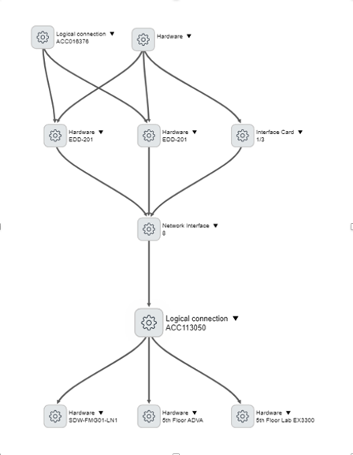
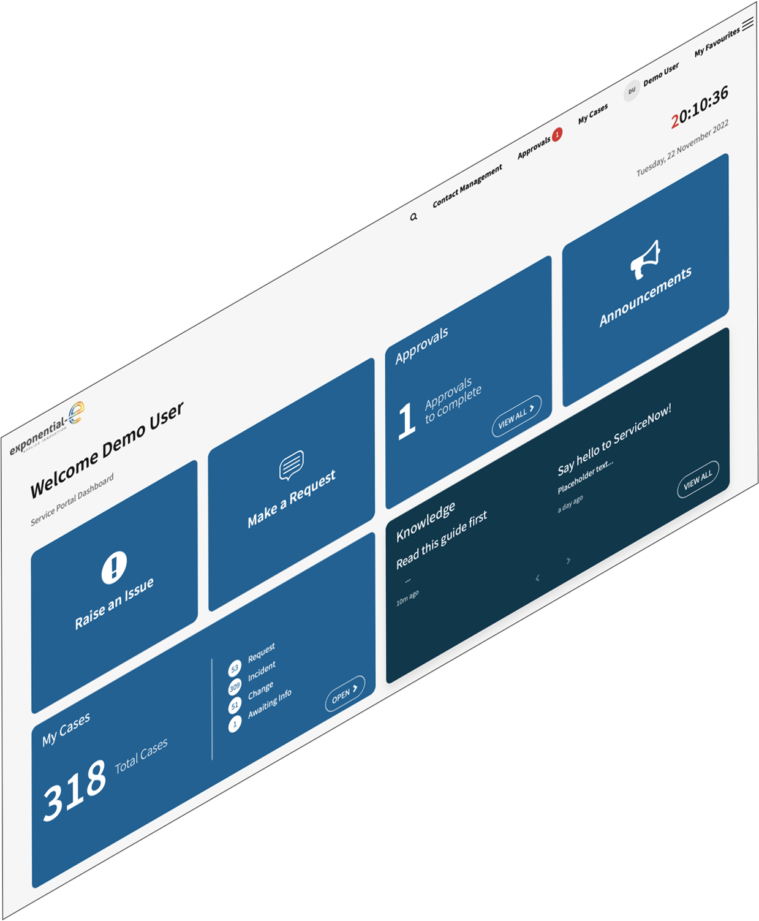
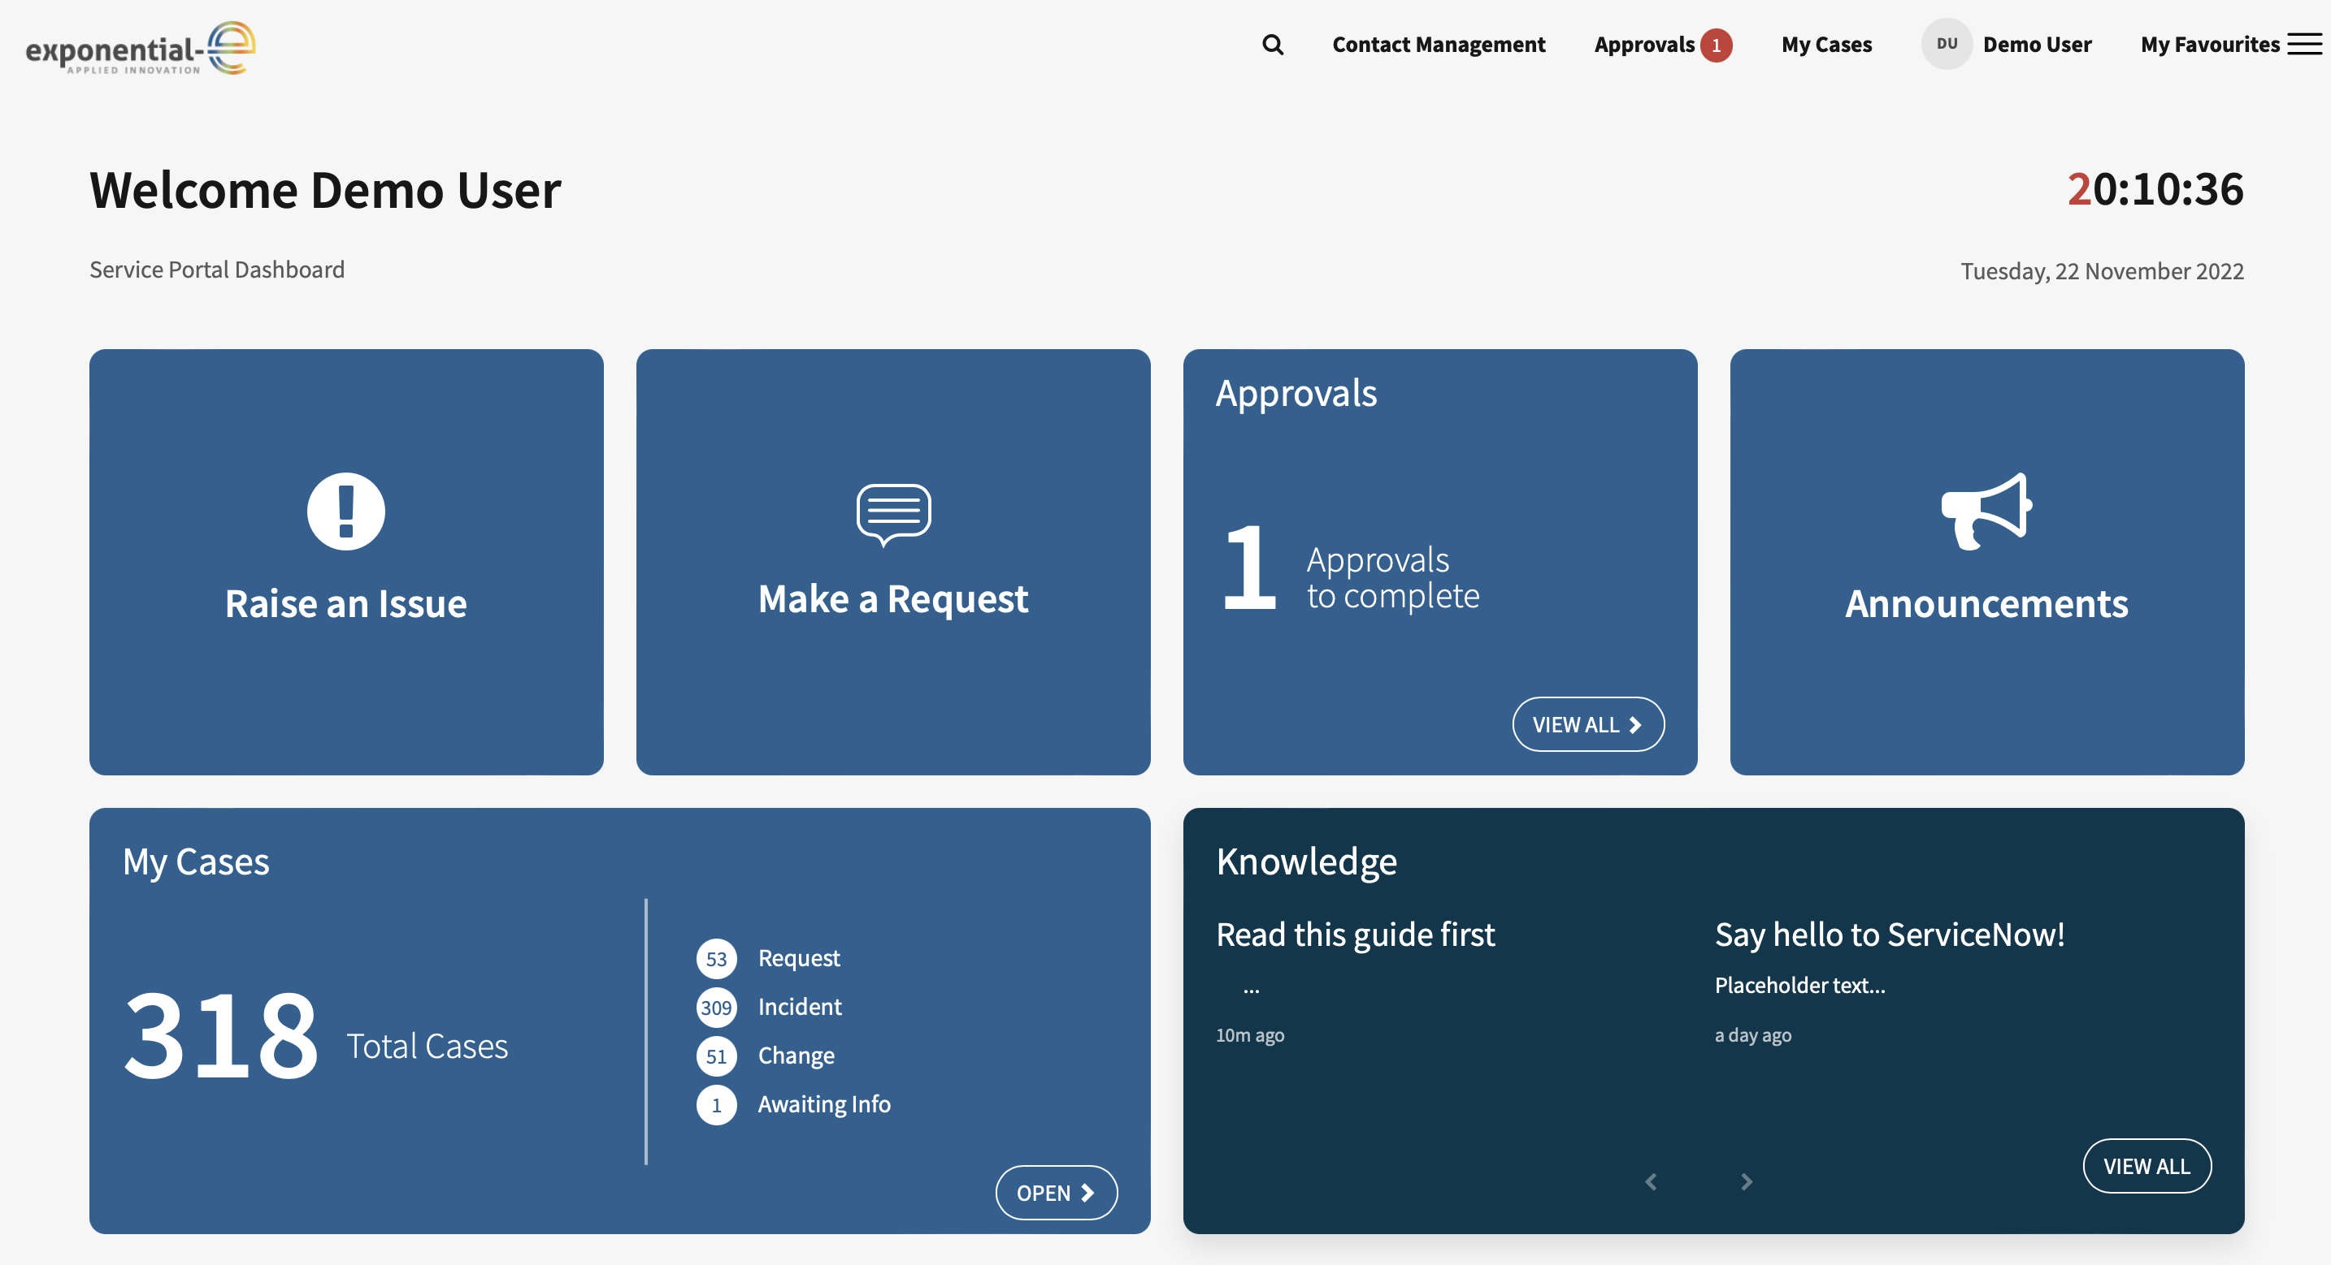
Customer Portal
CMDB
Customer Service Management Portal
Request Management
Request Visibility
Contact Management
Notes:
Click – CMDB appears
Click – Customer Service Management portal
Click – Request management
Click – Request Visiblity
Click – Contact Management
Click – Customer Service Demo user Screen comes to front

Slide 17
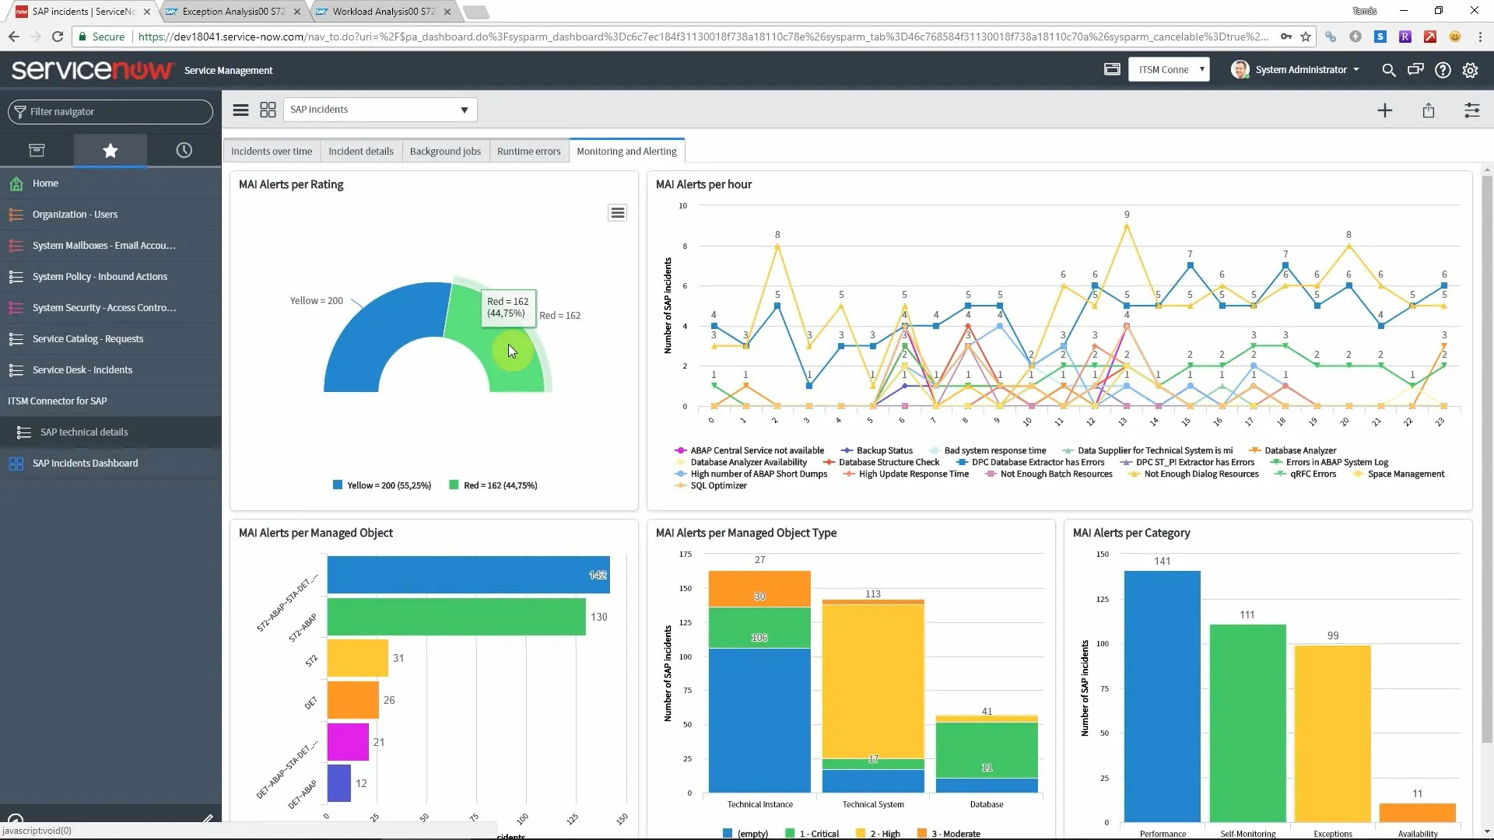
ServiceNow ITSM Dashboard
Initial Costs:
Infrastructure: Acquiring hardware, software licenses, and building the physical or virtual SOC space.
Personnel: Hiring and training security experts (analysts, incident responders, etc.).
Process Development: Creating incident response playbooks, policies, and procedures.
Ongoing Costs:
Salaries and Benefits: Payroll for SOC staff.
Maintenance and Upgrades: Regular updates to hardware, software, and tools.
Training: Continuous education for staff.
Operational Costs: Electricity, cooling, and other utilities.
Security Tools and Licenses: SIEM, IDS/IPS, threat intelligence feeds, etc.
Compliance and Auditing: Ensuring adherence to industry standards.
Challenges:
Expertise: Building and retaining a skilled team.
Scalability: Adapting to changing threat landscapes.
Time to Maturity: SOC effectiveness takes time to develop.
Risk: In-house SOC may miss emerging threats
Notes:
New Addition

Slide 18
Indicative ServiceNow Project Delivery
Post-implementation Support
Project Preparation
Prerequisite Gathering
Kick-off Call
Development & UAT
Release
Initiation Period
– 4 weeks
Implementation Phase
– 4 weeks
Support
– 4 weeks
Notes:
New Addition

Slide 19
Use Cases
Small IT Enterprise: A standard package designed for a variety of businesses seeking to enhance their IT operations and customer service management with ServiceNow.
Comprehensive IT and customer service management.
Enhanced operational visibility and efficiency.
Scalable solutions to match business growth.
IT Operations Management (ITOM): Vertical discovery of end-user devices, combined service desk sales, and flexible management of desktops and servers.
Extensive visibility into IT operations.
Streamlined service desk operations and end-user device management.
Flexible and scalable management of IT assets.
Customization and development: Tailored to specific organizational needs, with emphasis on development, catalogue, and workflow creation.
Customised workflow and catalogue creation.
Enhanced development capabilities.
Efficient service management through domain and resolver group setup.
Flexible solutions tailored to specific organisational needs.
IT Service Management (ITSM) improvement: Optimizing ITSM practices for enhanced ITSM management.
Improved resolver group efficiency.
Streamlined IT operations tailored for the public sector.
Robust support and maintenance for IT infrastructure.
Notes:
New Addition

Slide 20
Discovery Questions
Discovery Questions
Can you describe your current IT infrastructure, including hardware, software, and network components?
How do you currently monitor and manage your IT operations?
What are the key challenges you currently face in managing your IT operations?
What specific functionalities are you looking for in an ITSM solution?
Are there any particular pain points in your current ITSM processes that you are looking to address?
How important is customisation in your ITSM solution?
What are the main challenges you face in your current IT operations management (CMDB management)?
Have you experienced any significant downtimes or disruptions? Can you provide examples?
How do you currently track and manage your IT assets, such as servers, workstations, and network devices?
Are there any specific difficulties you face in maintaining an accurate inventory of your IT assets?
What are your organisation’s requirements regarding data security and compliance?
Do you have any specific compliance standards (like ISO, ITIL) that your ITSM solution needs to adhere to?
Notes:
Slide updated from original

Slide 21
Qualification Questions
Qualification Questions
What ITSM solution are you currently using? Are you familiar with ServiceNow?
Do you have the necessary internal resources and expertise to implement and manage a sophisticated ITSM solution?
Are there any specific timelines or constraints that we should be aware of for ITSM implementation?
Are there any existing systems or tools that the ITSM solution needs to be compatible with?
Does your organisation anticipate significant changes or growth that your ITSM tool will need to accommodate?
Notes:
Slide updated from original

Slide 22
Case Study - Nest
Challenges
Solution
National Employment Savings Trust (NEST), a prominent public sector entity, required a robust and flexible IT Service Management (ITSM) solution to manage its complex IT operations efficiently. Their needs included a comprehensive ITSM build-out and an ITOM framework capable of discovering and managing a wide array of CIs, such as office devices, digital services, and laptops.
Full Domain Separation for ITSM: We utilised ServiceNow’s domain separation capability to create a fully isolated ITSM environment for NEST. This ensured that NEST’s ITSM processes were tailored to their specific operational needs while maintaining privacy and security. The ITSM build-out included incident, problem, and change management modules, service catalogue development, and a self-service portal, all tailored to NEST’s requirements.
ITOM Discovery of CIs: Our solution incorporated ITOM features to discover and manage CIs. This involved automatic scanning and mapping of NEST’s IT infrastructure, including devices, services, and laptops. The ITOM module provided real-time visibility into NEST’s IT landscape, ensuring efficient tracking and management of all their CIs.
Integration with Existing Systems: The ServiceNow platform was seamlessly integrated with NEST’s existing IT infrastructure and third-party applications, ensuring streamlined operations and data consistency. This integration facilitated the flow of information between ServiceNow and other systems, enhancing overall IT service management efficiency.
12-Week Delivery Process: The entire project, from initial planning to final deployment, was completed within a 12-week timeframe. This was achieved through meticulous planning, agile methodology, and close collaboration with NEST’s IT team. Regular updates and feedback sessions ensured that the project remained on track and aligned with NEST’s expectations.
Outcomes
Enhanced IT Service Management: The implementation led to more efficient resolution of IT issues and improved management of IT resources. NEST experienced a significant improvement in IT service delivery, enhancing overall operational efficiency.
Streamlined IT Operations: The ITOM discovery component provided NEST with a clear and detailed view of their IT assets, improving their service desk’s ability to manage and respond to IT-related queries. Proactive identification and resolution of IT issues were enabled, reducing downtimes and improving user satisfaction.
Cost-Effectiveness : Through the economies of scale offered by Exponential-e, NEST benefited from cost savings in ITSM without compromising on quality or functionality. The solution’s scalability meant that NEST could expand its ITSM capabilities as needed without substantial additional investments.
Data Security and Compliance: The domain separation ensured that NEST’s data was securely managed and compliant with stringent public sector standards. Adherence to global standards like ISO and ITIL guaranteed best practices in IT service management, aligning with NEST’s compliance requirements.
Notes:
Slide updated from original

Slide 23
Next Steps / CTA’s / Engagement Process
Access ITSMaaS specific content in our Partner Hub: blog ideas, sales enablement, solution information, and more...
Identify target customers and create a joint sales creation campaign with us!
Arrange ITSMaaS training for your Sales, Technical and Operational teams
Engage Marketing and Enablement teams to help drive tailored engagement and maximise ROI
Notes:
Transferred from your deck so stays the same

